Slide 1
Foundational Principles of Early Learning and Social-Emotional Development in Infants (8-12 Months)
Key concepts supporting growth during infancy
Notes:
---
This presentation explores the essential principles guiding early learning and social-emotional development for infants aged 8 to 12 months. We will examine developmental needs, attachment formation, recent brain research, and effective parent-centered approaches to support infant growth during this critical period.

Slide 2
Agenda Overview
Key Principles of Early Learning in Infants Aged 8-12 Months
Social-Emotional Growth and Attachment Formation
Recent Research and Breakthroughs in Infant Brain Development
Parent-Centered Approaches and Interactive Effects
Notes:
We will cover four main areas: key principles of early learning, social-emotional growth and attachment, recent breakthroughs in infant brain development, and parent-centered strategies to support infant development through interactive approaches.

Slide 3
Key Principles of Early Learning in Infants Aged 8-12 Months
Notes:
Understanding the foundational elements of early learning at this stage is critical for fostering healthy cognitive and physical growth. This section highlights developmental needs, the role of responsive environments, and the importance of play.

Slide 4

Understanding Developmental Needs at 8-12 Months
Motor Skill Development
  Infants rapidly improve motor skills, including crawling, standing, and grasping objects during this age period.
Language Development
  Babies begin to babble and respond to sounds, laying the foundation for early communication and language skills.
Sensory Processing Growth
  Sensory processing abilities expand as infants explore their environment through touch, sight, and sound.
Notes:
---
Infants between 8 and 12 months experience rapid growth in motor skills, language, and sensory processing. Recognizing these evolving needs allows caregivers to provide appropriate stimulation and support tailored to individual developmental trajectories.
Image source: Microsoft 365 content library

Slide 5
Responsive Environments for Exploration
Safe Exploration Spaces
Safe environments allow infants to explore freely without risk, fostering confidence and independence.
Engaging Stimuli
Varied and interactive stimuli encourage curiosity and active learning in young children.
Support for Problem-Solving
Responsive environments promote problem-solving skills by offering challenges suitable for infant development.
Notes:
---
Creating safe, engaging, and responsive environments encourages infants to explore and learn. Such environments nurture curiosity and support the development of problem-solving skills by allowing infants to interact with varied stimuli.
Image source: Microsoft 365 content library

Slide 6
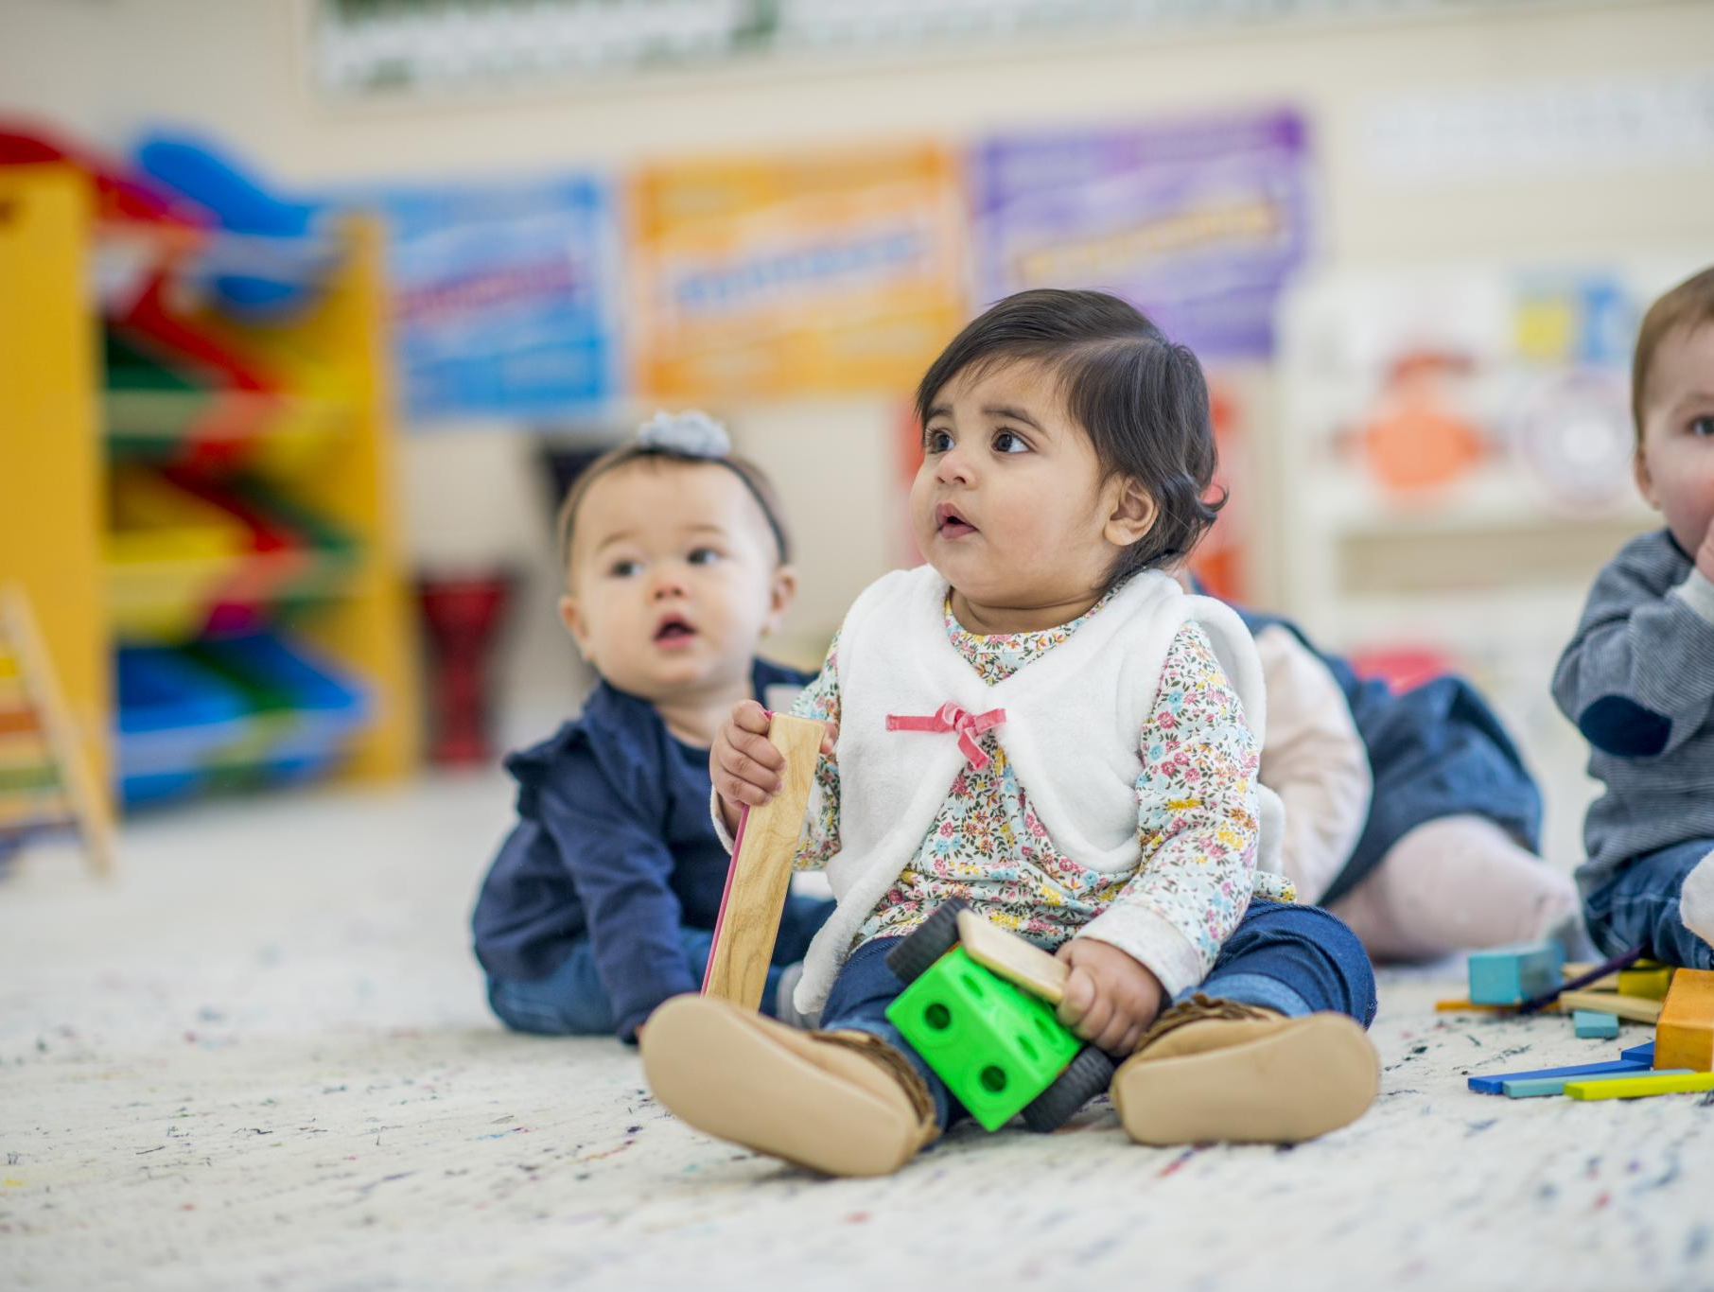
Role of Play in Cognitive and Physical Growth
Cognitive Development
  Play enables infants to experiment and understand cause-effect relationships enhancing cognitive growth.
Motor Coordination
  Through play, infants develop motor skills by practicing movement and coordination.
Social Engagement
  Play encourages infants to engage socially, fostering early interaction and communication skills.
Notes:
---
Play serves as a fundamental mechanism for infants to develop cognitive abilities, motor coordination, and social skills. Through play, infants experiment, learn cause-effect relationships, and begin to engage with their surroundings actively.
Image source: Microsoft 365 content library

Slide 7
Social-Emotional Growth and Attachment Formation
Notes:
The social-emotional domain during this period involves forming secure attachments and developing emotional understanding. This section covers attachment theory, emotional expression, and the impact of caregiver interactions.

Slide 8

Attachment Theory and Secure Relationships
Foundation of Healthy Development
  Secure attachment is essential for emotional and social growth in early childhood.
Responsive Caregiving
  Consistent and sensitive care fosters a sense of safety and trust in infants.
Emotional Regulation Support
  Secure attachment helps infants explore confidently and manage their emotions.
Notes:
---
Secure attachment forms the foundation for healthy emotional and social development. Responsive and consistent caregiving fosters trust and safety, enabling infants to explore confidently and regulate their emotions effectively.
Image source: Microsoft 365 content library

Slide 9

Emotional Expression and Recognition
Infants Express Emotions
  Infants gradually display a variety of emotions, reflecting their growing emotional awareness and development.
Recognition of Emotional Cues
  Infants start to identify and interpret emotions in others, helping develop social and empathetic skills.
Empathy and Social Engagement
  Early emotional recognition aids empathy development and fosters meaningful social interactions in infancy.
Notes:
---
Infants progressively express a range of emotions and begin recognizing emotional cues in others. This ability supports early empathy development and social engagement, essential for building relationships.
Image source: Microsoft 365 content library

Slide 10

Influence of Caregiver-Child Interactions
Promoting Social Competence
  Attuned caregiver-infant interactions foster social skills essential for positive relationships throughout life.
Building Emotional Resilience
  Supportive interactions help infants develop emotional strength and the ability to cope with challenges.
Foundation for Learning
  Secure relationships provide a base for infants to explore and learn about social norms and the world.
Notes:
---
Positive, attuned interactions between caregivers and infants promote social competence and emotional resilience. These interactions shape infants’ understanding of social norms and provide a secure base for learning.
Image source: Microsoft 365 content library

Slide 11
Recent Research and Breakthroughs in Infant Brain Development
Notes:
Advancements in neuroscience have deepened our understanding of infant brain development, highlighting critical milestones, brain plasticity, and sensitive periods that influence lifelong learning and behavior.

Slide 12

Critical Milestones and Sensitive Periods
Heightened Sensitivity Windows
  Certain periods in infancy show increased sensitivity to environmental stimuli, essential for optimal development.
Importance of Timely Stimulation
  Providing appropriate stimulation during these windows enhances learning and developmental outcomes for infants.
Optimizing Learning Opportunities
  Recognizing milestones allows caregivers to maximize learning through timely and targeted experiences.
Notes:
---
Certain developmental windows are marked by heightened sensitivity to environmental input, making timely stimulation crucial. Identifying these milestones helps optimize learning opportunities for infants.
Image source: Microsoft 365 content library

Slide 13

Brain Plasticity and Early Experiences
Infant Brain Plasticity
  The infant brain has high plasticity, enabling it to adapt and grow based on early life experiences.
Supportive Environments
  Nurturing relationships and supportive surroundings strengthen neural connections during early development.
Notes:
---
The infant brain exhibits remarkable plasticity, allowing adaptation and growth in response to experiences. Supportive environments and nurturing relationships enhance neural connections during this formative period.
Image source: Microsoft 365 content library

Slide 14

Notable Advancements in Neuroscientific Understanding
Advanced Brain Imaging
  Recent imaging techniques have revealed new insights into neural mechanisms of early learning and emotional regulation in infants.
Longitudinal Research Insights
  Long-term studies track infant development, clarifying how early experiences shape emotional and cognitive growth over time.
Supportive Development Approaches
  Evidence-based methods informed by neuroscientific findings promote healthy emotional regulation and learning in infancy.
Notes:
---
Recent studies using imaging and longitudinal research have elucidated mechanisms underlying early learning and emotional regulation, informing evidence-based approaches to support infant development.
Image source: Microsoft 365 content library

Slide 15
Parent-Centered Approaches and Interactive Effects
Notes:
Parents play a pivotal role in fostering infant development through responsive caregiving and interactive learning strategies. This section emphasizes effective parenting techniques and collaborative learning between parents and infants.

Slide 16

Importance of Responsive Parenting
Recognizing Infant Cues
  Responsive parenting starts with observing and accurately interpreting infants’ signals and needs.
Building Secure Attachments
  Timely and sensitive responses help form secure emotional bonds between parent and child.
Supporting Development
  Responsive parenting fosters optimal cognitive and emotional growth in infants.
Notes:
---
Responsive parenting involves recognizing and appropriately responding to infants’ cues. This nurtures secure attachments and promotes optimal cognitive and emotional development.
Image source: Microsoft 365 content library

Slide 17

Strategies for Supporting Development Through Interaction
Language Acquisition Support
  Talking and singing to infants enhances their early language development and vocabulary growth.
Social Skills Development
  Interactive play helps infants learn social cues and develop essential social skills for later life.
Emotional Bonding
  Meaningful interactions strengthen the emotional connection between parent and infant, promoting secure attachment.
Notes:
---
Engaging infants in meaningful interactions such as talking, singing, and playing supports language acquisition, social skills, and emotional understanding, strengthening the parent-infant bond.
Image source: Microsoft 365 content library

Slide 18

Collaborative Learning Between Parents and Infants
Parental Scaffolding
  Parents support infants by structuring learning experiences to guide and enhance understanding.
Active Infant Participation
  Infants actively engage in learning by exploring their environment and communicating with parents.
Development of Skills
  Collaborative learning fosters infants’ communication, exploration, and problem-solving abilities.
Notes:
---
Learning is enhanced when parents and infants engage collaboratively, with parents scaffolding experiences and infants actively participating. This dynamic fosters exploration, communication, and problem-solving abilities.
Image source: Microsoft 365 content library

Slide 19
Conclusion
Foundations of Early Development
Early social-emotional growth between 8 and 12 months forms the basis for lifelong development and learning.
Secure Attachments
Fostering strong, secure attachments supports healthy emotional and social growth in infants.
Neuroscience Insights
Applying neuroscience helps understand how early experiences shape brain development in this critical stage.
Responsive Parenting
Engaging in responsive parenting practices supports infants’ developmental needs effectively.
Notes:
Early learning and social-emotional development between 8 and 12 months are foundational for lifelong growth. Understanding developmental needs, fostering secure attachments, applying neuroscience insights, and engaging in responsive parenting are key to supporting infants during this critical stage.

