Slide 1
Principles of Early Learning for Infants Aged 8-12 Months: Peer Interaction, Milestones, and Brain Development Breakthroughs
Key aspects shaping infant growth and development
Notes:
---
This presentation explores essential principles of early learning for infants aged 8 to 12 months. We will examine cognitive and motor development, the role of peer interaction, recent brain development research, and the critical role parents play in facilitating learning.

Slide 2
Agenda Highlights
Key Principles of Early Learning for 8-12 Month-Olds
Learning with Peers: Developmental Insights
Current Research and Breakthroughs in Brain Development
Parent-Centered and Interactive Effects on Learning
Notes:
We will cover key principles of early learning, developmental insights from peer interactions, recent neuroscientific breakthroughs, and effective parent-centered strategies to support infant development during this crucial period.

Slide 3
Key Principles of Early Learning for 8-12 Month-Olds
Notes:
Understanding foundational cognitive and motor skills, the importance of responsive caregiving, and how play supports early learning is essential for fostering optimal infant development.

Slide 4

Foundational Cognitive and Motor Skills
Cognitive Development
  Infants develop object permanence, understanding that objects exist even when unseen.
Motor Skills Growth
  Between 8 to 12 months, infants begin crawling and standing, enhancing mobility and exploration.
Notes:
---
Between 8 to 12 months, infants develop important cognitive abilities such as object permanence and motor skills like crawling and standing. These milestones lay the groundwork for exploration and learning.
Image source: Microsoft 365 content library

Slide 5

Importance of Responsive Caregiving
Attentive Infant Care
  Responsive caregiving involves timely and attentive responses to an infant’s needs, which builds strong emotional bonds.
Supports Brain Development
  Such caregiving supports healthy brain growth during infancy, critical for future learning and development.
Creates Secure Environment
  Responsive caregiving creates a secure and engaging environment that fosters infant learning and emotional security.
Notes:
---
Responsive caregiving—attentive and timely responses to an infant's needs—builds trust and supports brain growth, enabling infants to feel secure and engaged in their learning environment.
Image source: Microsoft 365 content library

Slide 6

Role of Play in Early Learning
Play as Learning Method
  Play is a fundamental method through which infants explore and understand their environment.
Promotes Motor Coordination
  Engaging in play helps infants develop essential motor skills and physical coordination.
Enhances Social Interaction
  Play encourages social interactions that build communication and cooperation skills among infants.
Notes:
---
Play is a primary way infants learn during this stage. It promotes problem-solving, motor coordination, and social interaction skills that are critical for holistic development.
Image source: Microsoft 365 content library

Slide 7
Learning with Peers: Developmental Insights
Notes:
Peer interactions during infancy contribute to social and emotional development. Understanding social milestones and how peers influence growth can help foster positive experiences.

Slide 8

Social Milestones in Peer Interaction
Early Social Interest
  Infants aged 8 to 12 months start to show curiosity and interest in other children.
Gestures and Eye Contact
  Infants use gestures and eye contact to engage and communicate with peers.
Imitative Behavior
  Imitation helps infants learn social skills by copying actions of other children.
Notes:
---
By 8 to 12 months, infants begin to show interest in other children through gestures, eye contact, and imitation, laying the foundation for future social skills.
Image source: Microsoft 365 content library

Slide 9

Influence of Peer Learning on Emotional Growth
Development of Empathy
  Peer interactions foster empathy in infants by encouraging understanding and sharing of feelings.
Emotional Regulation Skills
  Playing with peers helps infants learn to manage and regulate their emotions effectively.
Communication Skill Building
  Engaging with peers enhances infants' communication abilities through interactive verbal and non-verbal cues.
Notes:
---
Engaging with peers helps infants develop empathy, emotional regulation, and communication skills that are vital for their emotional well-being.
Image source: Microsoft 365 content library

Slide 10
Facilitating Positive Peer Experiences
Safe Play Environments
Creating safe environments helps children feel secure and open to positive peer interactions.
Encouraging Shared Play
Shared play promotes cooperation and strengthens peer relationships among children.
Modeling Positive Behaviors
Caregivers demonstrate positive social behaviors to guide children's interactions effectively.
Notes:
---
Caregivers can support healthy peer interaction by creating safe environments, encouraging shared play, and modeling positive social behaviors.
Image source: Microsoft 365 content library

Slide 11
Current Research and Breakthroughs in Brain Development
Notes:
Recent neuroscientific discoveries shed light on how the infant brain develops during sensitive periods, particularly for language and social skills, emphasizing the importance of early intervention.

Slide 12
Neuroscientific Discoveries in Infancy
Rapid Neural Growth
Brain imaging shows infants experience rapid neural growth essential for cognitive and sensory development.
Neural Plasticity
Infant brains exhibit high plasticity, allowing for significant learning and adaptation in early life stages.
Critical Learning Windows
Early development includes critical periods where infants are especially receptive to learning stimuli.
Notes:
---
Advances in brain imaging reveal rapid neural growth and plasticity in infants, highlighting critical windows for learning and development.
Image source: Microsoft 365 content library

Slide 13

Sensitive Periods for Language and Social Skills
Critical Developmental Windows
  Infants have sensitive periods where early experiences greatly influence language and social skill development.
Role of Social Interaction
  Engagement with caregivers during sensitive periods enhances infants’ social abilities and communication skills.
Notes:
---
Infants experience sensitive periods when exposure to language and social interaction has a profound impact on skill acquisition and brain wiring.
Image source: Microsoft 365 content library

Slide 14

Implications for Early Intervention
Importance of Early Detection
  Identifying developmental delays during sensitive periods is crucial for timely intervention and better outcomes.
Maximizing Learning Outcomes
  Early support and intervention help children reach their full learning potential and developmental goals.
Notes:
---
Understanding these sensitive periods underscores the value of early detection and support for developmental delays to maximize learning outcomes.
Image source: Microsoft 365 content library

Slide 15
Parent-Centered and Interactive Effects on Learning
Notes:
Parents play a pivotal role as primary facilitators of learning through interactive play and engagement. Effective strategies at home nurture infant development.

Slide 16
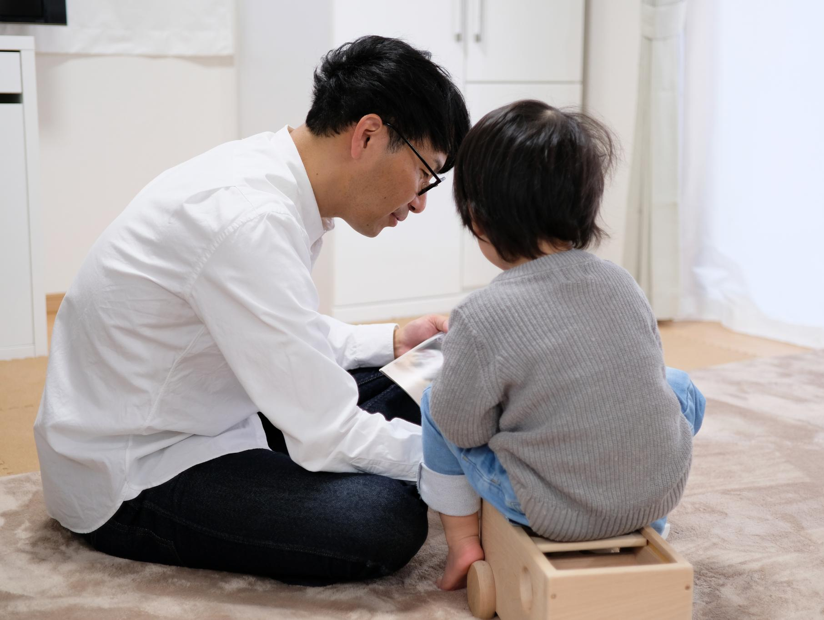
Parents as Primary Facilitators of Learning
First Learning Environment
  Parents create the initial learning environment, setting the foundation for lifelong development and growth.
Encouraging Exploration
  Parents encourage children to explore, ask questions, and discover new skills through supportive interaction.
Fostering Secure Attachments
  Secure attachments from parents promote emotional security essential for healthy cognitive and social development.
Notes:
---
Parents provide the first learning environment by responding to cues, encouraging exploration, and fostering secure attachments essential for development.
Image source: Microsoft 365 content library

Slide 17

The Interactive Effect of Joint Play and Engagement
Language Acquisition Boost
  Joint play helps infants develop language skills through interactive communication with parents.
Cognitive Skill Development
  Engagement during play stimulates infant cognitive growth and problem-solving abilities.
Social Bonding Enhancement
  Joint play strengthens emotional bonds and trust between parent and infant.
Notes:
---
Joint play between parents and infants enhances language acquisition, cognitive skills, and social bonding, creating rich learning experiences.
Image source: Microsoft 365 content library

Slide 18

Strategies for Supporting Infant Development at Home
Frequent Talking
  Talking frequently to infants promotes language development and strengthens parent-child bonding.
Providing Diverse Toys
  Offering a variety of toys stimulates sensory and cognitive skills essential for infant growth.
Encouraging Safe Exploration
  Creating a safe environment enables infants to explore and develop motor skills confidently.
Notes:
---
Simple strategies such as talking frequently, providing diverse toys, and encouraging safe exploration help parents support their infant’s developmental milestones.
Image source: Microsoft 365 content library

Slide 19
Conclusion
Foundational Skills Development
Early learning focuses on building foundational skills essential for future cognitive and social growth.
Peer Interactions
Interactions with peers contribute to social and emotional development during early months.
Brain Development Breakthroughs
Significant brain growth during this period underpins learning and memory capabilities.
Parental Involvement
Active parental participation strengthens learning and emotional bonding in early childhood.
Notes:
Early learning from 8 to 12 months is shaped by foundational skills, peer interactions, brain development breakthroughs, and active parental involvement. Together, these elements foster a strong basis for lifelong growth.

