Slide 1
Principles of Early Learning for 8-12 Months: Insights on Motor Development, Milestones, and Brain Growth
Understanding infant growth and support during early months
Notes:
---
This presentation explores key principles of early learning focused on infants aged 8 to 12 months, highlighting motor development milestones, brain growth breakthroughs, and the vital role of parents and environment in supporting this crucial stage.

Slide 2
Agenda Items
Key Motor Development Milestones in 8-12 Month Olds
Breakthroughs in Brain Development and Current Research
Parent-Centered Approaches to Early Learning
Interactive Effects: Environment, Play, and Parental Involvement
Notes:
We will cover four main topics: motor development milestones for 8-12 month olds, recent research on brain development, parent-centered early learning approaches, and how environment, play, and parental involvement interact to influence development.

Slide 3
Key Motor Development Milestones in 8-12 Month Olds
Notes:
Understanding typical motor milestones during this age range helps caregivers recognize normal growth patterns and support infants' physical abilities as they gain independence and coordination.

Slide 4
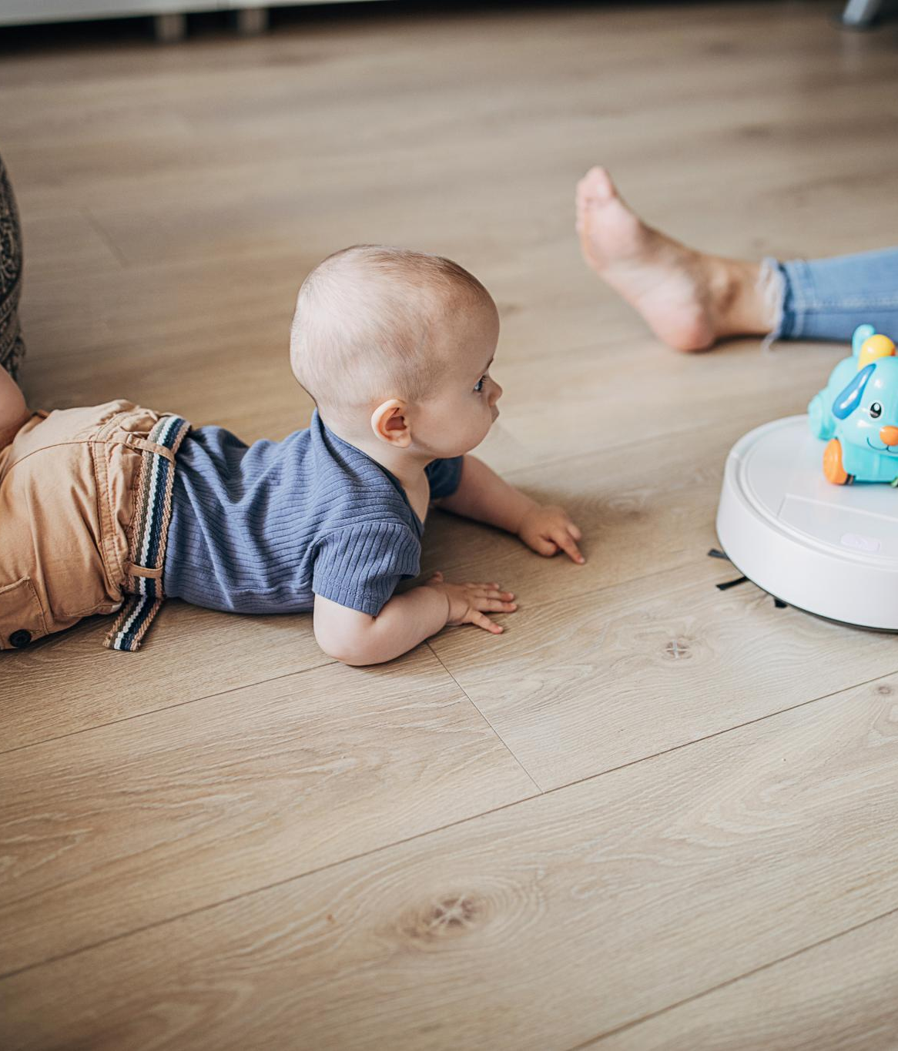
Typical Physical Abilities and Movements
Sitting Without Support
  By 8 to 12 months, infants typically develop the ability to sit steadily without support, improving posture control.
Crawling Development
  Crawling emerges as a key movement, helping infants explore and build coordination.
Pulling to Stand
  Infants start pulling themselves up to a standing position, strengthening leg muscles and balance.
Beginning to Walk
  Early walking attempts mark a major milestone, setting the stage for independent movement.
Notes:
---
By 8 to 12 months, many infants develop abilities such as sitting without support, crawling, pulling to stand, and beginning to walk. These physical movements lay the foundation for further motor skills.
Image source: Microsoft 365 content library

Slide 5

Emergence of Gross and Fine Motor Skills
Development of Gross Motor Skills
  Infants develop gross motor skills such as crawling and standing, which improve muscle strength and coordination.
Development of Fine Motor Skills
  Fine motor skills emerge as infants learn to pick up small objects, enhancing hand-eye coordination and dexterity.
Notes:
---
Gross motor skills like crawling and standing emerge alongside fine motor skills such as picking up small objects, showing the infant’s growing coordination and control of muscles.
Image source: Microsoft 365 content library

Slide 6

Observing Individual Variations in Milestone Achievement
Individual Pace of Milestones
  Infants develop skills at different rates, reflecting natural individual differences in growth and learning.
Influence of Genetics
  Genetic factors contribute to how and when infants achieve developmental milestones uniquely.
Role of Environment and Practice
  Environmental factors and opportunities for practice significantly affect infants’ milestone achievements.
Notes:
---
It is important to recognize that infants reach milestones at their own pace. Variations are normal and influenced by genetics, environment, and opportunities for practice.
Image source: Microsoft 365 content library

Slide 7
Breakthroughs in Brain Development and Current Research
Notes:
Recent studies shed light on critical periods of neural growth and the connections between physical movement and cognitive development during the first year of life.

Slide 8
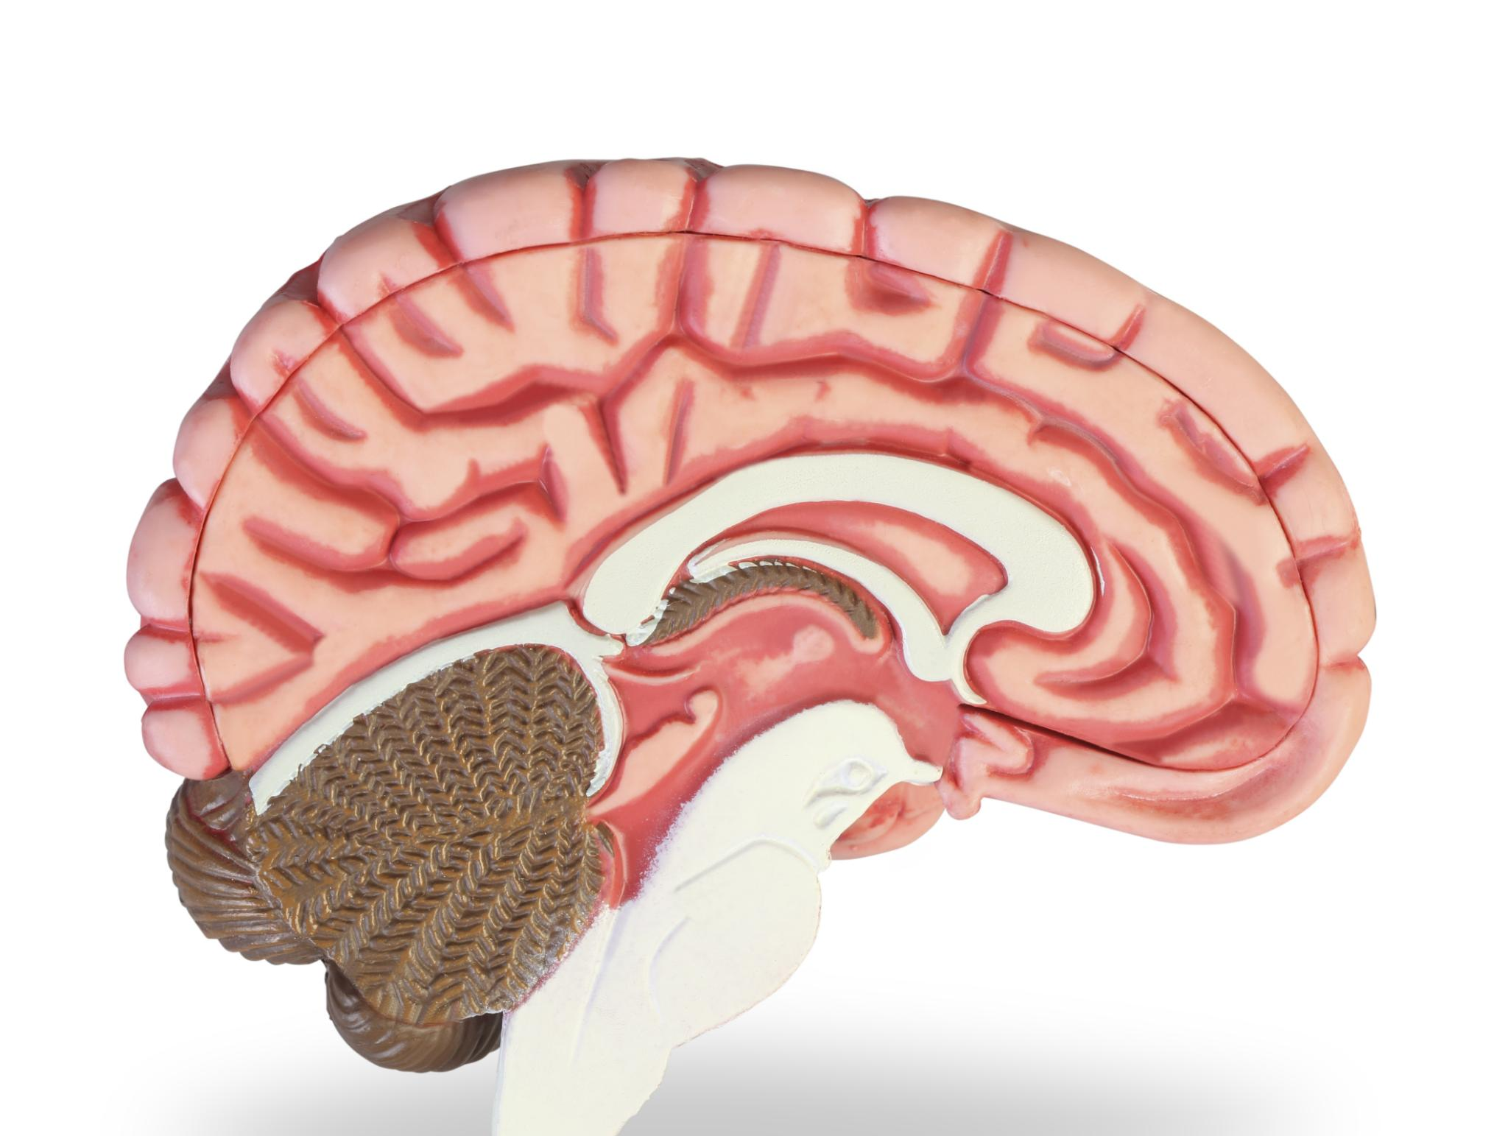
Critical Periods for Neural Growth
Rapid Brain Growth
  During 8 to 12 months, the brain experiences accelerated growth essential for cognitive development.
Synaptic Formation
  This period is crucial for synapse formation, supporting learning and neural connectivity.
Notes:
---
The 8-12 month period is marked by rapid brain growth and synaptic formation, making it a critical window for learning and development.
Image source: Microsoft 365 content library

Slide 9
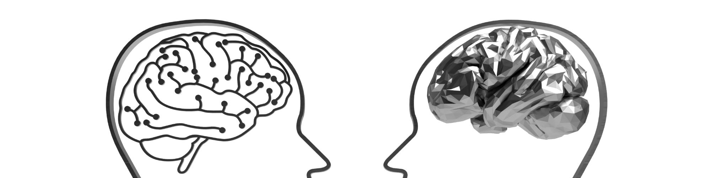
Links Between Movement and Cognitive Advancement
Motor Activities Stimulate Brain
  Physical movement activates brain regions linked to cognitive functions like problem-solving and memory.
Interplay of Physical and Cognitive Growth
  Physical and cognitive development are interconnected, with motor skills enhancing spatial awareness and memory.
Notes:
---
Motor activities stimulate brain areas responsible for problem-solving, spatial awareness, and memory, highlighting the interplay between physical and cognitive growth.
Image source: Microsoft 365 content library

Slide 10

Recent Research on Early Brain Plasticity
Brain Adaptability
  The brain shows a remarkable ability to adapt and reorganize itself based on new experiences and learning.
Importance of Enriching Environments
  Enriching environments play a crucial role in supporting early brain plasticity and cognitive development.
Notes:
---
Current research emphasizes the brain’s remarkable ability to adapt and reorganize in response to experiences, underscoring the importance of enriching environments.
Image source: Microsoft 365 content library

Slide 11
Parent-Centered Approaches to Early Learning
Notes:
Parents play a crucial role through responsive caregiving that nurtures secure relationships and supports the individual needs of their infants during this developmental phase.

Slide 12

Responsive Caregiving and Relationship Building
Attentive Infant Cues
  Caregivers respond sensitively to infant signals, promoting trust and strong emotional connections.
Emotional Security Foundation
  Emotional security built through responsive caregiving supports healthy infant development and relationships.
Notes:
---
Attentive and sensitive responses to infant cues foster trust and emotional security, which are foundational for healthy development.
Image source: Microsoft 365 content library

Slide 13
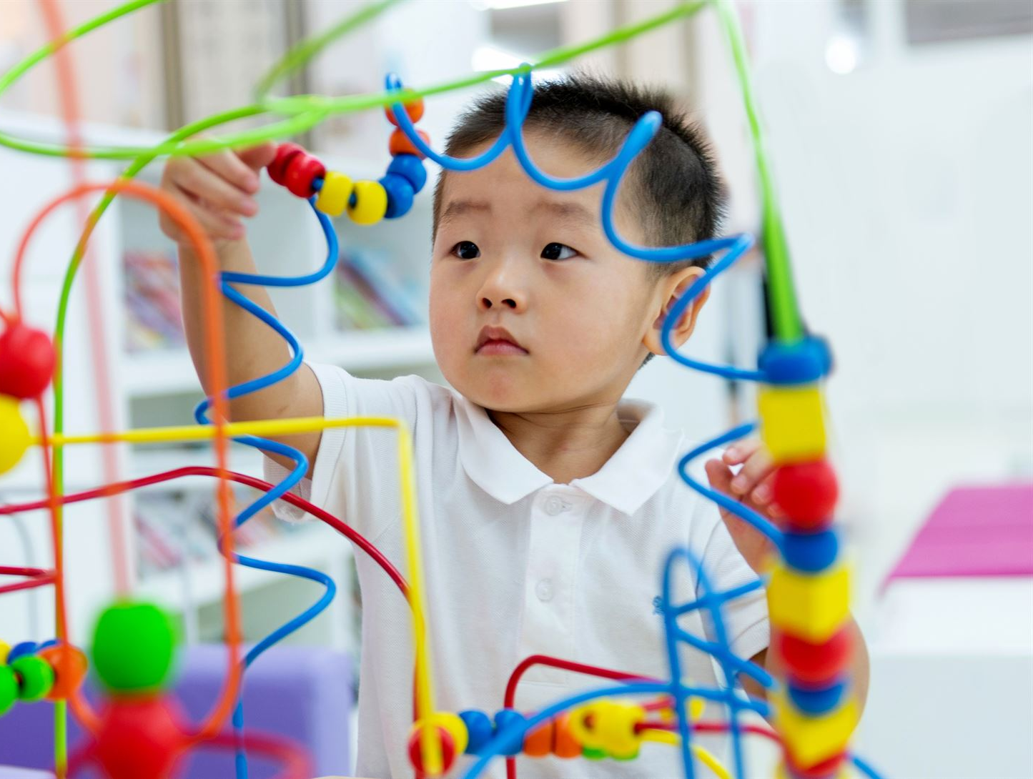
Supporting Exploration and Play
Safe Exploration Environments
  Creating secure spaces allows infants to explore freely and safely, fostering learning and confidence.
Guided Play Activities
  Adult-supported play encourages motor skills and cognitive growth through structured interaction.
Encouraging Curiosity
  Opportunities for exploration stimulate infants’ natural curiosity and desire to learn.
Notes:
---
Providing safe opportunities for exploration and guided play encourages curiosity, motor skills, and cognitive growth in infants.
Image source: Microsoft 365 content library

Slide 14

Recognizing and Responding to Individual Needs
Understanding Infant Temperament
  Recognizing each infant's unique temperament helps tailor support to their individual needs for better engagement.
Supporting Developmental Pace
  Adapting teaching methods to each infant’s developmental pace fosters effective and personalized early learning.
Notes:
---
Tailoring support to each infant’s unique temperament and developmental pace ensures effective early learning experiences.
Image source: Microsoft 365 content library

Slide 15
Interactive Effects: Environment, Play, and Parental Involvement
Notes:
The combined influence of environment, play, and parental support creates a powerful synergy that promotes milestone achievement and holistic development.

Slide 16
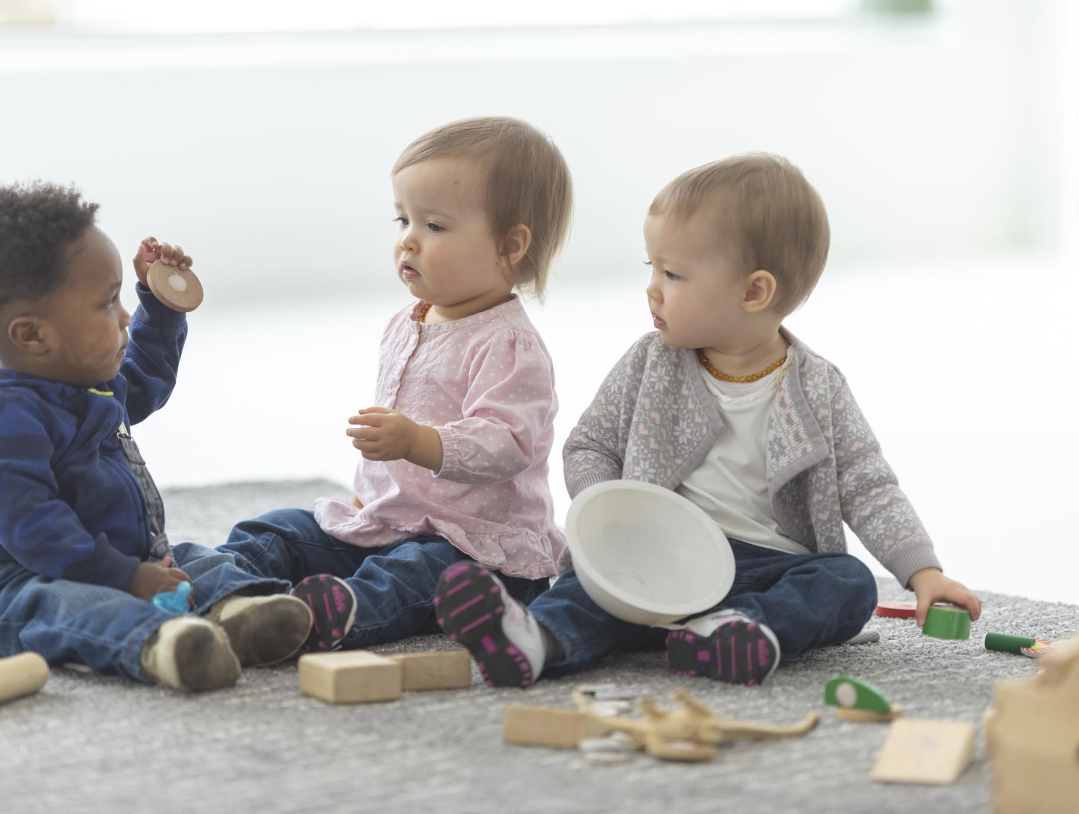
Role of Interactive Play in Learning
Social Skill Development
  Interactive play encourages infants to build essential social skills through communication and cooperation.
Emotional Growth
  Engaging in interactive play helps infants understand and express their emotions effectively.
Cognitive Skill Enhancement
  Interactive play stimulates cognitive development by encouraging problem-solving and creativity in infants.
Notes:
---
Interactive play fosters social, emotional, and cognitive skills, making it a vital component of early learning for infants.
Image source: Microsoft 365 content library

Slide 17
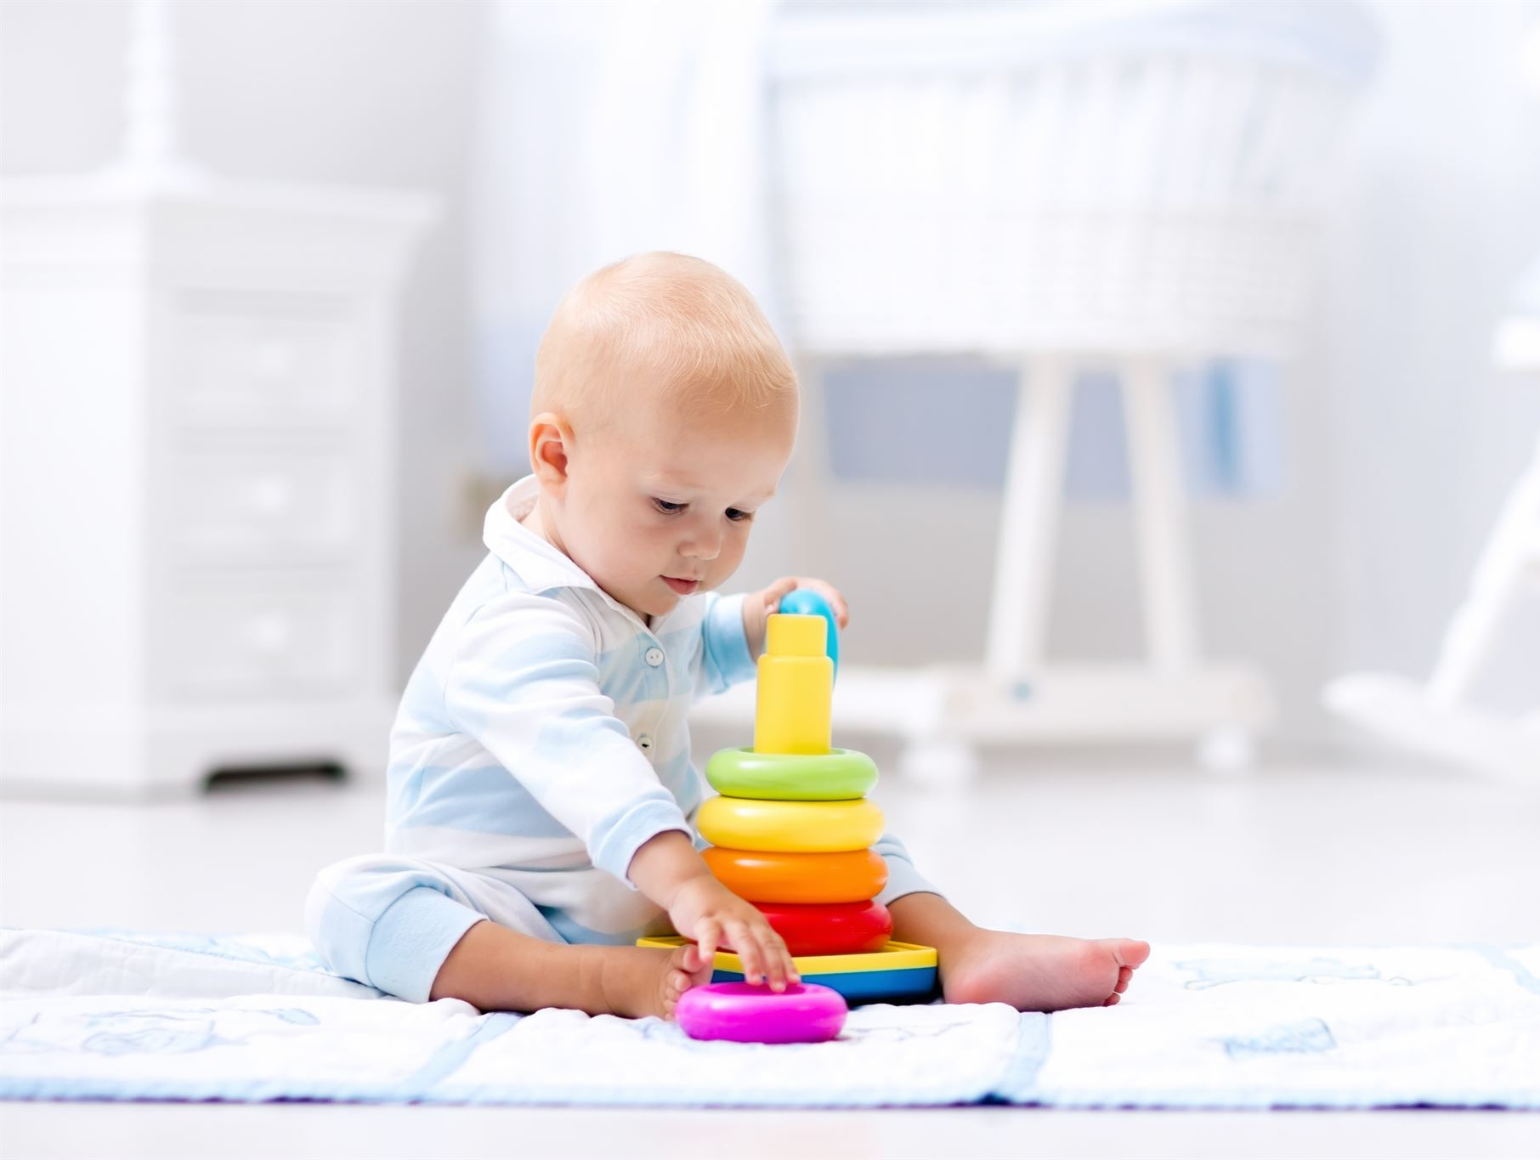
Environmental Influences on Development
Stimulating Environments
  Varied stimuli in an infant's environment encourage curiosity and active exploration essential for development.
Physical Growth Support
  Enriched surroundings promote physical development by motivating movement and motor skills practice.
Neurological Development
  Exposure to diverse stimuli fosters brain growth and cognitive development in early infancy.
Notes:
---
Enriching environments with varied stimuli encourage exploration and support the physical and neurological growth of infants.
Image source: Microsoft 365 content library

Slide 18

Synergy Between Parental Support and Milestone Attainment
Active Parental Involvement
  Parents who actively engage with their children boost developmental progress through supportive interactions.
Enhanced Play Benefits
  Supportive parental presence enriches play experiences, fostering faster milestone attainment.
Accelerated Milestone Achievement
  Combined efforts of parents and nurturing environments speed up key developmental milestones.
Notes:
---
Active parental involvement enhances the benefits of play and environment, accelerating the achievement of developmental milestones.
Image source: Microsoft 365 content library

Slide 19
Conclusion
Motor Development Importance
Motor development between 8 and 12 months is crucial for early learning and physical growth.
Brain Growth Impact
Rapid brain growth during this stage supports cognitive and sensory development in infants.
Role of Caregivers
Supportive caregiving through responsive and interactive experiences nurtures infant potential effectively.
Notes:
Early learning between 8 and 12 months is shaped by motor development, brain growth, and supportive caregiving. Understanding these principles helps parents and caregivers nurture infants’ potential through responsive, enriched, and interactive experiences.

