Slide 1
Principles of Early Learning for Infants (4–8 Months)
Supporting growth through interaction and development milestones
Notes:
---
This presentation explores the foundational principles of early learning in infants aged 4 to 8 months. We will focus on peer interaction, developmental milestones, and parent-focused engagement strategies to support optimal infant growth and development.

Slide 2
Agenda Items
Foundational Principles of Early Learning in Infancy
Learning With Peers: Early Social Development
Developmental Milestones and Breakthroughs in Brain Research
Parent-Centered Approaches and Interactive Effects
Notes:
We will cover key foundational principles of early learning, the role of peer interactions in social development, recent findings on developmental milestones and brain research, and parent-centered approaches that enhance early learning experiences.

Slide 3
Foundational Principles of Early Learning in Infancy
Notes:
Early learning in infancy is grounded in relationship-based approaches that emphasize responsive interactions. These principles foster secure attachment, which forms the basis for healthy cognitive and emotional development.

Slide 4

Importance of Relationship-Based Approaches
Consistent Caregiver Interactions
  Consistent and sensitive interactions help build trust and security in infants during early development stages.
Safe and Nurturing Environment
  A safe environment supports infant exploration, learning, and emotional self-regulation.
Notes:
---
Relationship-based approaches prioritize consistent, sensitive, and nurturing interactions between caregivers and infants. These interactions create a safe environment that supports exploration, learning, and emotional regulation during early development.
Image source: Microsoft 365 content library

Slide 5

Responsive Interactions and Secure Attachment
Responsive Caregiving
  Prompt and appropriate responses to infants' needs foster trust and emotional security in early development.
Secure Attachment Benefits
  Secure attachment supports social competence, emotional well-being, and healthy cognitive growth in children.
Long-Term Development
  Early secure attachments positively impact social and emotional skills throughout childhood and beyond.
Notes:
---
Responsive caregiving helps infants develop secure attachments by meeting their needs promptly and appropriately. Secure attachment is linked to better social competence, emotional well-being, and cognitive growth throughout infancy and beyond.
Image source: Microsoft 365 content library

Slide 6
Learning With Peers: Early Social Development
Notes:
Peer interactions during infancy provide important opportunities for social learning. Infants observe and imitate their peers, which supports early social and emotional skill development critical for later relationships.

Slide 7

Peer Observation and Imitation in Infants
Early Peer Observation
  Infants aged 4 to 8 months start observing the behaviors of their peers to learn social cues and gestures.
Imitation and Learning
  Mimicking peer behaviors helps infants develop basic communication skills and social interaction foundations.
Notes:
---
From 4 to 8 months, infants begin to observe and mimic the behaviors of their peers. This imitation aids in learning social cues, gestures, and basic communication, laying a foundation for more complex social interactions.
Image source: Microsoft 365 content library

Slide 8

Building Social and Emotional Skills Through Interaction
Turn-Taking Skills
  Infants learn turn-taking through repeated peer interactions, essential for social communication development.
Emotional Recognition
  Repeated social interactions help infants recognize and respond to different emotions effectively.
Attention Sharing
  Sharing attention with peers supports joint focus and early communication skills in infants.
Emotional Regulation and Empathy
  Early social experiences foster infants' emotional regulation and the development of empathy.
Notes:
---
Through repeated interactions with peers, infants develop skills such as turn-taking, emotional recognition, and sharing attention. These early social experiences contribute to emotional regulation and empathy.
Image source: Microsoft 365 content library

Slide 9
Developmental Milestones and Breakthroughs in Brain Research
Notes:
Recent research highlights critical cognitive, emotional, and social milestones in infants aged 4 to 8 months, alongside neural growth and plasticity that underpin these developments.

Slide 10
Current Findings in Infant Cognitive Development
Understanding Cause and Effect
Infants start grasping simple cause and effect relationships, showing early cognitive processing skills.
Face Recognition
Recognizing familiar faces is an important cognitive milestone during infancy.
Early Memory Formation
Infants demonstrate the beginnings of memory formation linked to rapid brain development.
Notes:
---
Studies show that infants at this stage begin to understand cause and effect, recognize familiar faces, and show early memory formation. These cognitive advances are linked to rapid brain development during this period.
Image source: Microsoft 365 content library

Slide 11

Key Emotional and Social Milestones at 4–8 Months
Social Smiling
  Infants begin to smile socially, showing recognition and positive response to familiar faces and interactions.
Emotional Response
  Babies respond to others' emotions, demonstrating early empathy and social awareness.
Expressing Emotions
  Infants express a wider range of emotions, reflecting increasing emotional complexity and communication skills.
Notes:
---
Between 4 and 8 months, infants typically smile socially, respond to others' emotions, and begin expressing a wider range of emotions themselves, signaling growing social awareness and emotional complexity.
Image source: Microsoft 365 content library

Slide 12

Impact of Neural Growth and Plasticity
Infant Brain Plasticity
  The infant brain exhibits high plasticity, enabling rapid adaptation and growth during early development.
Experience-Driven Neural Connections
  Neural connections rapidly form in response to experiences, supporting cognitive and sensory development.
Learning from Interactions
  Plasticity supports learning from social interactions and environmental stimuli, shaping behavior and skills.
Notes:
---
The infant brain demonstrates significant plasticity during this period, allowing experience-driven neural connections to form rapidly. This plasticity supports learning from social interactions and environmental stimuli.
Image source: Microsoft 365 content library

Slide 13
Parent-Centered Approaches and Interactive Effects
Notes:
Parents play a crucial role in shaping early learning by providing responsive care and facilitating interactive play. Their engagement influences infant development and strengthens the parent-child bond.

Slide 14

Role of Parental Responsiveness in Early Learning
Noticing Infant Cues
  Parents attentively observe infants’ signals to understand their needs and emotions effectively.
Secure Attachment Formation
  Responsive parenting fosters secure emotional bonds that enhance infants’ sense of safety and trust.
Cognitive and Emotional Growth
  Appropriate responses stimulate infants’ brain development and emotional well-being essential for learning.
Notes:
---
Parental responsiveness involves noticing and appropriately responding to infants’ cues, which promotes secure attachment and stimulates cognitive and emotional growth essential in early learning.
Image source: Microsoft 365 content library

Slide 15
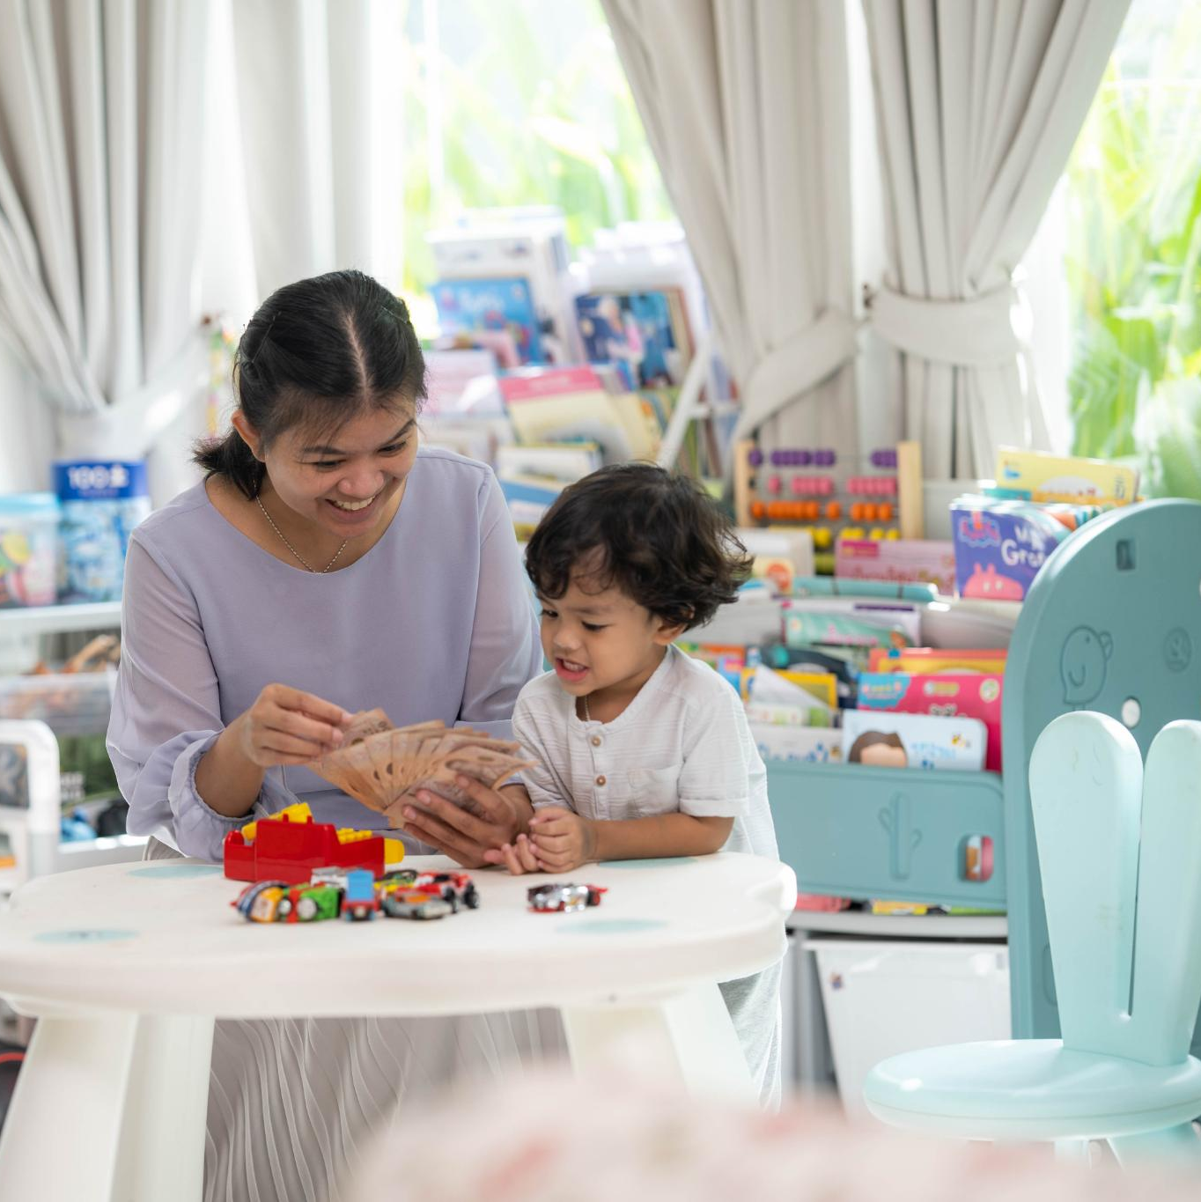
Strategies for Supporting Interactive Play and Exploration
Interactive Toys
  Using toys that encourage engagement helps infants safely explore their surroundings and develop curiosity.
Facial Expressions
  Caregivers' facial expressions enhance social bonding and encourage infants to participate in interactive play.
Shared Activities
  Participating in shared activities fosters problem-solving skills and social engagement in infants.
Notes:
---
Encouraging interactive play through toys, facial expressions, and shared activities helps infants explore their environment safely. These strategies boost curiosity, problem-solving skills, and social engagement.
Image source: Microsoft 365 content library

Slide 16
Conclusion
Early Learning Principles
Applying early learning principles boosts infant growth between 4 to 8 months effectively.
Peer Interaction Importance
Peer interaction supports social skills development in infants during early stages.
Parent Engagement Role
Active parent engagement fosters responsive caregiving and promotes infant thriving.
Notes:
Understanding and applying principles of early learning—focusing on peer interaction, developmental milestones, and parent engagement—can significantly enhance infant development during 4 to 8 months. Responsive caregiving and supportive social environments are key to nurturing thriving infants.

