Slide 1
Key Principles of Early Motor and Brain Development for Infants Aged 4-8 Months
Understanding infant growth through sensory and motor milestones
Notes:
---
This presentation explores the foundational principles, current research milestones, and parent-centered approaches related to motor and brain development in infants aged 4 to 8 months. We will cover motor progression, sensory experiences, developmental variability, and interactive caregiving strategies.

Slide 2
Agenda Overview
Foundational Principles of Early Motor Development
Current Milestones and Research in Infant Development
Parent-Centered and Interactive Effects
Integration of Theoretical Perspectives
Notes:
We will begin by discussing the foundational principles of early motor development, followed by an overview of current milestones and recent research findings. Next, we will focus on parent-centered and interactive effects, and conclude by integrating theoretical perspectives that inform best practices.

Slide 3
Foundational Principles of Early Motor Development
Notes:
Understanding core principles of motor development during infancy lays the groundwork for recognizing typical progression and how sensory-motor experiences and environmental factors influence physical milestones.

Slide 4

Core Concepts in Infant Motor Progression
Predictable Developmental Stages
  Infant motor skills develop in predictable stages marked by gradual improvements in control and coordination.
Reflexive to Voluntary Movements
  Early reflexive movements transition into voluntary actions as infants gain strength and neural control.
Increasing Motor Coordination
  Improved neural control enables infants to coordinate limbs and perform more complex movements.
Notes:
---
Infant motor development progresses through predictable stages that involve increasing motor control and coordination. This includes the transition from reflexive movements to voluntary actions as infants gain strength and neural control.
Image source: Microsoft 365 content library

Slide 5

Significance of Sensory-Motor Experiences
Exploration and Learning
  Sensory-motor experiences allow infants to explore their bodies and environment, enhancing learning and awareness.
Neural Pathway Stimulation
  These experiences stimulate neural pathways critical for brain development and sensory integration.
Motor and Cognitive Development
  Sensory-motor activities support growth of motor skills and cognitive functions in early childhood.
Notes:
---
Sensory-motor experiences are crucial for infants as they explore and learn about their bodies and environment. These experiences stimulate neural pathways and support the development of motor skills and cognitive functions.
Image source: Microsoft 365 content library

Slide 6

Influence of Environment on Physical Milestones
Impact of Physical Space
  A safe and well-arranged physical space encourages infants to explore and develop motor skills effectively.
Caregiver Interaction
  Positive interactions with caregivers promote confidence and enhance the quality of motor milestone achievement.
Notes:
---
The infant's environment, including physical space and caregiver interactions, significantly impacts the timing and quality of motor milestone achievements. Safe and stimulating environments encourage exploration and development.
Image source: Microsoft 365 content library

Slide 7
Current Milestones and Research in Infant Development
Notes:
This section highlights typical motor milestones for infants aged 4 to 8 months, recent findings on developmental variability, and advancements in understanding early brain changes during this critical period.

Slide 8

Typical Motor Milestones for 4-8 Months
Rolling Over
  Infants begin to roll over from front to back and vice versa, marking early motor development.
Sitting with Support
  Babies start sitting with support, strengthening core muscles and balance.
Reaching and Grasping
  Reaching for and grasping objects shows growing hand-eye coordination and exploration skills.
Hand and Mouth Exploration
  Exploring objects with hands and mouth is common for sensory and motor learning.
Notes:
---
Between 4 and 8 months, infants commonly achieve milestones such as rolling over, sitting with support, reaching and grasping objects, and beginning to explore with hands and mouth, marking significant motor progress.
Image source: Microsoft 365 content library

Slide 9

Recent Research on Developmental Variability
Variability in Development
  Infants show a wide range of developmental timelines that do not necessarily indicate delays or issues.
Individualized Observation
  Recognizing the uniqueness of each infant’s development highlights the need for personalized monitoring.
Range of Normal Development
  Understanding that a broad spectrum of growth patterns can be normal improves assessment and support strategies.
Notes:
---
New studies reveal that developmental timelines can vary widely among infants without indicating delay. These findings emphasize the importance of individualized observation and recognizing a range of normal development.
Image source: Microsoft 365 content library

Slide 10

Breakthroughs in Recognizing Early Brain Changes
Early Neural Markers
  Neuroscience research reveals early neural markers linked to motor and cognitive development in infants.
Brain Plasticity in Infancy
  Brain plasticity during infancy facilitates rapid learning and adaptation in motor and cognitive functions.
Notes:
---
Recent neuroscience research has identified early neural markers of motor and cognitive development, showing how brain plasticity during infancy supports rapid learning and adaptation.
Image source: Microsoft 365 content library

Slide 11
Parent-Centered and Interactive Effects
Notes:
Parents play a vital role in fostering infant development through responsive caregiving, engagement strategies, and interactive play, all of which enhance physical and brain growth.

Slide 12
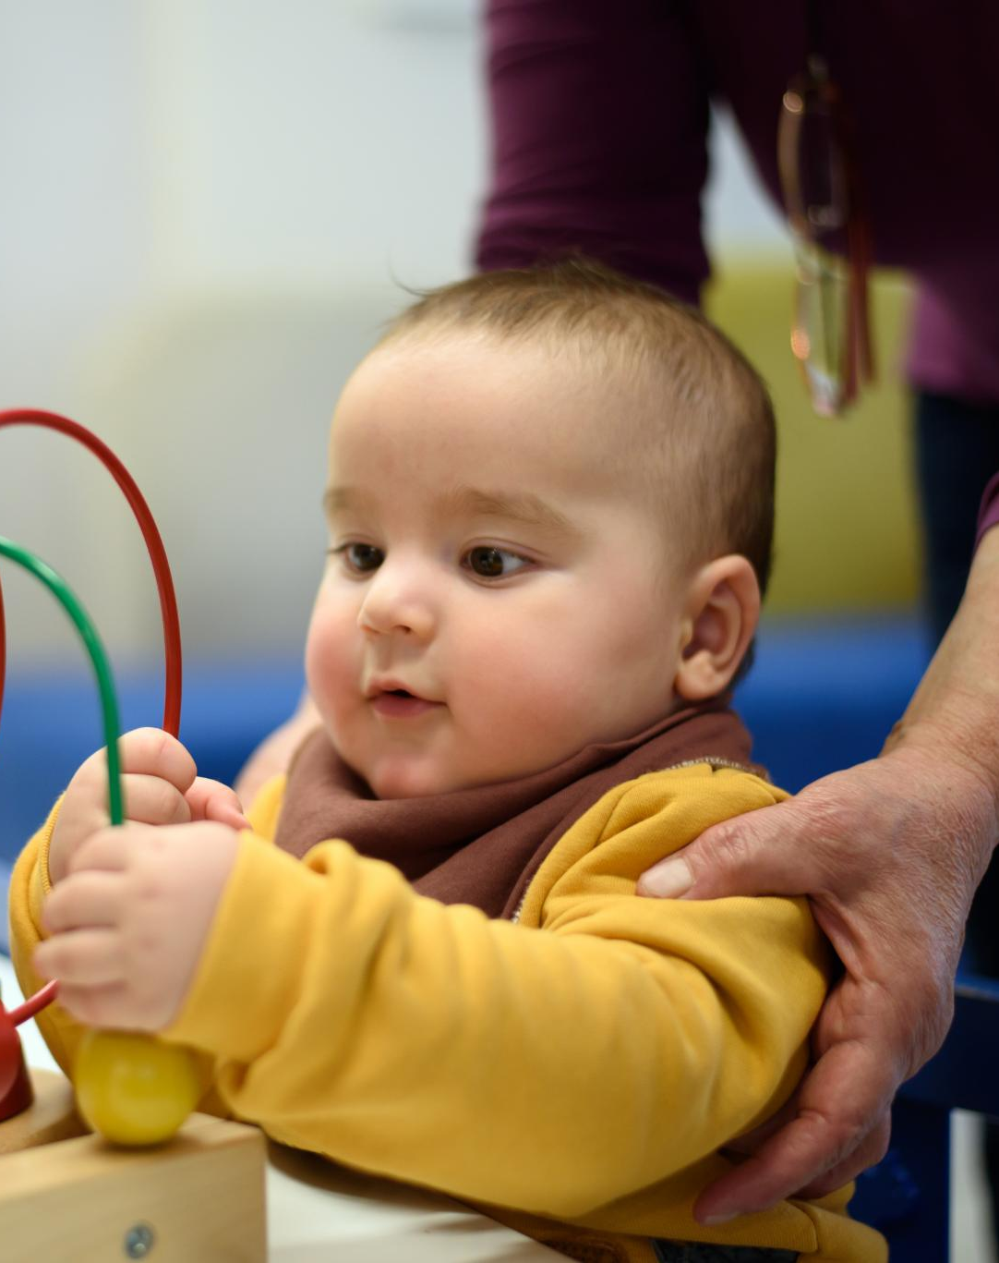
Role of Responsive Caregiving and Relationships
Responsive Caregiving Importance
  Attending to infant cues promotes strong attachment and emotional security.
Supports Developmental Outcomes
  Responsive caregiving provides a secure base for infant exploration and learning.
Notes:
---
Responsive caregiving that attends to infant cues strengthens attachment and supports developmental outcomes by providing a secure base for exploration and learning.
Image source: Microsoft 365 content library

Slide 13
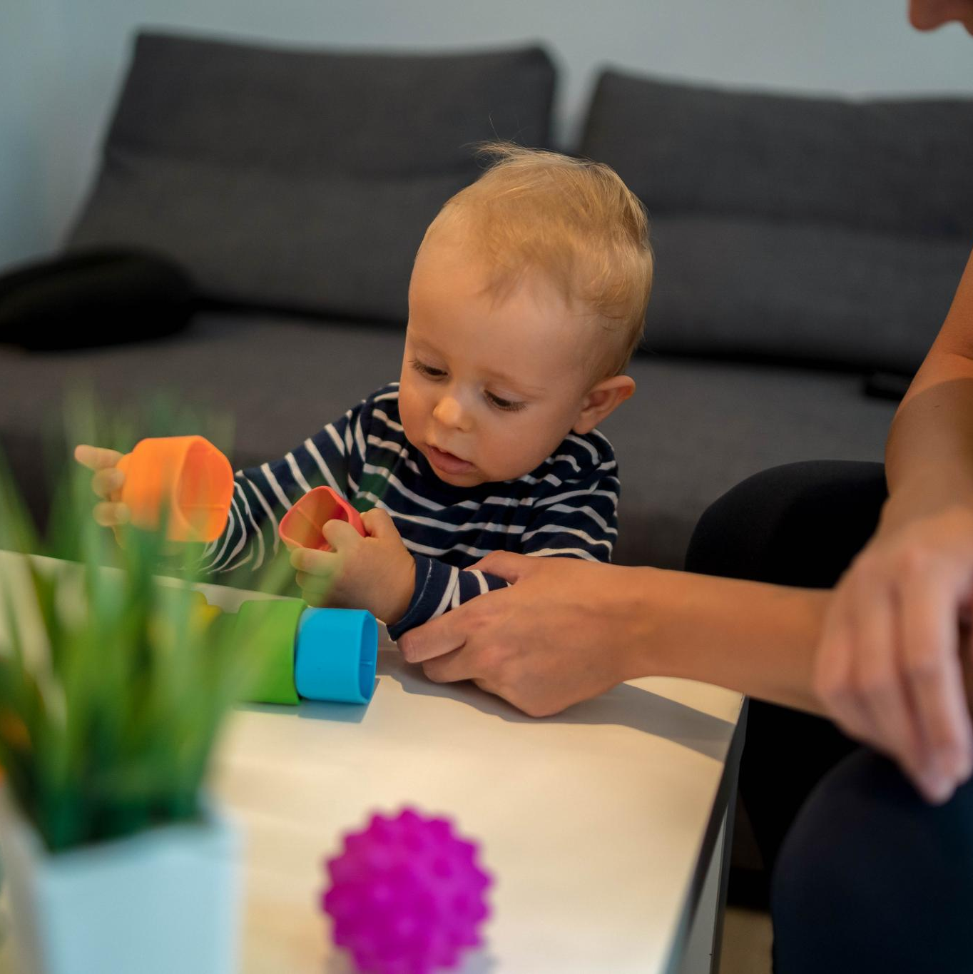
Strategies for Parent-Child Engagement
Following Infant’s Lead
  Observing and responding to the infant’s cues promotes trust and supports natural developmental progress.
Varied Sensory Experiences
  Providing diverse sensory inputs enriches infant’s brain development and cognitive skills.
Encouraging Motor Exploration
  Supporting safe motor activities helps infants develop coordination and physical strength.
Notes:
---
Effective strategies include following the infant’s lead, providing varied sensory experiences, and encouraging motor exploration in safe and supportive ways to optimize development.
Image source: Microsoft 365 content library

Slide 14

Interactive Play and Its Effect on Development
Motor Skills Development
  Interactive play enhances infants' motor skills by encouraging movement and coordination.
Problem-Solving Abilities
  Play activities stimulate infants' problem-solving skills through exploration and experimentation.
Social Communication
  Interactive play fosters social communication by encouraging interaction and responsiveness.
Notes:
---
Interactive play stimulates motor skills, problem-solving, and social communication, reinforcing brain connections and fostering holistic growth during early infancy.
Image source: Microsoft 365 content library

Slide 15
Integration of Theoretical Perspectives
Notes:
This final section integrates key theoretical frameworks such as Vygotsky’s social interaction theory and relationship-based principles that underpin effective developmental support and play as a foundation.

Slide 16
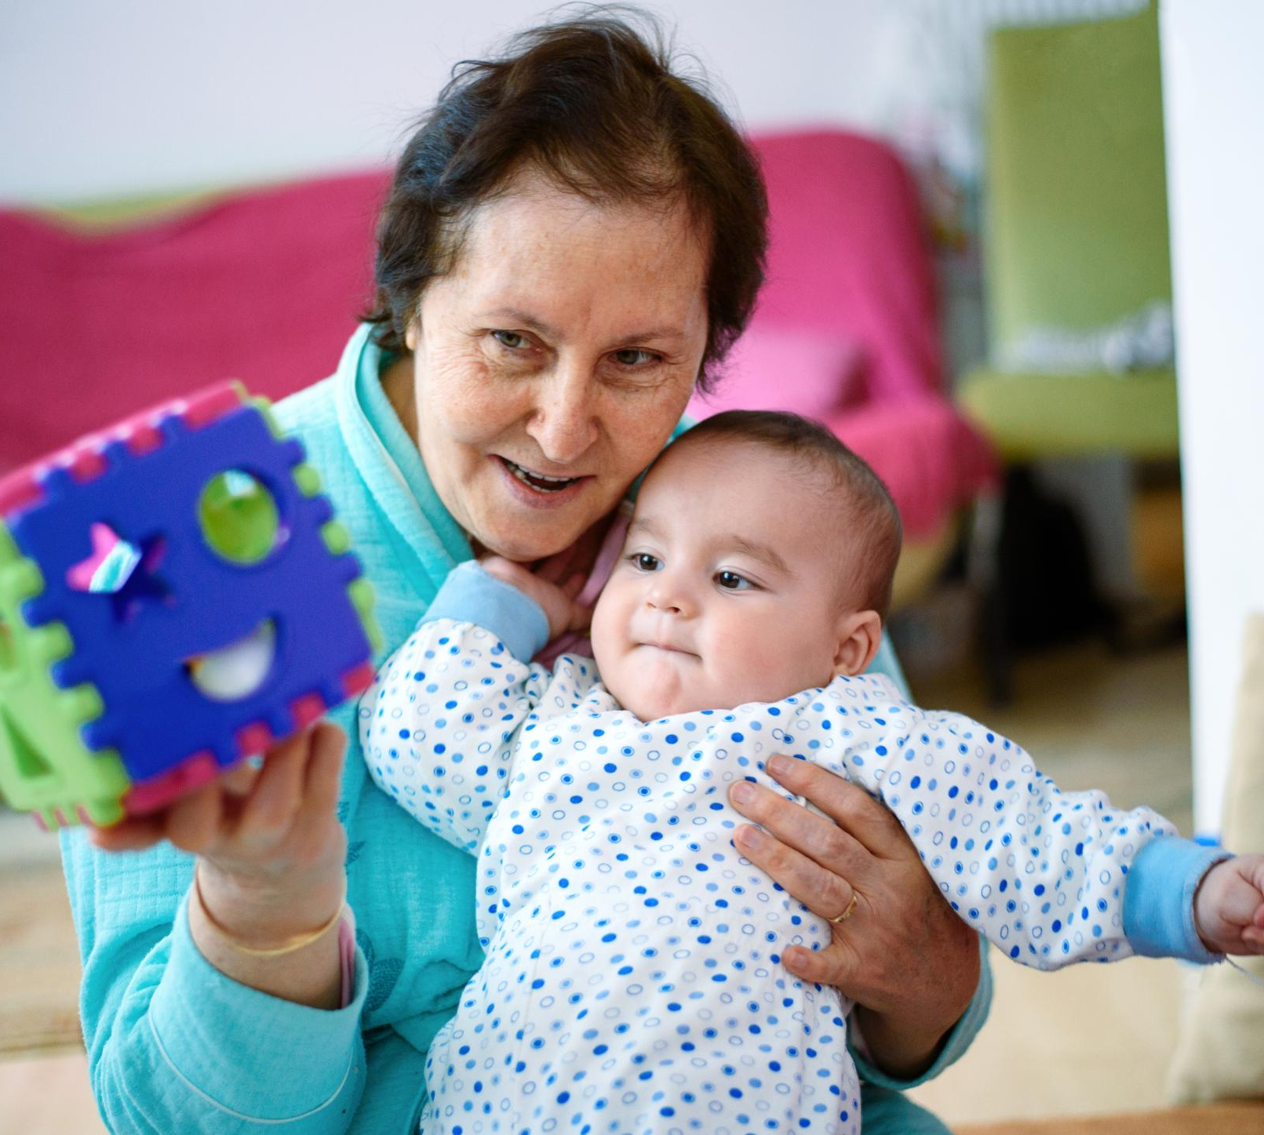
Vygotskian Approach and Social Interaction
Social Interaction in Development
  Social exchanges between caregivers and infants play a critical role in early cognitive and motor growth.
Scaffolding Motor Growth
  Caregiver support scaffolds infants’ motor skills and brain development during the crucial early months.
Notes:
---
Vygotsky emphasizes the role of social interaction in cognitive development, highlighting how caregiver-infant exchanges scaffold motor and brain growth during the early months.
Image source: Microsoft 365 content library

Slide 17

Relationship-Based Principles in Practice
Secure Caregiver-Infant Bonds
  Building secure bonds between caregivers and infants supports emotional safety and social development.
Promoting Trust and Regulation
  Responsive caregiving fosters trust and helps infants learn emotional regulation skills.
Supporting Developmental Resilience
  Strong relationships enhance infants’ ability to adapt and thrive in changing environments.
Notes:
---
Relationship-based approaches focus on creating secure, responsive caregiver-infant bonds that promote trust, emotional regulation, and developmental resilience.
Image source: Microsoft 365 content library

Slide 18
Play as a Foundation for Growth
Movement Experimentation
Infants use play to explore and develop their motor skills through varied physical activities.
Communication Development
Play encourages infants to practice communication, fostering early language and social skills.
Problem-Solving Skills
Through play, infants experiment with cause and effect, building early cognitive problem-solving abilities.
Notes:
---
Play is a critical context where infants experiment with movement, communication, and problem-solving, enabling integrated development of motor skills and brain function.
Image source: Microsoft 365 content library

Slide 19
Conclusion
Early Developmental Period
The period between 4 and 8 months is critical for motor and brain development in infants.
Role of Foundational Principles
Foundational developmental principles guide healthy growth and cognitive advancement in infants.
Parental Involvement
Active parental engagement significantly supports infants' healthy development and potential.
Notes:
Early motor and brain development between 4 and 8 months is shaped by foundational principles, evolving research, and the active role of parents. Understanding these elements helps caregivers support infants’ healthy growth and developmental potential.

