Slide 1
Fundamental Principles of Early Learning and Social-Emotional Development in Toddlers Aged 24-36 Months
Key milestones and caregiving strategies for toddler growth
Notes:
---
This presentation explores the essential principles guiding early learning and social-emotional growth in toddlers between 24 and 36 months old. It highlights developmental milestones, caregiving approaches, and recent research findings relevant to toddler development.

Slide 2
Agenda Highlights
Core Principles of Early Learning for Toddlers
Social, Emotional, and Attachment Development
Current Research Milestones and Breakthroughs in Brain Development
Parent-Centered and Interactive Approaches
Notes:
We will begin with the core principles of early learning for toddlers, followed by an overview of social, emotional, and attachment development. Next, we will discuss current research milestones in brain development, and conclude with parent-centered and interactive approaches to support toddlers.

Slide 3
Core Principles of Early Learning for Toddlers
Notes:
Early learning in toddlers is driven by key principles such as play-based exploration, scaffolding, and recognizing each child's unique pace and interests. These principles help create an optimal learning environment.

Slide 4

Importance of Play-Based Exploration
Cognitive Development
  Play-based exploration helps toddlers develop cognitive skills through active discovery and interaction with their environment.
Physical Growth
  Engaging in play encourages physical development by improving coordination, motor skills, and overall health in toddlers.
Emotional and Social Skills
  Play fosters emotional growth and independence, enhancing creativity, problem-solving, and social interactions among toddlers.
Notes:
---
Play-based exploration supports toddlers’ cognitive, physical, and emotional development. It allows children to discover their environment actively, fostering creativity, problem-solving skills, and independence.
Image source: Microsoft 365 content library

Slide 5
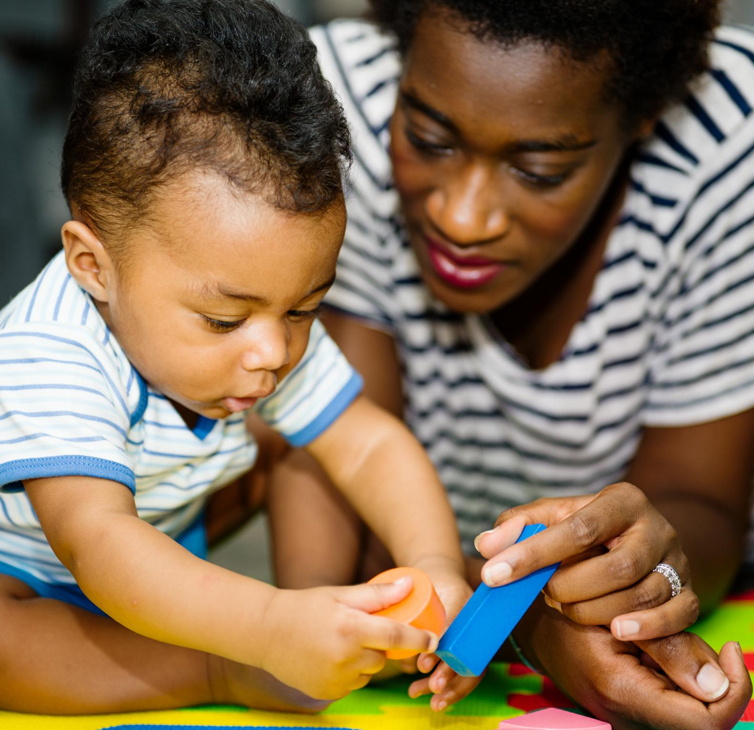
Scaffolding and Guided Participation
Scaffolding Support
  Adults provide tailored assistance to toddlers, helping them achieve tasks just beyond their current skill level.
Guided Participation
  Children engage in learning activities with appropriate adult help, fostering gradual mastery and confidence.
Notes:
---
Scaffolding involves adults providing support to toddlers just beyond their current abilities. Guided participation encourages children to engage in learning with appropriate assistance, promoting gradual mastery and confidence.
Image source: Microsoft 365 content library

Slide 6
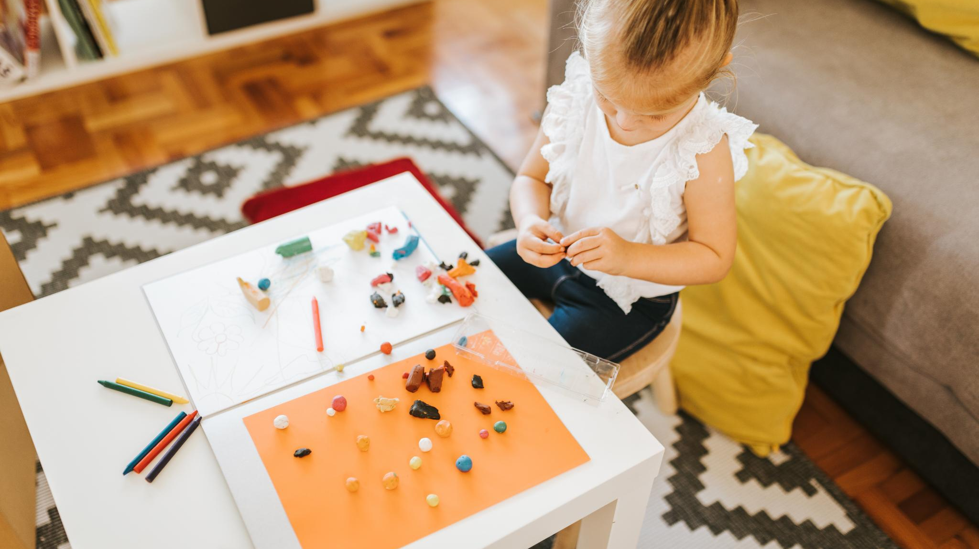
Respecting Individual Pace and Interests
Individual Learning Pace
  Recognizing that toddlers learn at their own speed is essential for effective teaching and development.
Tailored Activities
  Customizing activities based on each child's interests enhances engagement and motivation.
Meaningful Learning
  Supporting individual preferences fosters deeper and more meaningful learning experiences for toddlers.
Notes:
---
Every toddler learns differently, so respecting individual pace and interests is crucial. Tailoring activities to each child’s preferences helps maintain motivation and supports more meaningful learning experiences.
Image source: Microsoft 365 content library

Slide 7
Social, Emotional, and Attachment Development
Notes:
This section examines how toddlers form attachments, recognize and regulate emotions, and develop emerging social skills that lay the foundation for future relationships.

Slide 8

Formation of Secure Attachments
Consistent Responsive Caregiving
  Secure attachments form when caregivers consistently respond to toddlers' needs with care and sensitivity.
Safe Base for Exploration
  Secure attachments give toddlers confidence to explore their world knowing they have a safe, reliable caregiver.
Building Trust Socially
  These attachments enable toddlers to develop trust and positive social interactions as they grow.
Notes:
---
Secure attachments develop through consistent, responsive caregiving. These attachments provide toddlers with a safe base from which to explore and build trust in their social world.
Image source: Microsoft 365 content library

Slide 9
Recognition and Regulation of Emotions
Emotional Recognition in Toddlers
Toddlers start to recognize their own emotions and the feelings of others during early development stages.
Learning Emotional Regulation
Toddlers gradually develop the ability to regulate emotions with time and experience.
Role of Caregiver Support
Caregiver involvement is essential for teaching toddlers healthy emotional coping strategies.
Notes:
---
Toddlers begin to identify their own and others’ emotions and gradually learn to regulate feelings. Caregiver support is vital in helping children develop healthy emotional coping strategies.
Image source: Microsoft 365 content library

Slide 10
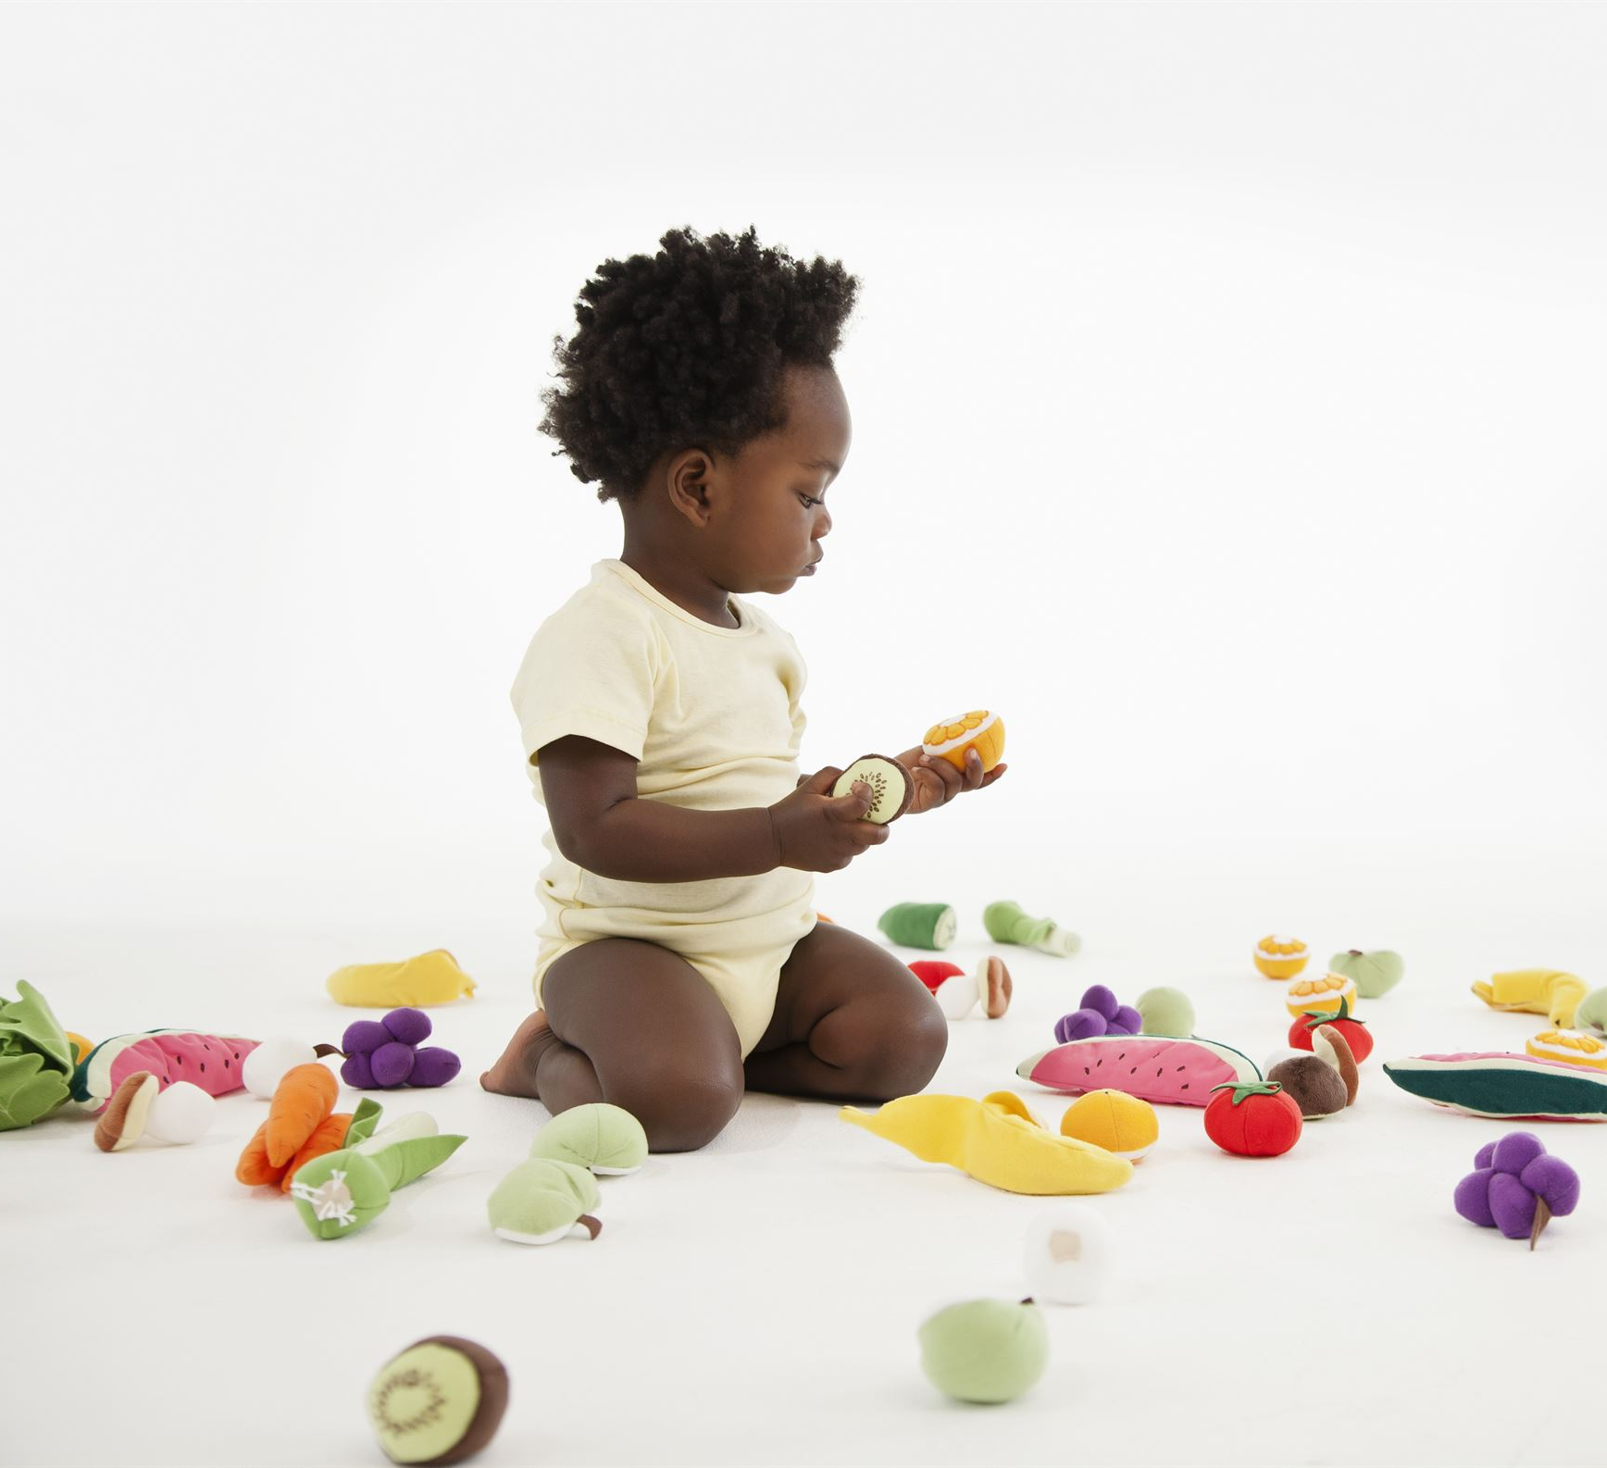
Emergent Social Skills and Peer Interaction
Interest in Peers
  Toddlers begin to notice and engage with other children, showing curiosity and social interest.
Sharing and Turn-Taking
  Children develop skills like sharing toys and taking turns during play, fostering cooperation.
Building Empathy and Communication
  Early social interactions lay the foundation for empathy and effective communication skills.
Notes:
---
Toddlers start to show interest in peers, developing skills such as sharing, turn-taking, and cooperation. These early social interactions support empathy and communication abilities.
Image source: Microsoft 365 content library

Slide 11
Current Research Milestones and Breakthroughs in Brain Development
Notes:
Recent research highlights critical periods of neural growth, the profound impact of responsive caregiving, and advances in understanding executive function development during toddlerhood.

Slide 12

Critical Periods of Rapid Neural Growth
Rapid Brain Development
  Toddlers undergo intense brain growth with rapid formation of neural connections during critical periods.
Cognitive Capacity Formation
  These critical periods are essential for shaping toddlers' cognitive abilities and learning skills.
Emotional and Social Growth
  Neural growth during this time also supports emotional regulation and social skill development.
Notes:
---
Toddlers experience significant brain development during this period, with rapid neural connections forming. These critical windows shape cognitive, emotional, and social capacities.
Image source: Microsoft 365 content library

Slide 13

Impact of Responsive Caregiving
Brain Architecture Development
  Responsive caregiving shapes healthy brain architecture critical for lifelong learning and development.
Secure Attachment Formation
  Consistent responsive care fosters secure attachment between caregiver and child.
Stress Regulation Benefits
  Responsive caregiving helps children regulate stress effectively, supporting emotional well-being.
Cognitive and Emotional Skills
  Healthy caregiving contributes to strong cognitive and emotional skills development in children.
Notes:
---
Responsive caregiving positively influences brain architecture, promoting secure attachment, stress regulation, and healthy development of cognitive and emotional skills.
Image source: Microsoft 365 content library

Slide 14

Latest Findings on Executive Function Development
Emergence of Executive Functions
  Executive functions such as attention control, working memory, and cognitive flexibility start developing in toddler years.
Self-Regulation Improvement
  Development of executive functions enables toddlers to better regulate their behavior and emotions.
Enhanced Problem-Solving
  Improved cognitive flexibility leads to enhanced problem-solving abilities in early childhood.
Notes:
---
Executive functions like attention control, working memory, and cognitive flexibility begin to emerge in toddler years, enabling better self-regulation and problem-solving capabilities.
Image source: Microsoft 365 content library

Slide 15
Parent-Centered and Interactive Approaches
Notes:
Effective early learning involves active parental engagement, interactive strategies, and collaboration between caregivers and educators to support toddlers’ holistic development.

Slide 16

Role of Responsive and Engaged Parenting
Responsive Parenting Importance
  Responsive parenting involves listening and adapting to a toddler’s cues to meet their needs effectively.
Secure Attachment Development
  Such parenting fosters secure attachments, which build the foundation for emotional and social growth.
Encouraging Exploration
  A supportive environment encourages toddlers to explore and learn confidently under parental guidance.
Notes:
---
Responsive parenting that listens and adapts to a toddler’s cues fosters secure attachments and encourages exploration and learning in a supportive environment.
Image source: Microsoft 365 content library

Slide 17

Strategies for Fostering Interactive Learning
Shared Reading
  Shared reading involves adults and children reading together to enhance comprehension and vocabulary development.
Conversational Turn-Taking
  Conversational turn-taking encourages back-and-forth dialogue, improving communication and social interaction skills.
Participatory Play
  Play that invites participation helps develop social skills and teamwork through collaborative activities.
Notes:
---
Interactive learning strategies include shared reading, conversational turn-taking, and play that invites participation, which together strengthen language and social skills.
Image source: Microsoft 365 content library

Slide 18
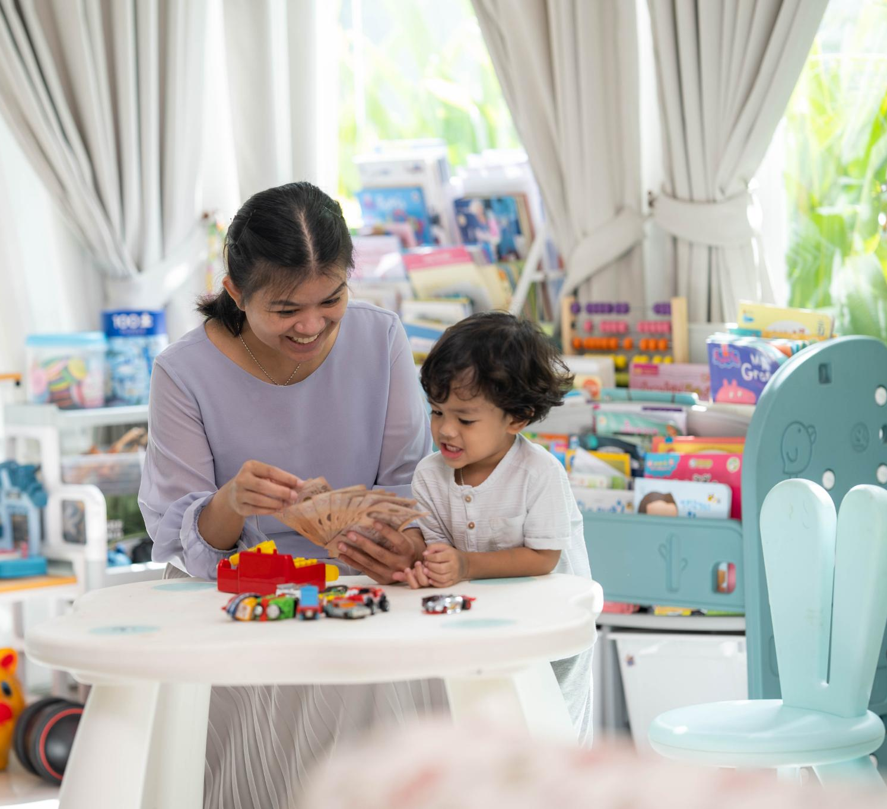
Collaborative Relationships with Caregivers and Educators
Importance of Collaboration
  Working together fosters consistency in learning and creates a strong support network for toddlers' growth.
Consistency in Learning
  Unified approaches between caregivers and educators help toddlers develop skills more effectively.
Supportive Network
  A network of involved adults provides essential emotional and developmental guidance for toddlers.
Notes:
---
Collaboration between parents, caregivers, and educators ensures consistency in learning approaches and provides a network of support essential for toddler development.
Image source: Microsoft 365 content library

Slide 19
Conclusion
Early Learning Foundations
Grasping core principles of early learning supports toddlers' healthy cognitive and social development.
Social-Emotional Growth
Responsive care fosters toddlers' social-emotional well-being essential for future success.
Research-Informed Approaches
Using research-based strategies ensures effective support for toddlers' lifelong learning.
Notes:
Understanding fundamental principles of early learning and social-emotional development in toddlers enables caregivers and educators to support healthy growth. Responsive, interactive, and research-informed approaches create the foundation for lifelong learning and well-being.

