Slide 1
Principles of Early Learning for 24–36 Months: Peer Interaction, Developmental Milestones, and the Role of Parents
Understanding toddler growth through social and parental support
Notes:
---
This presentation explores the foundational principles of early learning for toddlers aged 24 to 36 months. We will examine peer interactions, developmental milestones, and the critical role parents play in supporting early childhood development.

Slide 2
Today's Discussion Points
Key Principles of Early Learning for Toddlers Aged 24–36 Months
Learning with Peers: Social and Emotional Growth
Recent Milestones and Breakthroughs in Brain Development Research
Parent-Centered Approaches and the Interactive Effect
Notes:
We will cover four key areas: the principles of early learning for toddlers, social and emotional growth through peer interaction, recent research breakthroughs in brain development, and parent-centered approaches to support learning.

Slide 3
Key Principles of Early Learning for Toddlers Aged 24–36 Months
Notes:
Understanding the unique developmental stage of toddlers is essential. This section highlights their needs, the importance of play-based exploration, and how secure relationships facilitate learning.

Slide 4
Understanding the Developmental Stage and Unique Needs
Rapid Language Growth
Toddlers rapidly expand vocabulary and start forming simple sentences during this developmental stage.
Motor Skill Development
Improved coordination allows toddlers to walk, run, and manipulate objects with increasing skill.
Cognitive Advancement
Cognitive abilities grow, enabling toddlers to explore, solve simple problems, and understand cause and effect.
Notes:
---
Toddlers aged 24–36 months experience rapid growth in language, motor skills, and cognition. Recognizing these unique needs allows caregivers to provide appropriate learning experiences that foster development.
Image source: Microsoft 365 content library

Slide 5
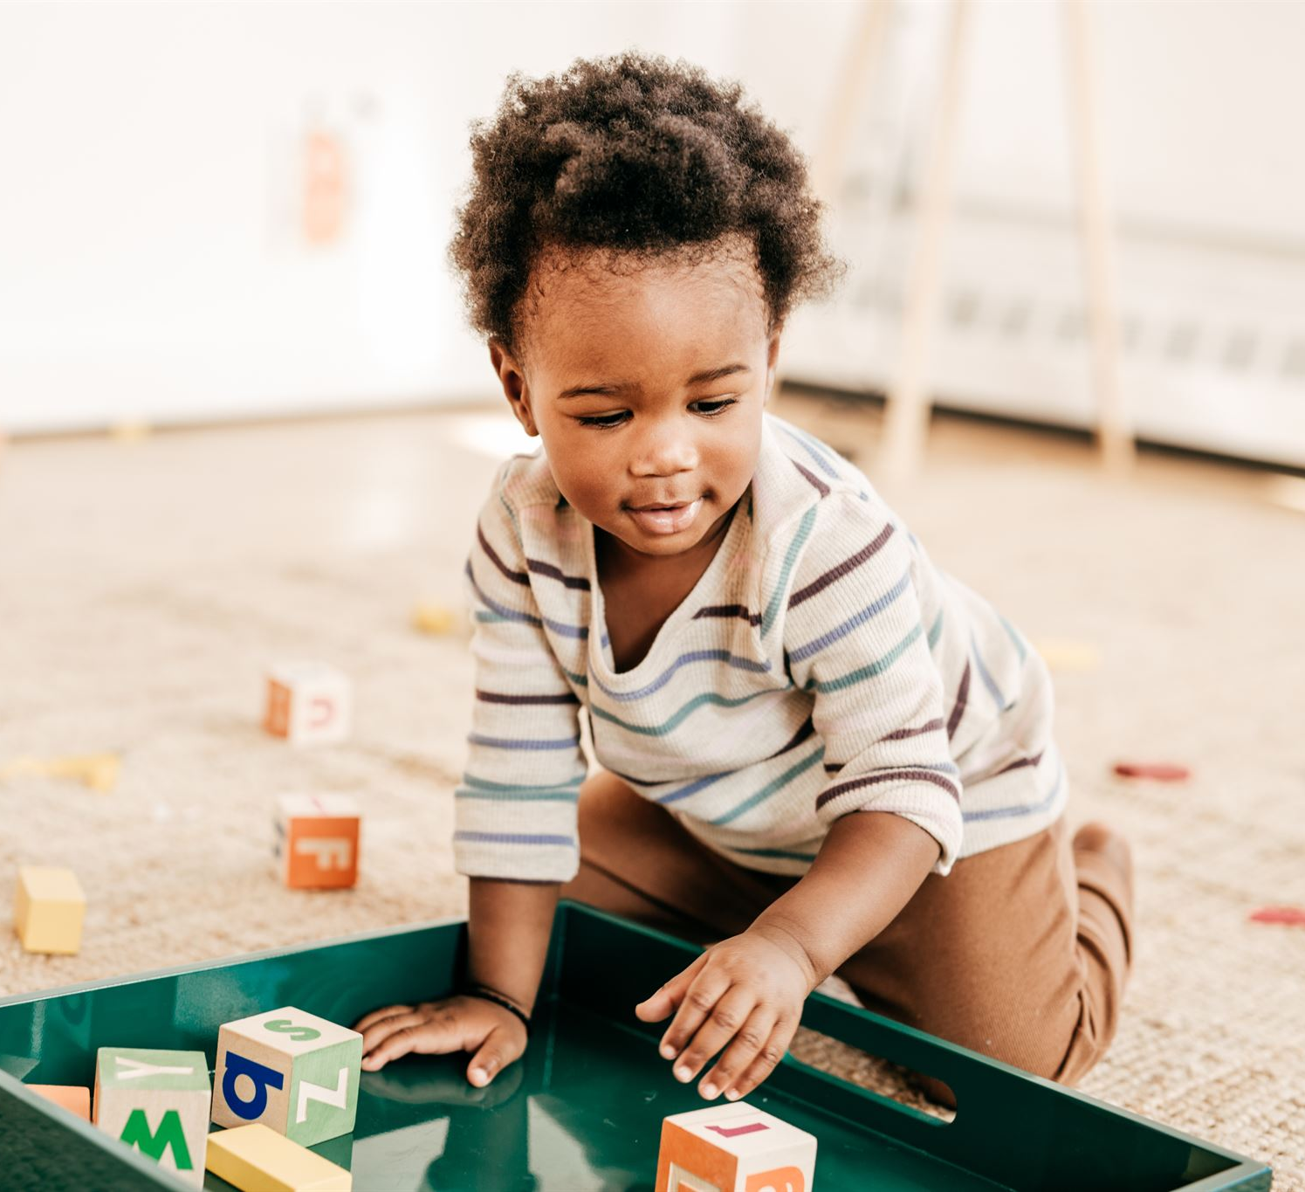
Importance of Play-Based Exploration
Natural Learning Through Play
  Play enables toddlers to naturally explore and learn about their environment in an engaging way.
Development of Problem-Solving
  Exploration through play helps children develop critical problem-solving and experimentation skills.
Building Creativity and Social Understanding
  Play fosters creativity and social skills by encouraging interaction and imaginative thinking.
Notes:
---
Play is a natural way for toddlers to learn. Through exploration and experimentation, children develop problem-solving skills, creativity, and social understanding in a supportive environment.
Image source: Microsoft 365 content library

Slide 6
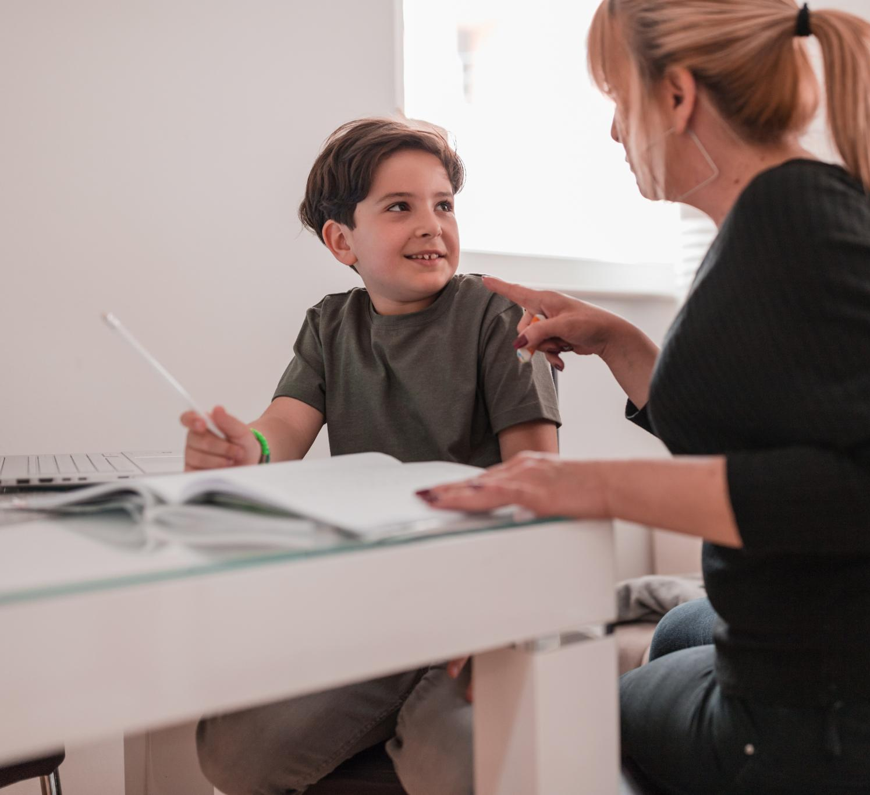
Role of Secure Relationships in Learning
Foundation of Trust and Safety
  Secure attachments between toddlers and caregivers build essential trust and promote a sense of safety.
Encouragement to Explore
  Secure relationships motivate toddlers to confidently explore their surroundings and learn actively.
Social Engagement
  Strong attachments support toddlers in engaging positively with other people and building social skills.
Notes:
---
Secure attachments with caregivers provide a foundation of trust and safety. These relationships encourage toddlers to explore their environment and engage with others confidently.
Image source: Microsoft 365 content library

Slide 7
Learning with Peers: Social and Emotional Growth
Notes:
Peer interaction during toddlerhood promotes social skills and emotional regulation. This section focuses on the types of play and early social competencies developing in this stage.

Slide 8
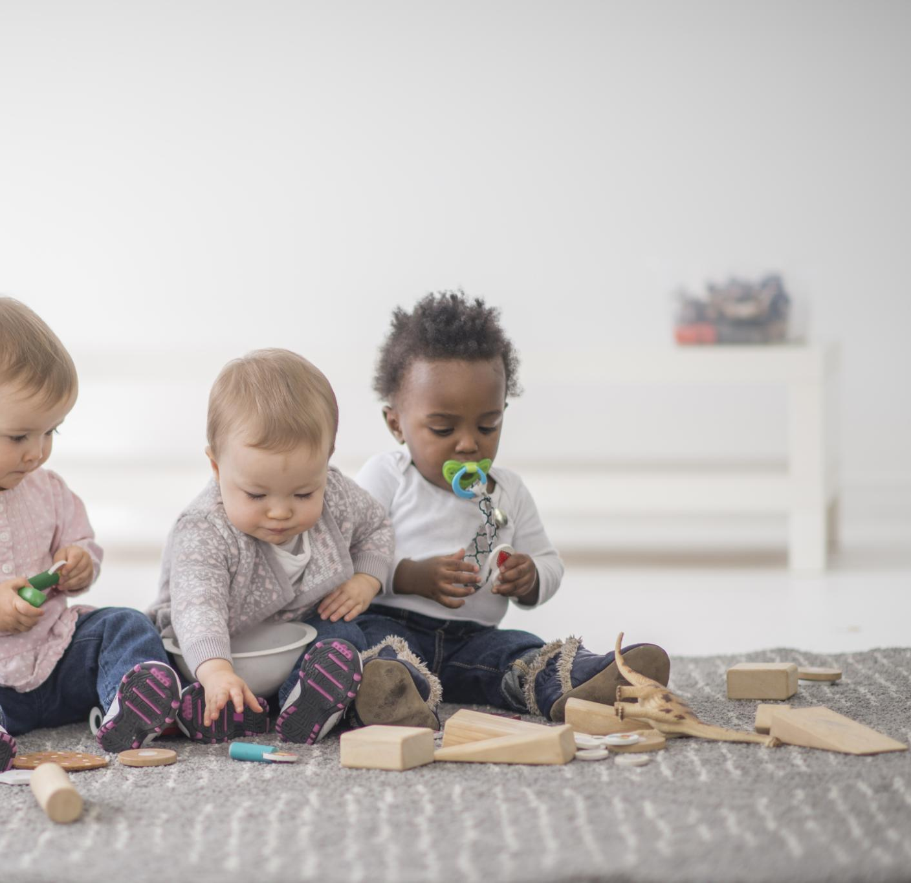
Emergence of Parallel and Cooperative Play
Parallel Play
  Toddlers play alongside each other without direct interaction, developing awareness of peers.
Cooperative Play
  Children engage together in shared activities, fostering collaboration and communication skills.
Notes:
---
Toddlers begin with parallel play, playing alongside peers without direct interaction, and gradually engage in cooperative play, which fosters collaboration and communication skills.
Image source: Microsoft 365 content library

Slide 9
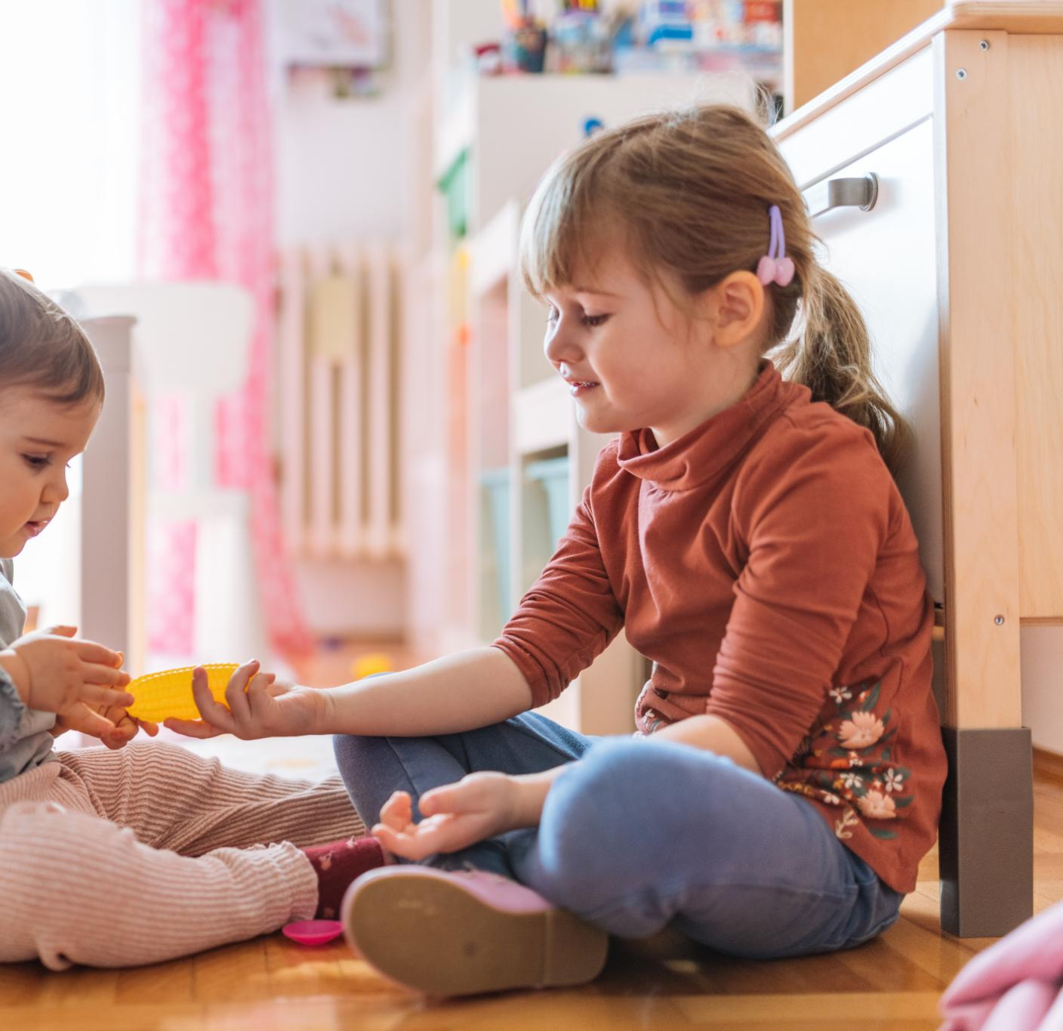
Foundational Skills in Sharing and Turn-Taking
Importance of Sharing
  Sharing helps toddlers develop empathy and cooperation essential for social growth and positive interactions.
Learning Turn-Taking
  Turn-taking teaches toddlers patience and respect, reinforcing understanding of social norms and fairness.
Notes:
---
Sharing and turn-taking are critical early social skills. Toddlers learn these through guided interactions, helping them understand social norms and build positive relationships.
Image source: Microsoft 365 content library

Slide 10
Early Signs of Empathy and Social Communication
Recognition of Feelings
Toddlers begin to recognize and respond to others' emotions, an early sign of empathy development.
Nonverbal Communication
Gestures and facial expressions become key tools for toddlers to communicate socially during this stage.
Simple Language Use
Toddlers begin using basic words to express themselves and engage in social communication.
Notes:
---
During this period, toddlers start showing empathy by recognizing others' feelings and practicing social communication through gestures, facial expressions, and simple language.
Image source: Microsoft 365 content library

Slide 11
Recent Milestones and Breakthroughs in Brain Development Research
Notes:
Neuroscience research sheds light on brain plasticity and the effects of early experiences. This section discusses critical periods, the role of peer interaction, and advances in understanding self-regulation.

Slide 12

Critical Periods of Neural Plasticity
Early Childhood Adaptability
  During early childhood, the brain exhibits heightened adaptability, making it a critical period for development.
Experience Shapes Neural Pathways
  Experiences in critical periods influence the formation and strengthening of neural pathways essential for learning.
Lifelong Learning Impact
  Neural plasticity during critical periods affects lifelong learning, behavior, and cognitive functions.
Notes:
---
Early childhood is marked by critical periods when the brain is especially adaptable. Experiences during this time shape neural pathways that influence lifelong learning and behavior.
Image source: Microsoft 365 content library

Slide 13
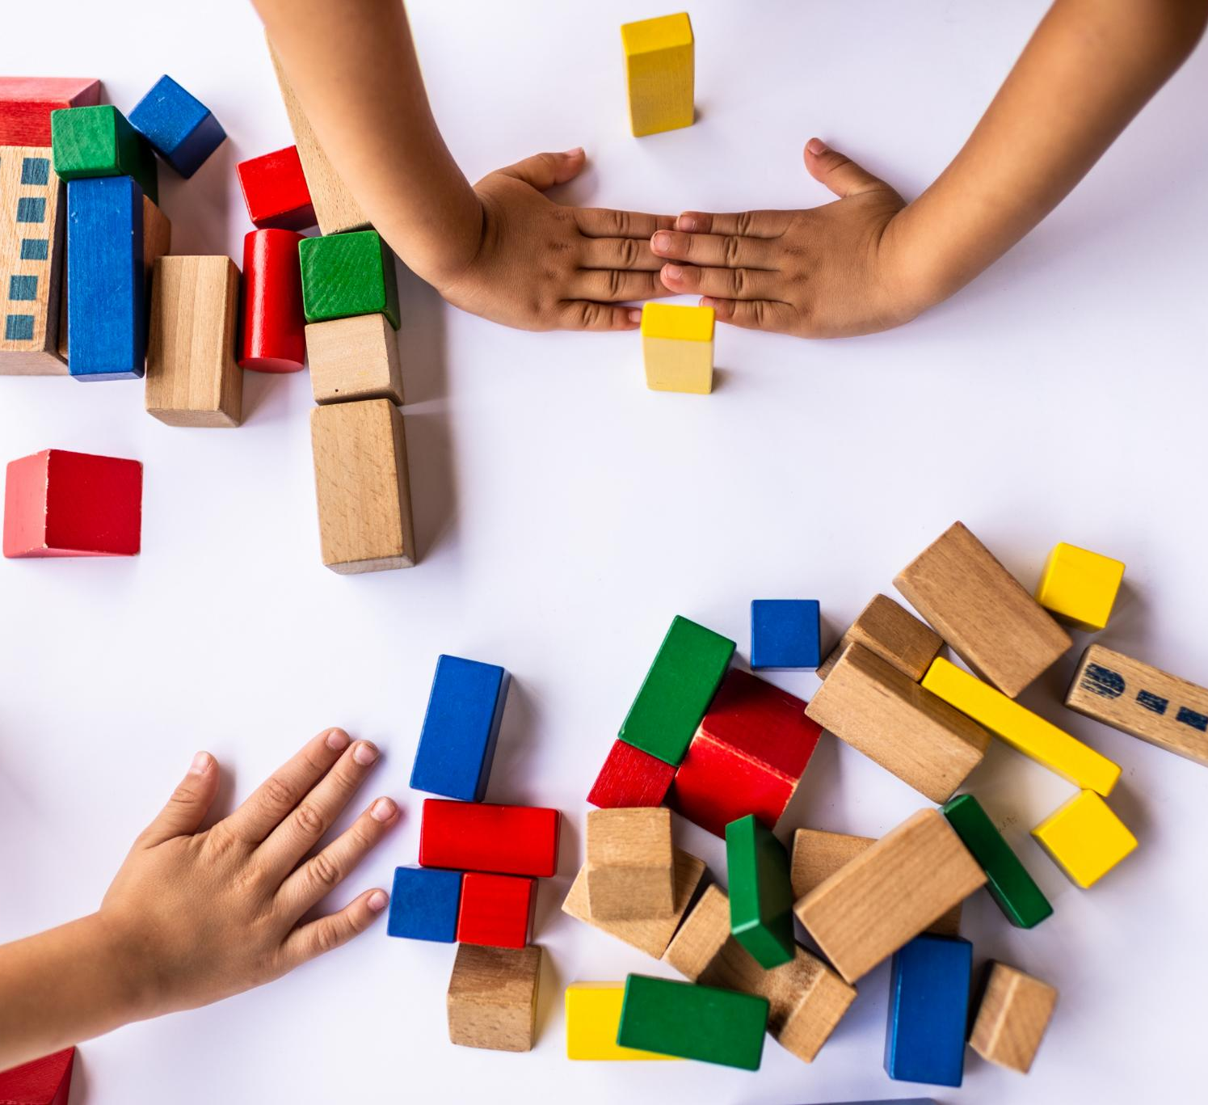
Influence of Peer Interaction on Cognitive Growth
Peer Interaction Stimulates Thinking
  Interacting with peers promotes critical thinking and problem-solving abilities vital for cognitive growth.
Enhancement of Language Skills
  Peer communication nurtures language development and improves expressive and receptive skills.
Perspective-Taking Development
  Collaboration with peers fosters understanding of different viewpoints and social reasoning.
Notes:
---
Engaging with peers stimulates cognitive development by encouraging problem-solving, language skills, and perspective-taking essential for intellectual growth.
Image source: Microsoft 365 content library

Slide 14
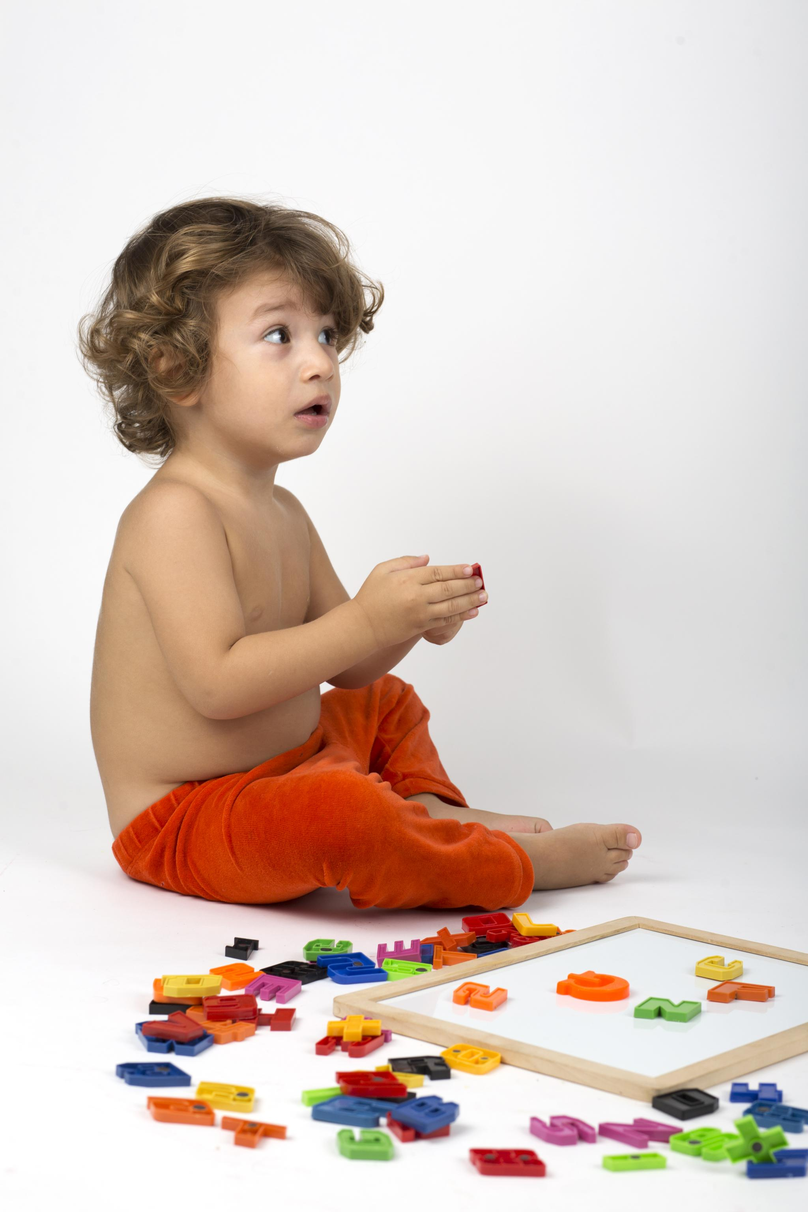
Advances in Understanding Self-Regulation Development
Development of Self-Regulation
  Toddlers develop essential self-regulation skills that help them control emotions and behaviors effectively.
Social Success
  Self-regulation supports toddlers in interacting positively with peers and adults, fostering social success.
Academic Readiness
  Strong self-regulation skills prepare toddlers for academic challenges by aiding focus and task management.
Notes:
---
Recent studies highlight how toddlers develop self-regulation skills, including managing emotions and behaviors, which are crucial for social success and academic readiness.
Image source: Microsoft 365 content library

Slide 15
Parent-Centered Approaches and the Interactive Effect
Notes:
Parents play a pivotal role in early learning through responsive caregiving and fostering peer engagement. This section explores strategies for effective partnerships between parents and educators.

Slide 16

Responsive Caregiving and Modeling Behavior
Recognizing Toddler Cues
  Responsive caregiving means attentively noticing and understanding toddlers' signals and needs.
Modeling Positive Behavior
  Parents demonstrate positive actions that toddlers imitate to promote social and emotional skills.
Reinforcing Social Learning
  Imitating modeled behavior helps toddlers develop strong social and emotional learning foundations.
Notes:
---
Responsive caregiving involves recognizing and responding to toddlers' cues. Parents model positive behaviors that children imitate, reinforcing social and emotional learning.
Image source: Microsoft 365 content library

Slide 17
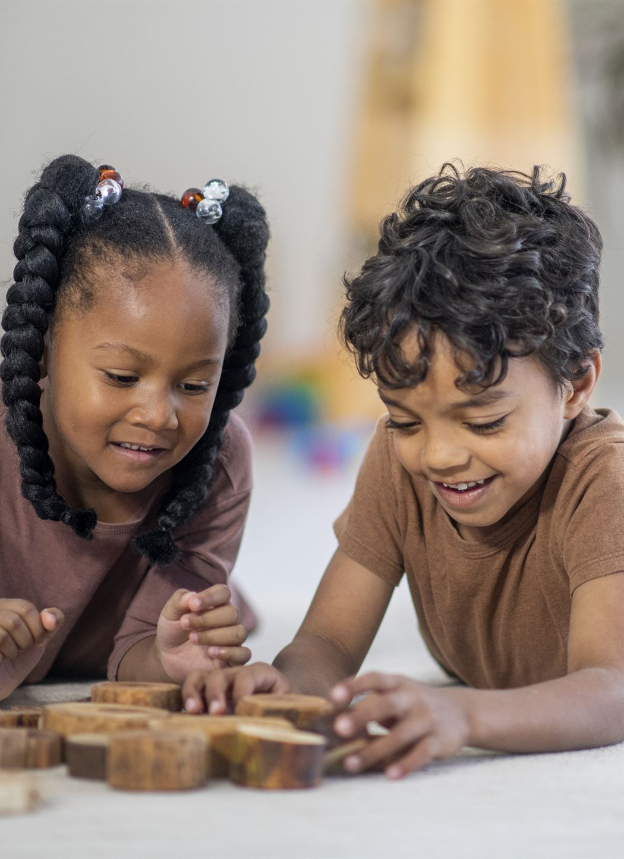
Strategies for Fostering Peer Engagement
Arranging Playdates
  Parents can foster peer engagement by organizing playdates for children to interact in a friendly environment.
Guidance in Social Situations
  Parents guide children through social situations to help them navigate interactions and build confidence.
Teaching Sharing and Cooperation
  Teaching children to share and cooperate promotes positive social development and peer relationships.
Notes:
---
Parents can encourage peer interactions by arranging playdates, guiding social situations, and teaching sharing and cooperation to support social development.
Image source: Microsoft 365 content library

Slide 18
Collaborative Partnerships Between Parents and Educators
Collaboration Importance
Collaboration between parents and educators strengthens early learning and supports toddler development effectively.
Sharing Observations
Sharing observations about the toddler helps tailor educational strategies to meet developmental needs consistently.
Consistent Support
Consistent support from both families and educators fosters a nurturing environment for toddler growth.
Notes:
---
Effective early learning involves collaboration between families and educators. Sharing observations and strategies ensures consistent support for the toddler's developmental needs.
Image source: Microsoft 365 content library

Slide 19
Conclusion
Critical Learning Period
The age between 24 and 36 months is vital for early learning and development.
Role of Peer Interaction
Interactions with peers significantly influence social and cognitive development in toddlers.
Supportive Parenting
Supportive parenting nurtures developmental milestones and promotes lifelong learning foundations.
Notes:
Early learning between 24 and 36 months is a critical period shaped by peer interactions, developmental milestones, and supportive parenting. Understanding these principles helps foster healthy growth and lifelong learning foundations.

