Slide 1
Principles of Early Learning for 24–36 Month-Olds: Motor Development, Milestones, and Brain Breakthroughs
Understanding toddler growth and parent-focused learning strategies
Notes:
---
This presentation explores key principles of early motor development in toddlers aged 24 to 36 months, highlighting important milestones and recent breakthroughs in brain development. We will also discuss parent-centered approaches that support optimal learning and development.

Slide 2
Meeting Program
Key Principles of Early Motor Development for Toddlers
Current Research Milestones and Brain Development Breakthroughs
Parent-Centered Approaches and Interactive Effects
Notes:
We will cover three main sections: key principles of early motor development, current research on developmental milestones and brain growth, and parent-centered strategies that enhance learning through responsive caregiving and interactive routines.

Slide 3
Key Principles of Early Motor Development for Toddlers
Notes:
Understanding motor development in toddlers involves examining both gross and fine motor skills, the critical role of play and movement in learning, and theoretical perspectives such as Vygotsky's concept of guided participation.

Slide 4

Core Concepts in Gross and Fine Motor Skills
Gross Motor Skills
  Gross motor skills involve large muscle movements such as walking, jumping, and running that support mobility.
Fine Motor Skills
  Fine motor skills include precise actions like grasping small objects and drawing, crucial for hand-eye coordination.
Importance for Development
  Mastery of motor skills is vital for toddlers’ independence and supports cognitive and physical development.
Notes:
---
Gross motor skills include large movements like walking and jumping, while fine motor skills involve precise actions like grasping and drawing. Mastery of these skills is essential for toddlers’ independence and cognitive development.
Image source: Microsoft 365 content library

Slide 5

Importance of Play and Movement in Learning
Motor Skill Development
  Play and movement are essential for developing toddlers' coordination and balance skills naturally.
Cognitive Growth Through Play
  Active play enhances toddlers' problem-solving abilities and supports cognitive growth in early childhood.
Notes:
---
Play and physical movement are vital for motor skill development and cognitive growth. Active engagement in play helps toddlers practice coordination, balance, and problem-solving abilities in a natural context.
Image source: Microsoft 365 content library

Slide 6
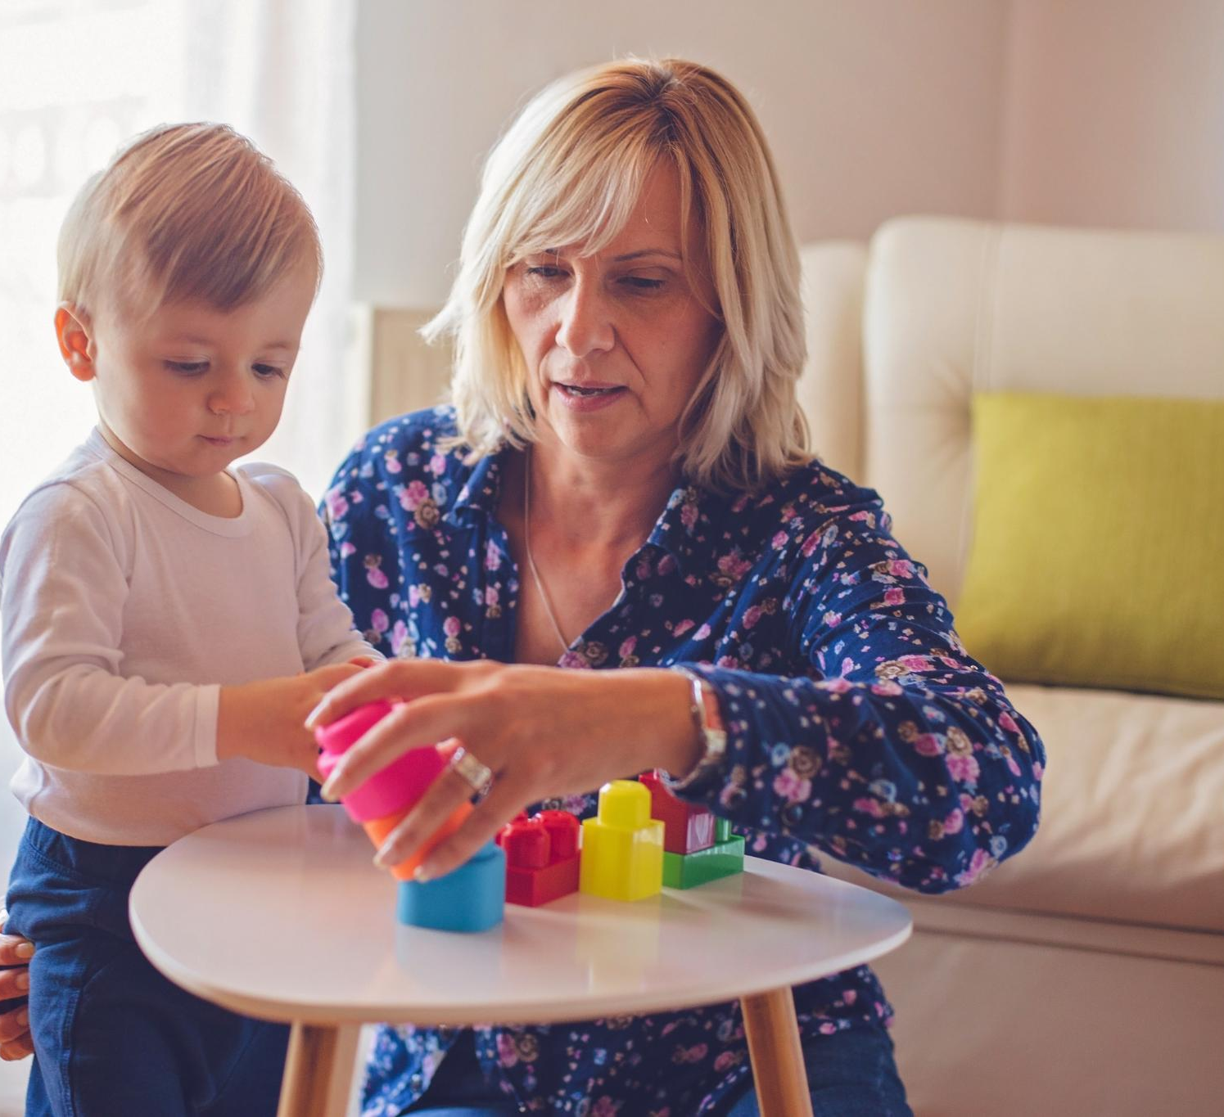
Vygotskian Perspectives on Guided Participation
Guided Participation Concept
  Guided participation involves adults supporting children in tasks slightly beyond their current skill level.
Role of Social Interaction
  Learning occurs through social interaction where caregivers scaffold children's understanding and skills.
Scaffolding Support
  Scaffolding provides temporary support helping toddlers achieve tasks they cannot do alone yet.
Notes:
---
Vygotsky's theory emphasizes guided participation, where caregivers support toddlers in tasks just beyond their current abilities, fostering learning through social interaction and scaffolding.
Image source: Microsoft 365 content library

Slide 7
Current Research Milestones and Brain Development Breakthroughs
Notes:
Recent studies reveal important milestones in toddler development and significant progress in understanding brain growth and neural connectivity shaped by experience and environment.

Slide 8

Recent Findings in Toddler Developmental Milestones
Motor Skill Development
  Toddlers typically develop motor skills such as walking and fine motor coordination within specific age ranges.
Language Milestones
  Language development includes babbling, first words, and early sentence formation around expected ages.
Social Interaction
  Social milestones involve toddlers engaging in play, showing empathy, and responding to social cues.
Notes:
---
Research highlights typical timelines for motor, language, and social milestones in toddlers, helping caregivers and educators identify age-appropriate developmental progress.
Image source: Microsoft 365 content library

Slide 9

Breakthroughs in Brain Growth and Neural Connectivity
Rapid Brain Growth
  Neuroscience reveals rapid brain development during toddlerhood, critical for cognitive and emotional growth.
Increased Neural Connections
  Neural connections multiply in toddler brains, forming the foundation for learning and behavior regulation.
Notes:
---
Advances in neuroscience show rapid brain growth during toddlerhood, with increasing neural connections that support learning capacities and behavioral regulation.
Image source: Microsoft 365 content library

Slide 10
Role of Experience and Environment in Brain Shaping
Early Experiences Impact
Early life experiences significantly influence the development and structure of the brain during critical periods.
Enriched Environments Role
Stimulating and responsive environments promote healthy brain architecture and cognitive growth.
Responsive Caregiving Importance
Responsive caregiving provides emotional support essential for healthy brain development in sensitive periods.
Notes:
---
Early experiences and enriched environments play a crucial role in shaping brain architecture, emphasizing the need for stimulating, responsive caregiving during this sensitive period.
Image source: Microsoft 365 content library

Slide 11
Parent-Centered Approaches and Interactive Effects
Notes:
Parents and caregivers are central to supporting toddler development through responsive caregiving, scaffolding learning, and engaging in interactive routines that promote co-regulation.

Slide 12

Responsive Caregiving and Relationship-Based Strategies
Attuned Interactions
  Responsive caregiving requires caregivers to be sensitive and responsive to toddlers' needs and cues.
Secure Attachment Development
  Sensitive caregiving fosters secure attachments, providing toddlers with emotional safety and trust.
Social-Emotional Growth
  Relationship-based strategies promote toddlers’ social skills and emotional regulation through nurturing care.
Cognitive Development Support
  Responsive caregiving encourages cognitive development by providing stimulating and supportive experiences.
Notes:
---
Responsive caregiving involves attuned, sensitive interactions that build secure attachments and foster social-emotional and cognitive growth in toddlers.
Image source: Microsoft 365 content library

Slide 13

Parental Involvement in Scaffolding Learning
Tailored Support
  Parents provide assistance that matches the toddler's current developmental needs to promote effective learning.
Gradual Independence
  Parental scaffolding gradually reduces support as toddlers gain confidence and skills, fostering independence.
Notes:
---
Active parental involvement in scaffolding helps toddlers master new skills by providing support tailored to their developmental level and gradually increasing independence.
Image source: Microsoft 365 content library

Slide 14

Interactive Routines and Co-Regulation
Importance of Structured Routines
  Structured daily routines provide toddlers with predictable environments that support emotional security and learning growth.
Role of Co-Regulation
  Co-regulation involves caregivers helping toddlers manage emotions, fostering self-regulation and healthy development.
Enhancing Learning Skills
  Combining routines with co-regulation techniques promotes learning and self-regulation skills essential for childhood growth.
Notes:
---
Structured daily routines and co-regulation—where caregivers help toddlers manage emotions—enhance learning and self-regulation skills critical for healthy development.
Image source: Microsoft 365 content library

Slide 15
Conclusion
Early Motor Development
Motor skills in toddlers develop through play and exploration, supporting physical and cognitive growth.
Guided Learning
Guided learning helps toddlers achieve developmental milestones through structured and supportive activities.
Parent-Centered Approaches
Parent involvement and responsive caregiving foster brain development and lifelong learning foundations.
Notes:
Early motor development, milestones, and brain breakthroughs highlight the importance of play, guided learning, and parent-centered approaches. Together, these principles create a strong foundation for toddlers’ lifelong growth and learning.

