Slide 1
Principles of Early Language Learning for 24-36 Months: Insights From Current Research and Brain Development
Foundations of toddler language growth and brain insights
Notes:
---
This presentation explores foundational principles of language development in toddlers aged 24 to 36 months, integrating recent research findings and understanding of brain development during this critical stage.

Slide 2
Today's Agenda
Core Principles of Language Development in Toddlers
Milestones in Language Development: What Current Research Reveals
Breakthroughs in Toddler Brain Development
Parent-Centered Approaches and Interactive Effects
Notes:
We will cover four key areas: core principles of language development in toddlers, milestones in language growth backed by current research, breakthroughs in toddler brain development related to language acquisition, and parent-centered approaches that enhance language learning.

Slide 3
Core Principles of Language Development in Toddlers
Notes:
Understanding how toddlers develop language is essential. This section focuses on responsive interactions, the role of play, and scaffolding methods inspired by Vygotskian theory that support early language learning.

Slide 4

Understanding Responsive Interactions and Relationship-Based Learning
Responsive Interactions
  Adults attentively respond to toddler cues to foster meaningful communication and connection.
Relationship-Based Learning
  Secure bonds built on trust and shared attention support toddler language development.
Notes:
---
Responsive interactions involve adults tuning into toddler cues and engaging in meaningful communication. Relationship-based learning emphasizes building secure bonds that facilitate language growth through trust and shared attention.
Image source: Microsoft 365 content library

Slide 5

The Importance of Play in Fostering Language Growth
Language Experimentation
  Play offers toddlers a natural setting to try out new words and develop early communication skills.
Creativity and Social Interaction
  Engaging in play fosters creativity and social skills essential for language acquisition in young children.
Notes:
---
Play provides a natural context for toddlers to experiment with language, practice new words, and develop communication skills. It encourages creativity and social interaction, which are vital for language acquisition.
Image source: Microsoft 365 content library

Slide 6

Scaffolding and Guided Participation as Outlined by Vygotskian Theory
Tailored Support by Caregivers
  Caregivers provide assistance matching the child’s current abilities to facilitate learning progress.
Gradual Increase in Complexity
  Challenges are gradually increased to help the child develop new skills independently over time.
Promotion of Independent Language Use
  Scaffolding promotes children’s ability to use language independently within social interactions.
Notes:
---
Vygotskian theory highlights scaffolding where caregivers provide support tailored to the child’s current abilities, gradually increasing complexity to promote independent language use within social interactions.
Image source: Microsoft 365 content library

Slide 7
Milestones in Language Development: What Current Research Reveals
Notes:
Research details typical language milestones for toddlers, emphasizing vocabulary expansion, sentence formation, listening skills, expressive language, and emerging social communication capabilities.

Slide 8
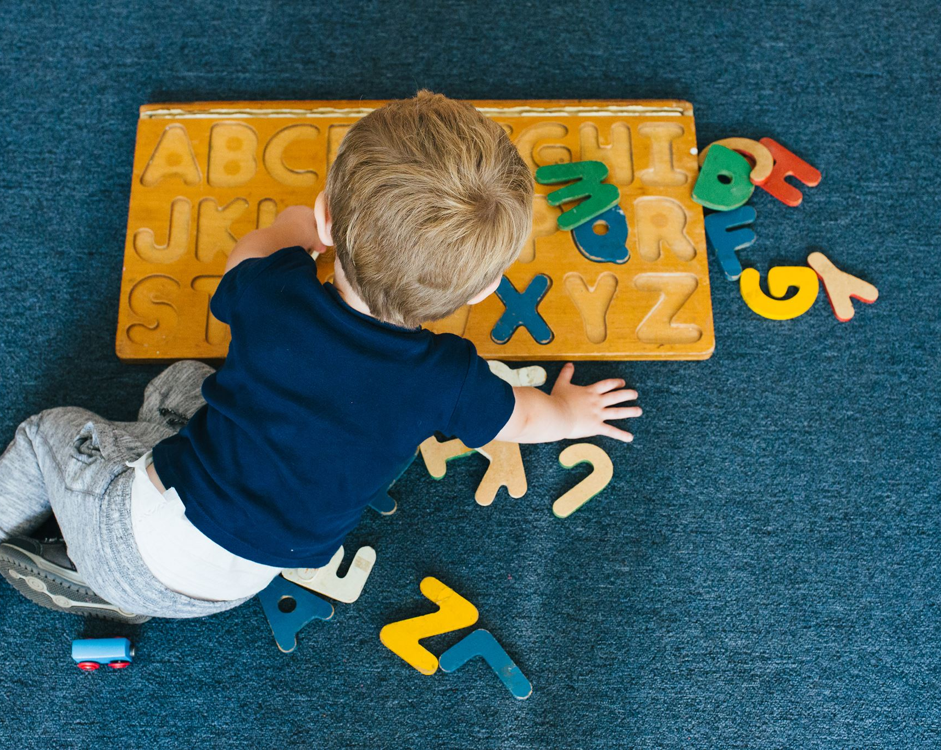
Typical Vocabulary Growth and Sentence Formation
Rapid Vocabulary Increase
  Toddlers rapidly expand their vocabulary between ages 2 and 3, learning many new words quickly.
Simple Sentence Formation
  Children begin combining words into simple sentences, marking early language development milestones.
Notes:
---
Between 24 to 36 months, toddlers rapidly increase their vocabulary and begin combining words into simple sentences, laying the foundation for more complex language structures.
Image source: Microsoft 365 content library

Slide 9

Emerging Skills in Listening and Expressive Language
Listening Skill Development
  Toddlers enhance their listening skills to better understand instructions and stories in their environment.
Expressive Language Improvement
  Expressive language grows through toddlers' trial, imitation, and feedback from adults.
Notes:
---
Toddlers develop enhanced listening skills allowing them to understand instructions and stories, while their expressive language improves through trial, imitation, and adult feedback.
Image source: Microsoft 365 content library

Slide 10

Indicators of Social Communication and Self-Regulation
Social Communication Milestones
  Toddlers use language to interact and express needs effectively in social settings.
Self-Regulation Development
  Growing self-regulation skills help toddlers manage emotions and maintain conversations smoothly.
Notes:
---
Social communication milestones include using language to interact with others and express needs, with growing self-regulation skills helping toddlers manage emotions and maintain conversations.
Image source: Microsoft 365 content library

Slide 11
Breakthroughs in Toddler Brain Development
Notes:
This section delves into how neural pathways form during language acquisition, the cognitive benefits of play, and the critical periods of brain plasticity that support early learning.

Slide 12

Neural Pathways Forming During Language Acquisition
Rapid Neural Development
  Language learning triggers rapid growth of neural connections in critical brain regions during toddlerhood.
Brain Adaptability
  The brain shows high adaptability in processing and producing language during early childhood development.
Notes:
---
Language learning coincides with rapid development of neural connections in brain regions responsible for processing and producing language, highlighting the brain's adaptability during toddlerhood.
Image source: Microsoft 365 content library

Slide 13

Role of Play and Exploration in Cognitive Growth
Brain Stimulation through Play
  Exploratory play activates brain areas responsible for problem-solving and communication development.
Language Skill Reinforcement
  Engaging with varied sensory experiences during play strengthens children's language and communication skills.
Notes:
---
Exploratory play stimulates brain regions involved in problem-solving and communication, reinforcing language skills through engagement with diverse sensory experiences.
Image source: Microsoft 365 content library

Slide 14

Critical Periods and Plasticity in Early Childhood
Brain Plasticity in Early Childhood
  Early childhood features heightened brain plasticity, enabling significant neural changes and learning.
Language Exposure Importance
  Exposure to language during this critical period profoundly affects long-term language skills and communication.
Notes:
---
Early childhood is marked by heightened brain plasticity, making it a critical period during which language exposure and interaction have profound impacts on long-term language abilities.
Image source: Microsoft 365 content library

Slide 15
Parent-Centered Approaches and Interactive Effects
Notes:
Effective strategies for parents include responsive parenting, establishing interactive routines, and supporting toddlers through behavioral challenges to foster optimal language development.

Slide 16

Strategies for Responsive Parenting in Language Learning
Observing Child’s Cues
  Responsive parenting starts with carefully observing the child’s verbal and nonverbal signals for effective communication.
Prompt and Meaningful Responses
  Timely and relevant responses from parents foster language practice and boost emotional bonding with the child.
Creating Language Opportunities
  Parents create rich language learning experiences by encouraging dialogue and interactive play.
Notes:
---
Responsive parenting involves observing and responding to a child’s cues promptly and meaningfully, creating rich opportunities for language practice and emotional connection.
Image source: Microsoft 365 content library

Slide 17

Interactive Routines and Their Impact on Development
Consistent Language Input
  Regular routines offer predictable language exposure, enriching vocabulary and communication skills over time.
Learning Through Repetition
  Repetitive interactions during daily tasks reinforce understanding and retention of language concepts.
Contextual Learning
  Embedding language in everyday routines helps children connect words with meaningful contexts.
Notes:
---
Regular, predictable routines such as shared reading and conversation during daily activities provide consistent language input and reinforce learning through repetition and context.
Image source: Microsoft 365 content library

Slide 18

Supporting Children Through Challenging Behaviors
Understanding Toddler Behavior
  Toddlers often use behavior to express frustration or difficulty when communication is limited.
Supportive Adult Responses
  Patience and guidance from adults create positive communication environments for toddlers.
Promoting Language Growth
  Positive communication fosters language development during early childhood challenges.
Notes:
---
Toddlers may express frustration or difficulty through behavior. Supportive responses that combine patience and guidance help maintain positive communication environments conducive to language growth.
Image source: Microsoft 365 content library

Slide 19
Conclusion
Responsive Interactions
Responsive interactions with toddlers significantly influence their language acquisition and communication skills development.
Role of Play
Play activities stimulate brain development and encourage toddlers to practice and develop language skills naturally.
Parental Engagement
Active parental involvement nurtures toddlers’ communication abilities and supports early language milestones.
Notes:
Early language learning between 24 and 36 months is shaped by responsive interactions, play, brain development, and parent engagement. Understanding these principles equips caregivers to nurture toddlers’ communication skills effectively.

