Slide 1
Principles of Early Learning for 24–36 Months: Cognitive Development, Key Milestones, and the Role of Parents
Understanding toddler growth through cognitive milestones and parenting
Notes:
---
This presentation focuses on the essential principles guiding early learning in toddlers aged 24 to 36 months. We will explore cognitive development, key developmental milestones, and how parents play a critical role in nurturing young children's growth.

Slide 2
Presentation Agenda
Core Principles of Cognitive Development in Toddlers (24–36 Months)
Developmental Milestones and Insights From Current Research
Parent-Centered Approaches to Fostering Early Learning
Interactive Effects: The Toddler, Parent, and Environment
Notes:
We will cover core principles of cognitive development in toddlers, review developmental milestones supported by current research, discuss parent-centered approaches to foster learning, and examine the interactive effects of the toddler, parent, and environment on early development.

Slide 3
Core Principles of Cognitive Development in Toddlers (24–36 Months)
Notes:
During the toddler years, rapid cognitive growth occurs as children expand their thinking and understanding of the world through play, language, and problem-solving activities.

Slide 4

The Role of Play in Cognitive Growth
Exploration Through Play
  Play motivates toddlers to explore their environment, enhancing sensory and cognitive experiences.
Imagination and Learning
  Imaginative play promotes creative thinking and problem-solving in early childhood development.
Neural and Critical Skill Growth
  Hands-on play fosters neural connections and critical thinking skills essential for cognitive growth.
Notes:
---
Play is fundamental for toddlers’ cognitive development. It encourages exploration, imagination, and learning through hands-on experience, fostering neural connections and critical thinking skills.
Image source: Microsoft 365 content library

Slide 5

Language Acquisition and Symbolic Thought
Rapid Language Development
  Toddlers rapidly acquire language skills between 24 and 36 months, enhancing communication abilities.
Symbolic Thinking Emergence
  Children begin to use symbols to represent objects and ideas, marking key cognitive growth.
Notes:
---
Between 24 and 36 months, toddlers develop language rapidly and begin to use symbols to represent objects and ideas. This symbolic thinking is a crucial step in cognitive development.
Image source: Microsoft 365 content library

Slide 6

Emergence of Problem-Solving Skills
Experimentation with Objects
  Toddlers explore and manipulate objects to discover how things work around them.
Learning Cause-and-Effect
  Children learn how their actions produce specific results through observation and interaction.
Trial and Error Method
  Using repeated attempts, toddlers find solutions and understand problem-solving processes.
Notes:
---
Toddlers start to demonstrate problem-solving abilities by experimenting with objects and actions, learning cause-and-effect relationships, and using trial and error to find solutions.
Image source: Microsoft 365 content library

Slide 7
Developmental Milestones and Insights From Current Research
Notes:
Understanding typical milestones and recent scientific findings helps caregivers support healthy brain development and recognize individual variation in toddlers' growth.

Slide 8

Standard Cognitive Milestones (Memory, Attention, Reasoning)
Memory Development
  Toddlers enhance their ability to retain and recall information, improving memory retention.
Attention Span Growth
  Sustained attention improves as toddlers focus longer on tasks and activities.
Emerging Reasoning
  Early reasoning skills appear as toddlers solve simple problems and make connections.
Notes:
---
Toddlers between 24 and 36 months typically show improvements in memory retention, sustained attention, and early reasoning skills that lay the groundwork for later learning.
Image source: Microsoft 365 content library

Slide 9

Recent Findings on Brain Development Breakthroughs
Synaptic Growth and Pruning
  Brain development involves rapid synaptic growth followed by pruning to optimize neural connections for efficient function.
Role of Environment
  Enriched and supportive environments significantly enhance optimal brain development during critical growth periods.
Notes:
---
Contemporary research highlights the rapid synaptic growth and pruning during this period, emphasizing the importance of enriched and supportive environments for optimal brain development.
Image source: Microsoft 365 content library

Slide 10

Impact of Experiences on Neural Connections
Formative Years Influence
  Experiences in early life shape the formation and strength of neural pathways in the brain.
Positive Interaction Effects
  Positive stimulation and interactions enhance neural connections, boosting cognitive abilities.
Notes:
---
Experiences during these formative years significantly influence neural pathways. Positive interactions and stimulation strengthen connections, enhancing cognitive capacities.
Image source: Microsoft 365 content library

Slide 11
Parent-Centered Approaches to Fostering Early Learning
Notes:
Parents play a pivotal role by providing responsive caregiving, creating interactive routines, and supporting toddlers’ self-regulation and positive behavior development.

Slide 12

Responsive Caregiving and Secure Attachment
Sensitive Caregiving
  Responsive and attuned caregiving supports toddlers’ emotional needs and builds trust.
Secure Attachment Importance
  Secure attachments are crucial for toddlers’ emotional security and enable confident exploration.
Notes:
---
Attuned and sensitive caregiving fosters secure attachments, which are essential for toddlers’ emotional security and cognitive exploration.
Image source: Microsoft 365 content library

Slide 13

Interactive Routines and Enriching Environments
Engagement Through Routine
  Interactive daily routines promote toddler engagement and stimulate curiosity essential for learning.
Exploration and Learning
  Enriching environments encourage exploration, fostering cognitive and social-emotional development in toddlers.
Notes:
---
Daily routines that encourage engagement, exploration, and learning create enriching environments that support toddlers’ cognitive and social-emotional growth.
Image source: Microsoft 365 content library

Slide 14

Supporting Self-Regulation and Positive Behavior
Importance of Self-Regulation
  Helping toddlers manage emotions builds crucial self-regulation skills that support learning and social success.
Positive Behavior Support
  Encouraging positive behavior in toddlers promotes healthy social interactions and emotional development.
Notes:
---
Guiding toddlers to manage emotions and behaviors helps develop important self-regulation skills, contributing to successful learning and social interactions.
Image source: Microsoft 365 content library

Slide 15
Interactive Effects: The Toddler, Parent, and Environment
Notes:
The dynamic interplay between toddler characteristics, parenting behaviors, and environmental contexts shapes cognitive and emotional development in early childhood.

Slide 16
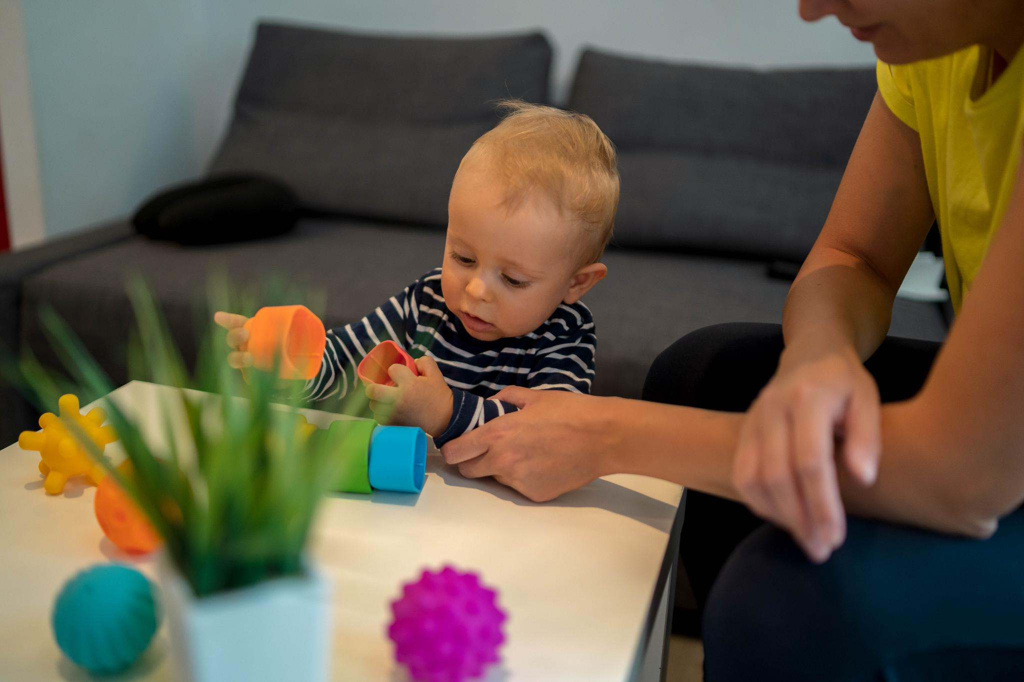
How Parent-Child Interactions Shape Development
Nurturing Interactions
  Consistent and loving parent-child interactions build a secure environment for toddler development.
Language Development
  Engaging toddlers in conversations promotes early language skills and communication abilities.
Encouraging Curiosity
  Supportive interactions stimulate toddlers’ natural curiosity and desire to explore their environment.
Problem-Solving Skills
  Parents fostering exploration help develop toddlers’ problem-solving and cognitive abilities.
Notes:
---
Consistent, nurturing interactions between parents and toddlers promote language development, curiosity, and problem-solving abilities.
Image source: Microsoft 365 content library

Slide 17

The Importance of Nurturing Relationships
Building Confidence
  Supportive relationships help toddlers develop strong self-confidence essential for learning.
Motivating Learning
  Nurturing bonds motivate toddlers to explore and engage actively in learning activities.
Fostering Resilience
  Strong relationships cultivate resilience and help toddlers adapt to challenges effectively.
Notes:
---
Strong, supportive relationships build toddlers’ confidence and motivation to learn, fostering resilience and adaptive skills.
Image source: Microsoft 365 content library

Slide 18

Collaborative Play and Guided Learning
Collaborative Play Importance
  Playing together fosters bonding and creates an engaging environment for toddler learning.
Scaffolding Learning
  Parents guide toddlers to discover new skills by supporting and extending play activities.
Notes:
---
Engaging in play and activities together allows parents to scaffold learning experiences, guiding toddlers to discover new concepts and skills effectively.
Image source: Microsoft 365 content library

Slide 19
Conclusion: Supporting Toddler Cognitive Growth Together
Role of Play
Play stimulates toddlers' brain development and encourages exploration and creativity essential for learning.
Responsive Parenting
Attentive and responsive parenting supports emotional security and cognitive milestones in early childhood.
Enriching Experiences
Providing varied and stimulating environments fosters curiosity and lifelong learning habits in toddlers.
Notes:
Early cognitive development is shaped by a combination of play, responsive parenting, and enriching experiences. By understanding these principles and milestones, parents and caregivers can provide a strong foundation for lifelong learning.

