Slide 1
Principles of Early Learning for 18-24 Months: Social-Emotional Growth, Attachment, and Breakthroughs in Brain Development
Understanding toddler development during critical early years
Notes:
---
This presentation explores key principles of early learning for toddlers aged 18 to 24 months, focusing on social-emotional growth, attachment development, and the latest discoveries in brain development during this critical period.

Slide 2
Agenda Overview
Core Principles of Early Learning for 18-24 Month-Olds
Social-Emotional and Attachment Development
Milestones and Breakthroughs in Brain Development
Parent-Centered Strategies and Interactive Effects
Notes:
We will cover core principles of early learning for toddlers, delve into social-emotional and attachment development, review milestones and breakthroughs in brain development, and discuss parent-centered strategies to support optimal growth.

Slide 3
Core Principles of Early Learning for 18-24 Month-Olds
Notes:
Understanding the foundational principles guiding early learning helps caregivers foster development in toddlers during this important stage, emphasizing active exploration, language emergence, and curiosity.

Slide 4
Active Exploration and Play-Based Learning
Active Exploration Benefits
Active exploration enhances toddlers' motor skills and cognitive development through hands-on interaction.
Play-Based Learning Impact
Play-based learning fosters engagement and meaningful discovery in early childhood education.
Social Understanding Growth
Through play, toddlers develop essential social skills and emotional understanding with peers.
Notes:
---
Toddlers learn best through active exploration and play, which build motor skills, cognitive abilities, and social understanding. Play-based learning encourages engagement and discovery in a natural and meaningful way.
Image source: Microsoft 365 content library

Slide 5
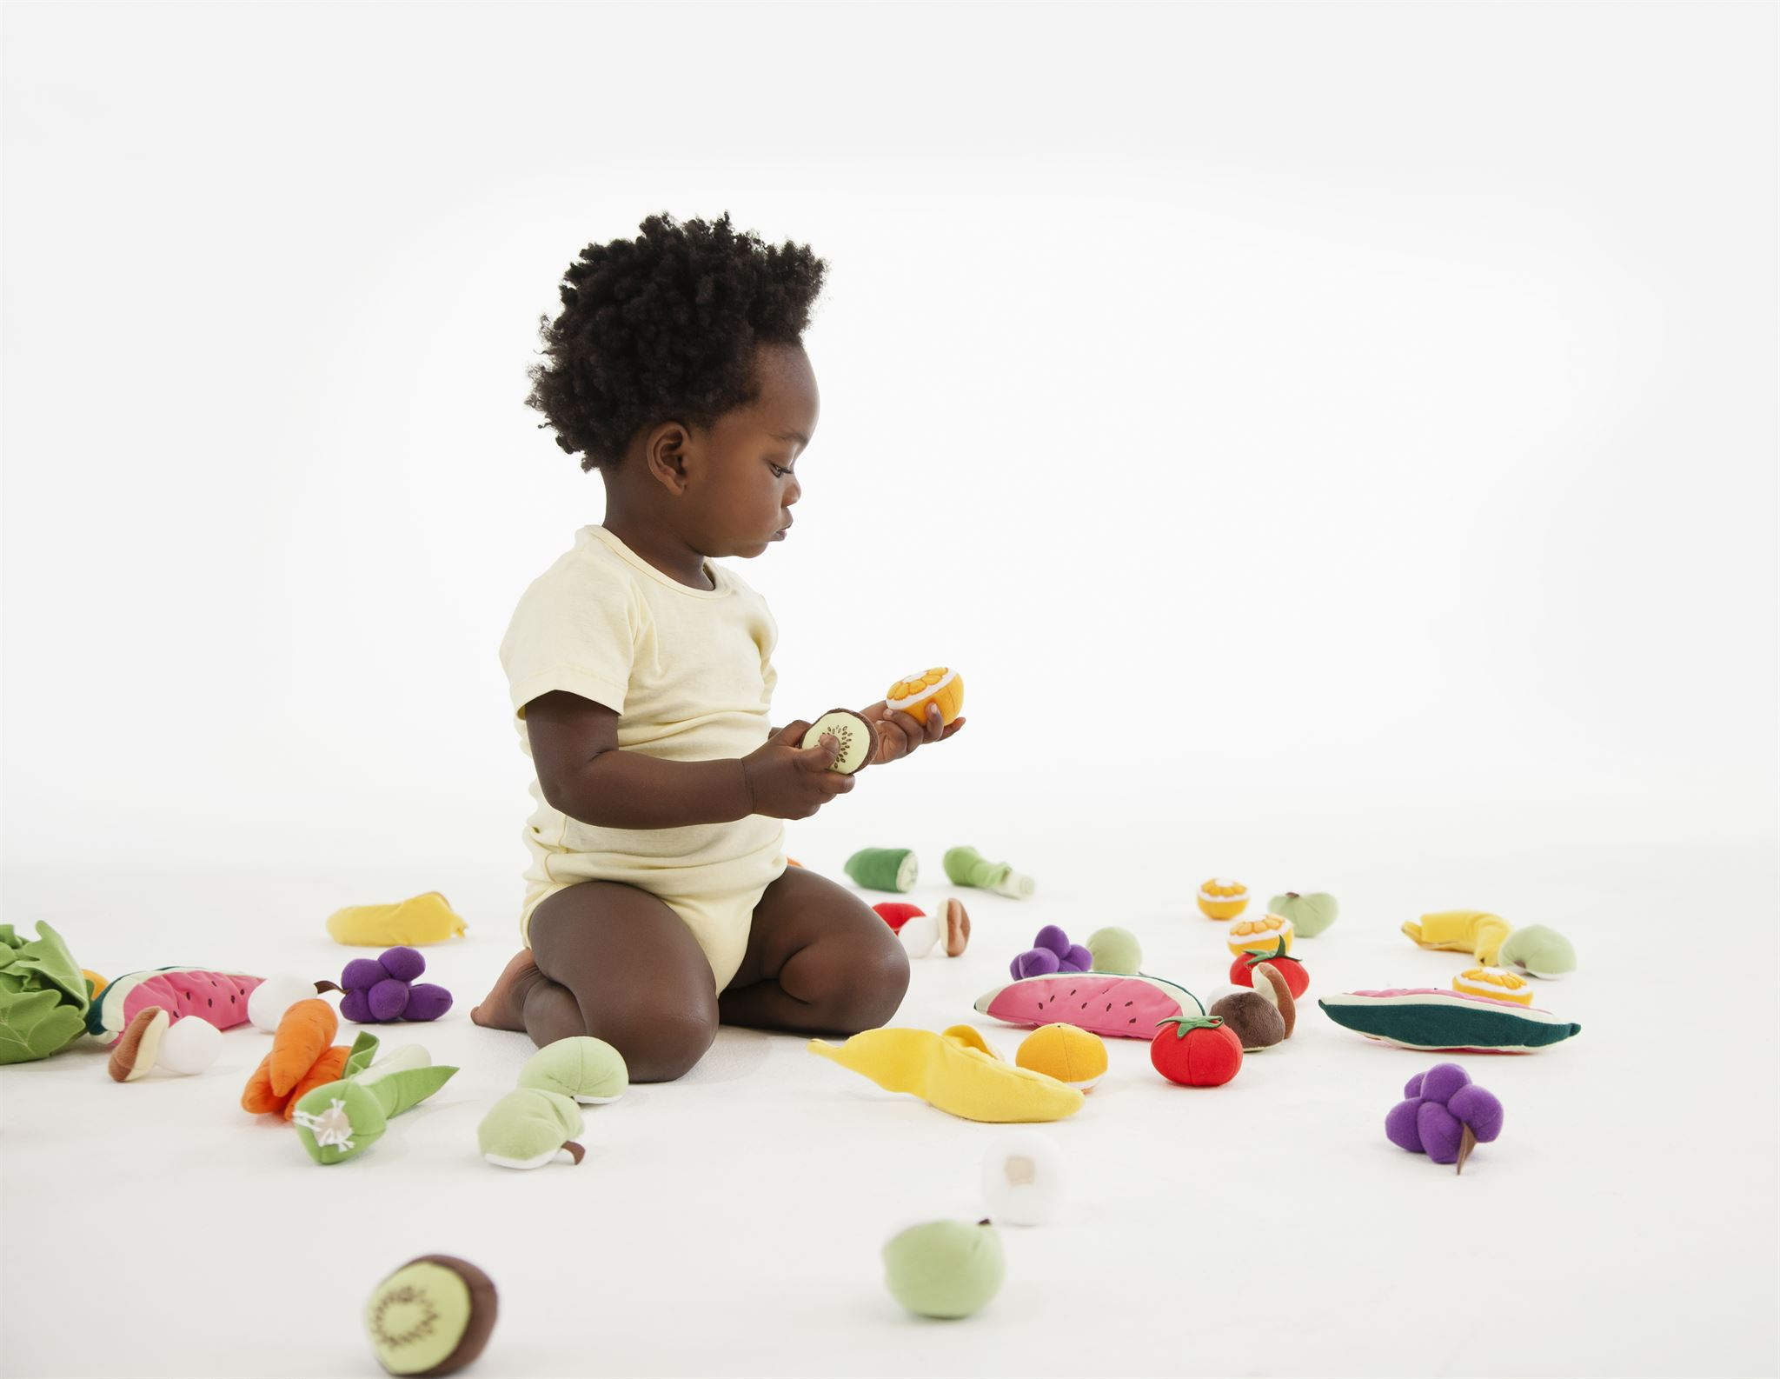
Emergence of Language and Communication
Rapid Language Development
  Children begin combining words and understanding simple instructions between 18 and 24 months.
Use of Gestures
  Gestures become an important part of communication, helping children express themselves effectively.
Social and Cognitive Growth
  Language growth supports social interaction and enhances cognitive development in young children.
Notes:
---
Between 18 and 24 months, children rapidly develop language skills, beginning to combine words, understand simple instructions, and use gestures. Communication growth supports social interaction and cognitive development.
Image source: Microsoft 365 content library

Slide 6
Fostering Curiosity and Problem-Solving
Nurturing Cognitive Flexibility
Encouraging curiosity helps toddlers develop the ability to adapt their thinking to new information and experiences.
Developing Critical Thinking
Problem-solving activities promote critical thinking by allowing toddlers to experiment with cause-and-effect relationships.
Guided Exploration
Guided activities support toddlers in exploring new ideas and concepts safely and effectively.
Notes:
---
Encouraging curiosity and problem-solving during this stage nurtures cognitive flexibility and critical thinking. Toddlers start experimenting with cause-and-effect and exploring new ideas through guided activities.
Image source: Microsoft 365 content library

Slide 7
Social-Emotional and Attachment Development
Notes:
This section focuses on how toddlers form attachments, recognize and express emotions, and develop empathy and self-regulation skills crucial for healthy social relationships.

Slide 8

Attachment Formation and Security
Secure Attachment Development
  Secure attachment forms when caregivers consistently respond to toddlers’ needs with sensitivity and care.
Emotional Safety
  Responsive caregiving provides toddlers emotional safety essential for healthy psychological growth.
Confidence for Exploration
  Secure attachment gives toddlers a foundation to explore their surroundings confidently and independently.
Notes:
---
Secure attachment develops through consistent responsive caregiving, providing toddlers with emotional safety and a foundation for exploring their environment confidently.
Image source: Microsoft 365 content library

Slide 9

Recognition and Expression of Emotions
Identifying Basic Emotions
  Toddlers start recognizing core emotions such as joy, anger, and fear in themselves and others.
Expressing Emotions
  Young children learn to express their feelings effectively through gestures, sounds, and facial expressions.
Responding to Emotional Cues
  Toddlers develop the ability to respond appropriately to others’ emotional signals and cues.
Notes:
---
Toddlers begin to identify and express basic emotions such as joy, anger, and fear, learning to communicate feelings effectively and respond to others' emotional cues.
Image source: Microsoft 365 content library

Slide 10

Development of Empathy and Self-Regulation
Emerging Empathy
  Toddlers begin to understand and relate to the feelings of others during early development stages.
Self-Regulation Skills
  Toddlers develop the ability to manage impulses and control emotional responses in social situations.
Notes:
---
Emerging empathy allows toddlers to relate to others’ feelings, while developing self-regulation skills helps them manage impulses and emotional responses in social contexts.
Image source: Microsoft 365 content library

Slide 11
Milestones and Breakthroughs in Brain Development
Notes:
Brain development during this period is rapid, laying the groundwork for future learning and behavior. Here, we review key milestones and research insights.

Slide 12
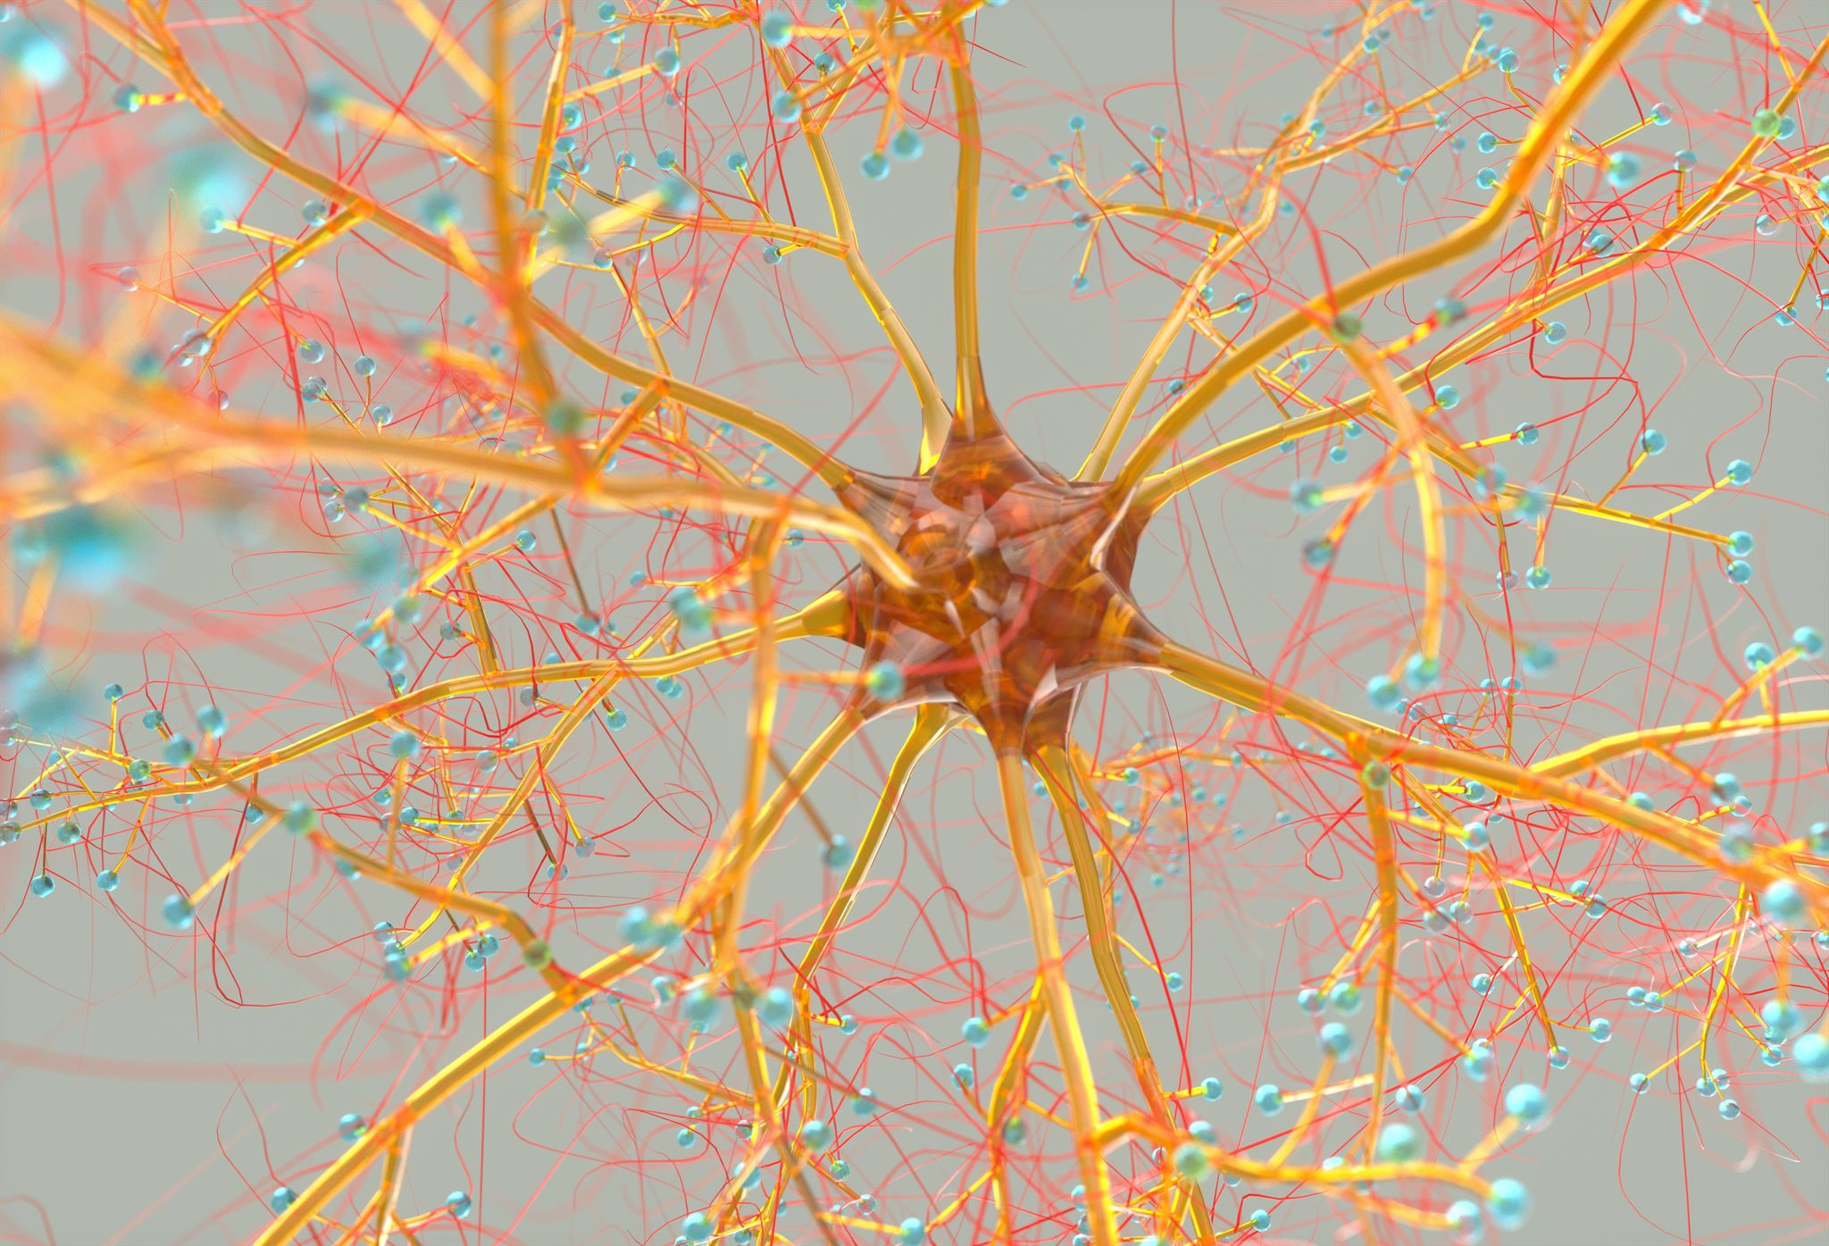
Rapid Synaptic Growth and Neural Connections
Synapse Formation
  The brain rapidly creates numerous synapses, increasing communication pathways between neurons.
Enhanced Neural Connectivity
  Increased synapses improve neural connectivity, enabling complex brain functions to develop.
Support for Cognitive Functions
  These neural connections support advanced cognitive and emotional functions during brain development.
Notes:
---
The brain forms an abundance of synapses during this stage, enhancing neural connectivity and supporting complex cognitive and emotional functions.
Image source: Microsoft 365 content library

Slide 13

Current Research on Early Childhood Brain Development
Impact of Early Experiences
  Experiences in toddlerhood critically shape the brain's architecture and influence lifelong development.
Importance of Enriched Environments
  Enriched environments promote healthy brain development through sensory, social, and cognitive stimulation.
Role of Positive Interactions
  Positive caregiver interactions support emotional and cognitive development in early childhood.
Notes:
---
Recent studies illuminate how experiences during toddlerhood shape brain architecture, emphasizing the importance of enriched environments and positive interactions.
Image source: Microsoft 365 content library

Slide 14

Influence of Environment and Relationships on Brain Architecture
Role of Supportive Relationships
  Positive social interactions foster healthy neural connections, enhancing brain growth and cognitive functions.
Impact of Stimulating Environment
  Enriched environments encourage brain plasticity and development, supporting learning and memory.
Effects of Stress and Neglect
  Chronic stress and neglect disrupt brain architecture and impair neural pathways.
Notes:
---
Supportive relationships and stimulating environments promote healthy brain development, while stress and neglect can negatively affect neural pathways.
Image source: Microsoft 365 content library

Slide 15
Parent-Centered Strategies and Interactive Effects
Notes:
Effective caregiving strategies empower parents to support their toddlers’ learning and emotional growth through responsive and interactive approaches.

Slide 16

Responsive Caregiving and Relationship-Based Approaches
Sensitive Response to Needs
  Caregivers who respond sensitively to toddlers' cues promote secure attachments and emotional comfort.
Building Secure Attachments
  Secure attachments formed during early years foster trust and support social-emotional development.
Long-Term Well-Being
  Responsive caregiving lays a foundation for children's lifelong emotional and social well-being.
Notes:
---
Responding sensitively to toddlers’ needs builds secure attachments and fosters trust, providing a foundation for lifelong social and emotional well-being.
Image source: Microsoft 365 content library

Slide 17

Promoting Interactive Play and Joint Attention
Shared Play Benefits
  Shared play encourages language development and enhances social interaction skills among children.
Joint Attention Importance
  Focusing attention together helps improve cognitive growth and understanding of social cues.
Notes:
---
Engaging in shared play and focusing attention together supports language development, social skills, and cognitive growth during this stage.
Image source: Microsoft 365 content library

Slide 18
Supporting Challenging Behaviors and Positive Guidance
Toddler Developmental Testing
Toddlers naturally test limits as a normal and important part of their development process.
Positive Guidance Techniques
Positive guidance uses patience and consistency to help parents manage challenging behaviors effectively.
Encouraging Self-Regulation
These techniques promote healthy self-regulation skills in toddlers for better emotional control.
Notes:
---
Toddlers test limits as part of development. Positive guidance techniques help parents navigate challenging behaviors with patience and consistency to encourage healthy self-regulation.
Image source: Microsoft 365 content library

Slide 19
Conclusion
Critical Development Period
The 18-24 month age range is vital for toddlers' social, emotional, and brain development.
Responsive Caregiving
Caregivers applying responsive strategies create supportive, nurturing environments for toddlers' growth.
Notes:
The 18-24 month period is crucial for social, emotional, and brain development. By understanding core principles and applying responsive strategies, caregivers can create nurturing environments that support toddlers’ growth and lifelong success.

