Slide 1
Principles of Early Learning for 18–24 Months: Peer Interaction, Brain Milestones, and Parent-Centered Approaches
Supporting toddler growth through social and cognitive development
Notes:
---
This presentation explores key principles of early learning for toddlers aged 18 to 24 months, focusing on peer interactions, brain development milestones, and the influence of parent-centered strategies to support optimal growth and development during this critical period.

Slide 2
Exploring Early Learning Principles
Foundational Principles of Early Learning for 18–24 Months
Learning With Peers: Social and Cognitive Development
Current Research Milestones and Brain Development Breakthroughs
Parent-Centered and Interactive Effects on Early Learning
Notes:
We will cover foundational principles of early learning, examine social and cognitive development through peer interactions, review recent brain development research milestones, and discuss how parent-centered approaches enhance early learning outcomes.

Slide 3
Foundational Principles of Early Learning for 18–24 Months
Notes:
Understanding the developmental stages of toddlers, the importance of play and exploration, and how imitation and repetition contribute to learning form the foundation of early childhood education for this age group.

Slide 4
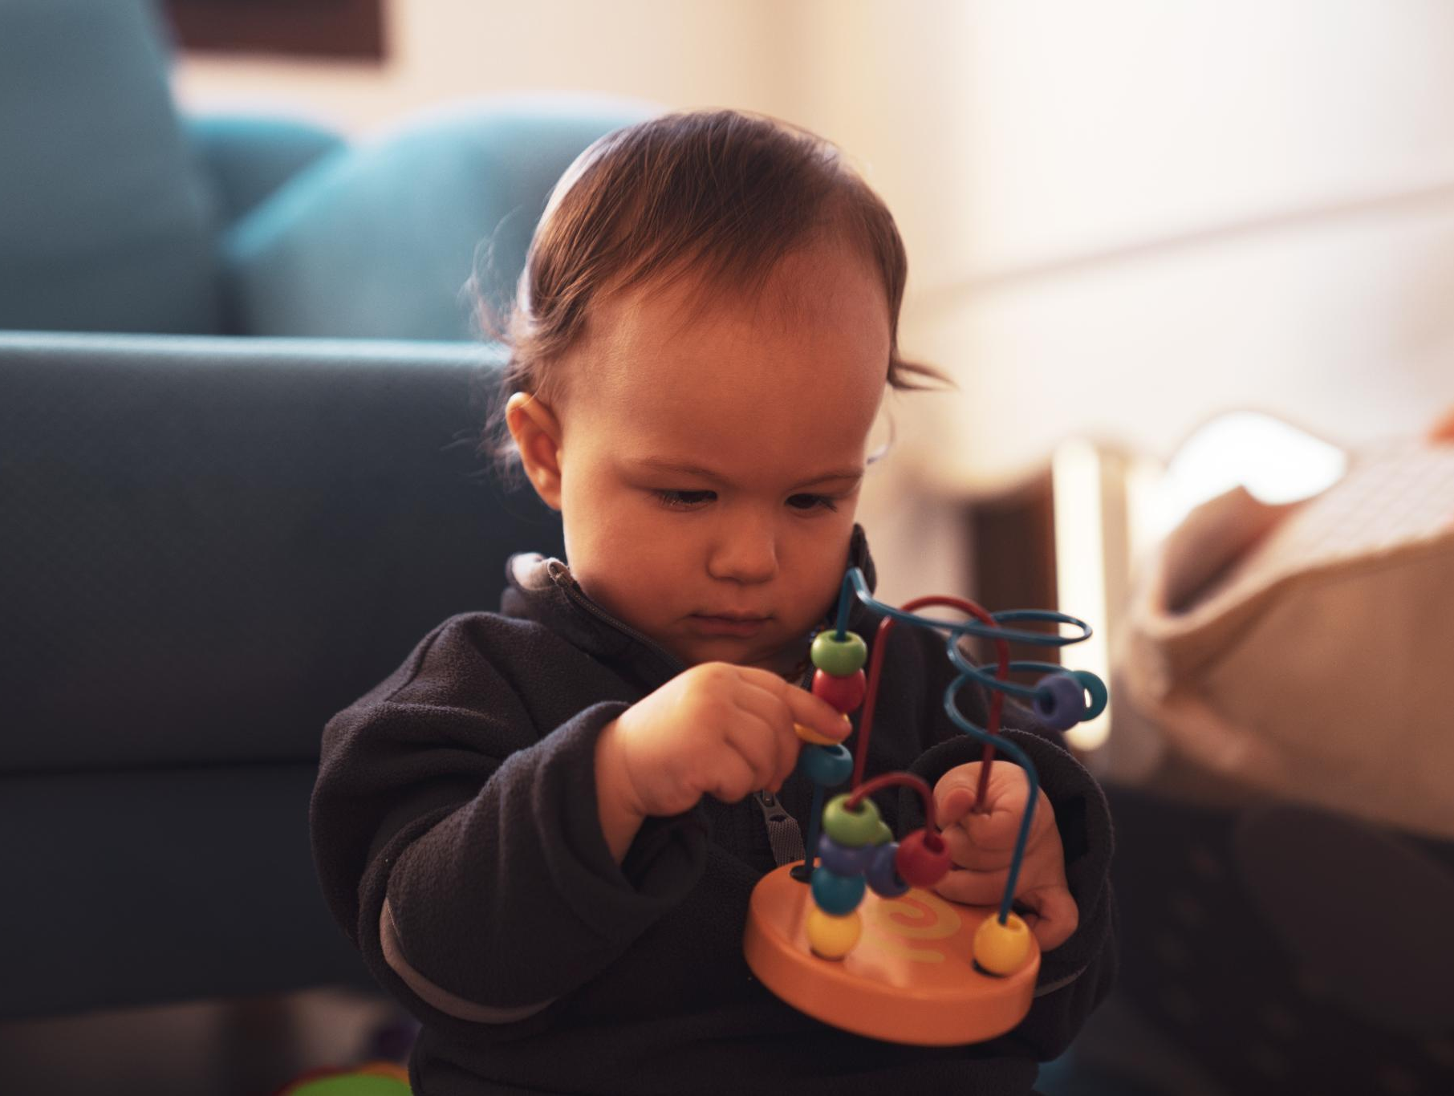
Understanding Developmental Stages in Toddlerhood
Motor Skill Growth
  Toddlers rapidly improve walking, climbing, and fine motor skills between 18 and 24 months.
Language Development
  Language skills expand quickly as toddlers begin to form words and simple sentences during this stage.
Cognitive Abilities
  Cognitive growth includes problem-solving and recognizing objects, essential for early learning.
Notes:
---
Toddlers between 18 and 24 months experience rapid growth in motor skills, language, and cognitive abilities. Recognizing these developmental stages is crucial for nurturing appropriate learning experiences.
Image source: Microsoft 365 content library

Slide 5
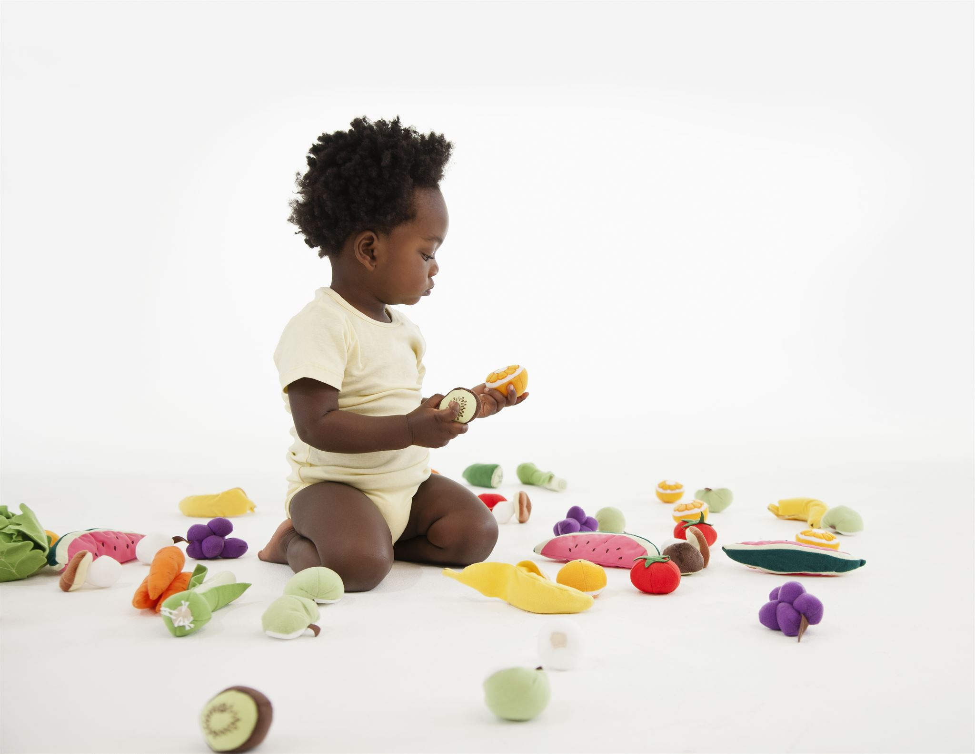
Importance of Play and Exploration
Environmental Exploration
  Play enables toddlers to discover and engage with their surroundings, fostering curiosity and learning.
Problem-Solving Skills
  Through play, toddlers develop essential problem-solving abilities by experimenting and overcoming challenges.
Creativity Development
  Play encourages creative thinking and imagination, vital for emotional and cognitive growth.
Notes:
---
Play allows toddlers to explore their environment, develop problem-solving skills, and build creativity. It is essential for cognitive and emotional development during this stage.
Image source: Microsoft 365 content library

Slide 6
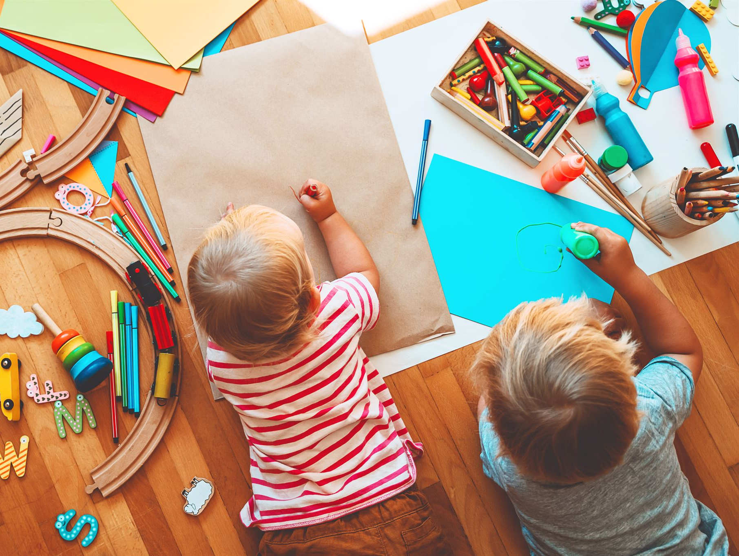
The Role of Imitation and Repetition
Learning Through Imitation
  Toddlers develop new skills by observing and copying the behavior of adults and peers around them.
Repetition Reinforces Learning
  Repeated practice helps toddlers solidify skills and better understand social cues and interactions.
Notes:
---
Toddlers learn by imitating adults and peers. Repetition reinforces learning, helping toddlers master new skills and understand social cues.
Image source: Microsoft 365 content library

Slide 7
Learning With Peers: Social and Cognitive Development
Notes:
Peer interactions promote social-emotional growth and cognitive development through shared activities and collaborative learning models inspired by Vygotskian theory.

Slide 8
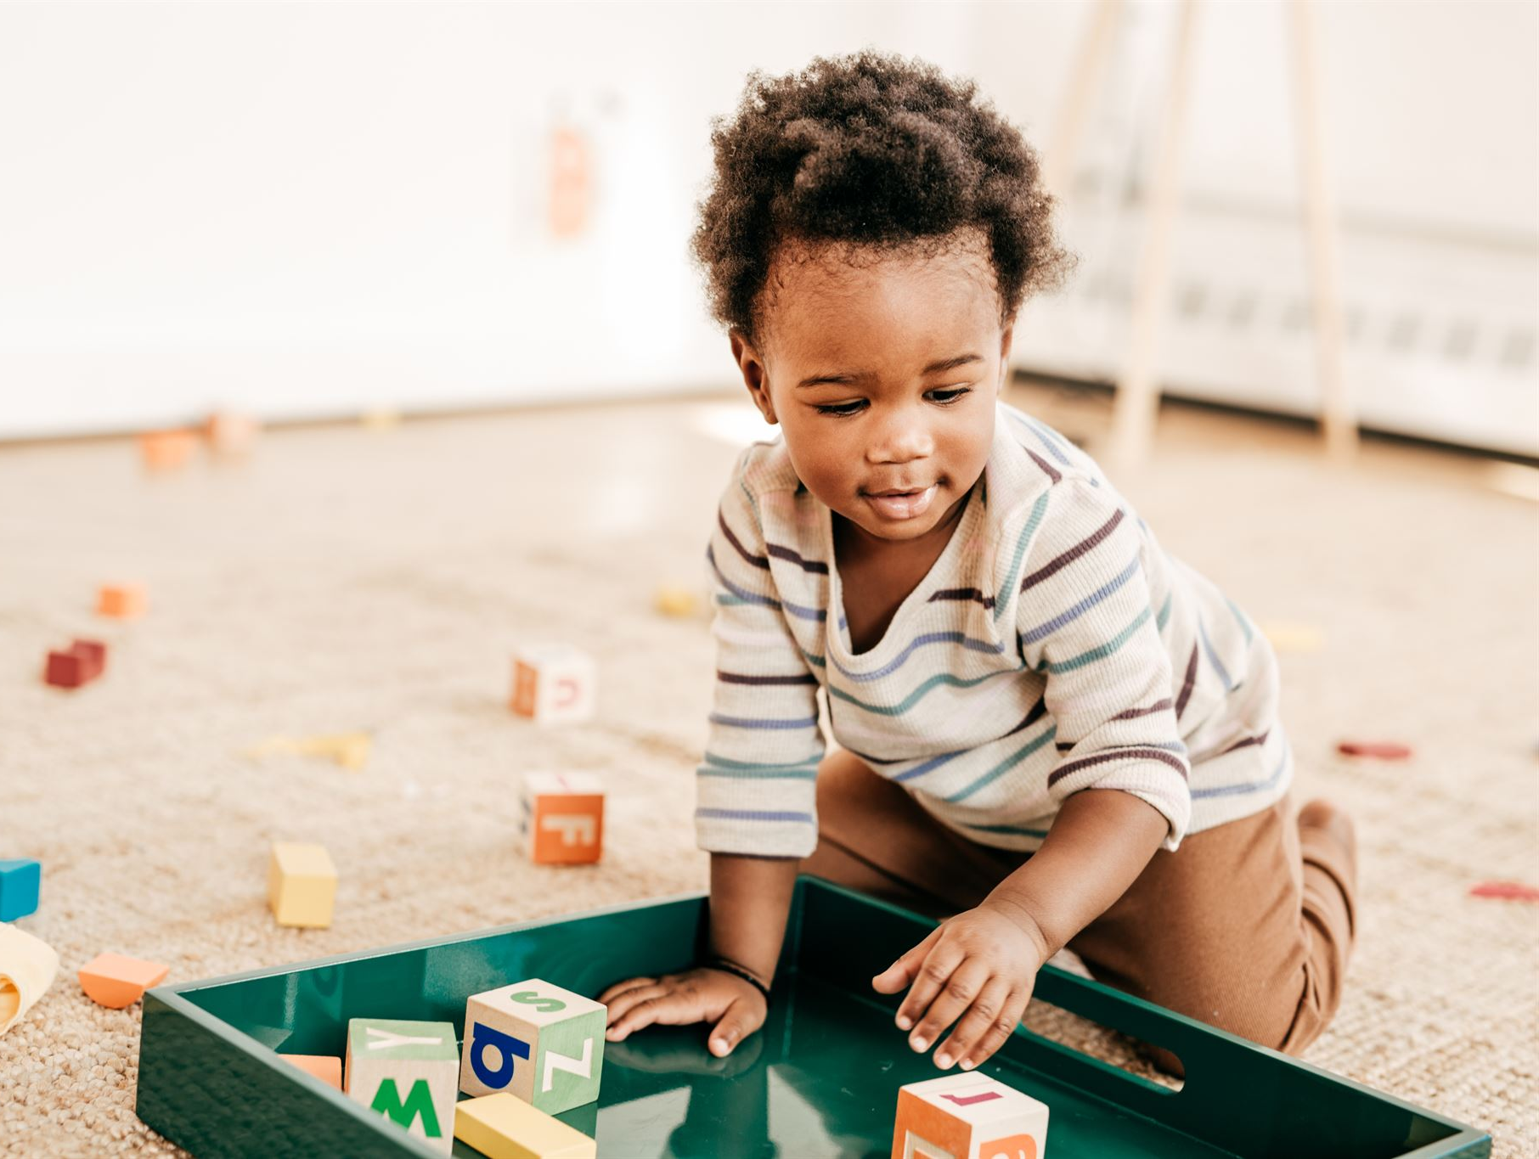
Emerging Peer Interactions and Shared Activities
Simple Social Behaviors
  Toddlers start to show social behaviors like sharing and playing side-by-side, which are early social skills.
Foundation for Cooperation
  These early interactions set the stage for future cooperative play and effective communication among peers.
Notes:
---
Toddlers begin to engage in simple social behaviors such as parallel play and sharing, building the foundation for future cooperative play and communication.
Image source: Microsoft 365 content library

Slide 9
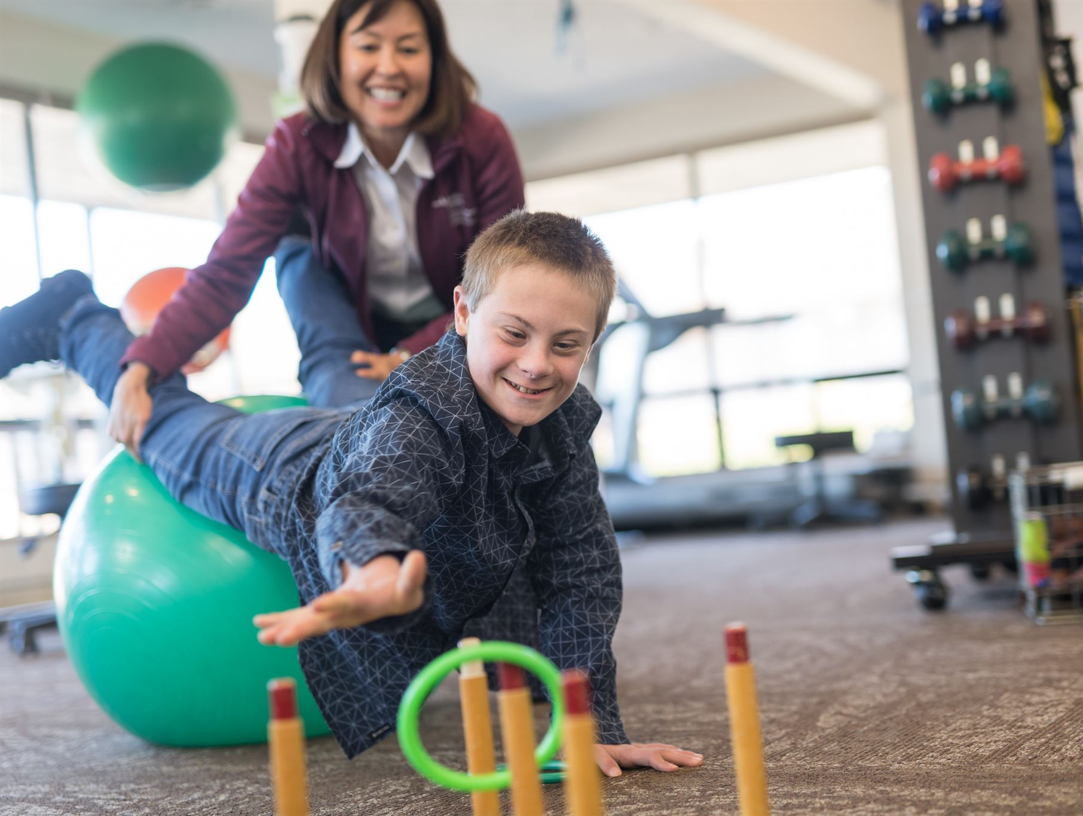
Development of Social-Emotional Skills
Empathy Development
  Toddlers learn to recognize and respond to others' feelings through social interactions.
Turn-Taking Skills
  Engaging with peers teaches toddlers patience and sharing by taking turns during activities.
Emotional Regulation
  Peer interactions help toddlers manage emotions like frustration and excitement effectively.
Notes:
---
Through peer interactions, toddlers develop empathy, turn-taking, and emotional regulation skills essential for healthy social development.
Image source: Microsoft 365 content library

Slide 10
Tools of the Mind: Vygotskian Perspectives on Collaborative Learning
Social Context in Development
Vygotsky's theory highlights how social interactions shape toddlers' cognitive growth and learning abilities.
Guided Interaction
Guided participation with adults or peers supports cognitive development and scaffolds learning in toddlers.
Collaborative Learning Benefits
Collaborative experiences promote language development, problem-solving, and social skills among young children.
Notes:
---
Vygotsky’s theory emphasizes the role of social context and guided interaction in cognitive development, highlighting the importance of collaborative learning experiences among toddlers.
Image source: Microsoft 365 content library

Slide 11
Current Research Milestones and Brain Development Breakthroughs
Notes:
Recent neuroscience research provides insights into neural growth, the significance of sensitive periods, and key cognitive, motor, and language milestones in toddler development.

Slide 12

Recent Findings in Neural Growth and Connectivity
Rapid Synaptic Development
  Synapses form quickly, enhancing communication between neurons and supporting brain adaptability.
Increased Brain Connectivity
  Neural pathways strengthen, improving brain network efficiency and cognitive function.
Brain Plasticity
  The brain’s ability to adapt and learn is highlighted by its dynamic structural changes.
Notes:
---
Studies show rapid synaptic development and increased brain connectivity during this age, emphasizing the brain’s plasticity and capacity for learning.
Image source: Microsoft 365 content library

Slide 13

Sensitive Periods and the Impact of Experience
Definition of Sensitive Periods
  Sensitive periods are specific time windows when the brain is especially receptive to learning certain skills or information.
Experience Influences Brain Development
  Experiences during sensitive periods significantly shape neural connections and skill acquisition in the developing brain.
Notes:
---
Sensitive periods are windows of opportunity where specific experiences can significantly influence brain development and skill acquisition.
Image source: Microsoft 365 content library

Slide 14

Milestones in Cognitive, Motor, and Language Development
Independent Walking
  Toddlers usually begin walking independently between 18 and 24 months, marking a major motor development milestone.
Combining Words
  At this stage, toddlers start combining words to form simple sentences, demonstrating language development progress.
Problem Solving
  Toddlers begin solving simple problems, showing early cognitive development and learning abilities.
Notes:
---
Between 18 and 24 months, toddlers typically reach important milestones such as walking independently, combining words, and solving simple problems.
Image source: Microsoft 365 content library

Slide 15
Parent-Centered and Interactive Effects on Early Learning
Notes:
Responsive caregiving and interactive play between parents and toddlers powerfully shape learning, behavior, and developmental outcomes.

Slide 16
Responsive Caregiving and Relationship-Based Learning
Sensitive Caregiving
Attuned caregiving supports toddlers’ emotional security and promotes positive development.
Secure Attachments
Secure attachments encourage toddlers to feel safe to explore their environment confidently.
Relationship-Based Learning
Learning grounded in strong adult-child relationships fosters curiosity and cognitive growth.
Notes:
---
Attuned and sensitive caregiving fosters secure attachments, encouraging toddlers to explore and learn confidently.
Image source: Microsoft 365 content library

Slide 17
Parent Strategies for Fostering Development
Stimulating Environments
Creating environments rich with learning materials helps children develop cognitive and sensory skills effectively.
Modeling Behaviors
Parents demonstrate positive behaviors which children learn and imitate, fostering social and emotional development.
Encouraging Safe Exploration
Allowing children to explore within safe boundaries promotes independence and problem-solving skills.
Notes:
---
Parents can support development by providing stimulating environments, modeling behaviors, and encouraging exploration within safe boundaries.
Image source: Microsoft 365 content library

Slide 18

Interactive Play and Its Effect on Behavior and Learning
Communication Skills Development
  Interactive play helps children improve their verbal and non-verbal communication skills effectively.
Social Skills Enhancement
  Playing interactively fosters collaboration, empathy, and sharing among children.
Cognitive Growth
  Engagement in play boosts critical thinking, problem-solving, and creativity in young learners.
Notes:
---
Engaging in interactive play strengthens communication, social skills, and cognitive abilities, facilitating holistic early learning experiences.
Image source: Microsoft 365 content library

Slide 19
Conclusion: Supporting Holistic Early Learning in Toddlers
Developmental Stages
Understanding toddlers’ developmental stages guides effective learning support tailored to their needs.
Peer Learning Benefits
Toddlers gain social and cognitive skills through interactions and learning with peers.
Brain Research Insights
Brain research informs strategies that stimulate toddlers’ cognitive and emotional growth.
Parent-Centered Approach
Engaging parents in learning fosters a supportive environment for toddlers’ holistic growth.
Notes:
Integrating knowledge of developmental stages, peer learning, brain research, and parent-centered approaches creates a robust framework to nurture toddlers’ growth and lifelong learning skills.

