Slide 1
Principles of Early Language Learning for 18-24 Months
Supporting toddlers’ speech and cognitive growth effectively
Notes:
---
This presentation explores early language development in toddlers aged 18 to 24 months. We will examine developmental milestones, brain growth, parent-centered approaches, and integrate research insights to support effective language learning during this critical period.

Slide 2
Agenda Overview
Key Milestones in Language Development for 18–24 Months
Breakthroughs in Brain Development and Language Acquisition
Parent-Centered Approaches and Interactive Effects
Integrating Theory and Practice: Insights From Current Research
Notes:
We will cover key language milestones during 18 to 24 months, breakthroughs in brain development that support language acquisition, parent-focused strategies to enrich language environments, and current research frameworks to apply in practice.

Slide 3
Key Milestones in Language Development for 18–24 Months
Notes:
During this age, toddlers experience rapid vocabulary expansion and begin combining words. Both receptive and expressive language skills emerge, alongside early signs of social language use and conversational abilities.

Slide 4

Typical Vocabulary Growth and First Word Combinations
Vocabulary Expansion
  Children grow their vocabulary rapidly from a few words to over 50 between 18 and 24 months.
First Word Combinations
  Toddlers begin combining two words to form simple phrases, showing early language development.
Notes:
---
Between 18 and 24 months, children typically increase their vocabulary from a few words to over 50, beginning to combine two words to form simple phrases, reflecting advancing cognitive and linguistic skills.
Image source: Microsoft 365 content library

Slide 5
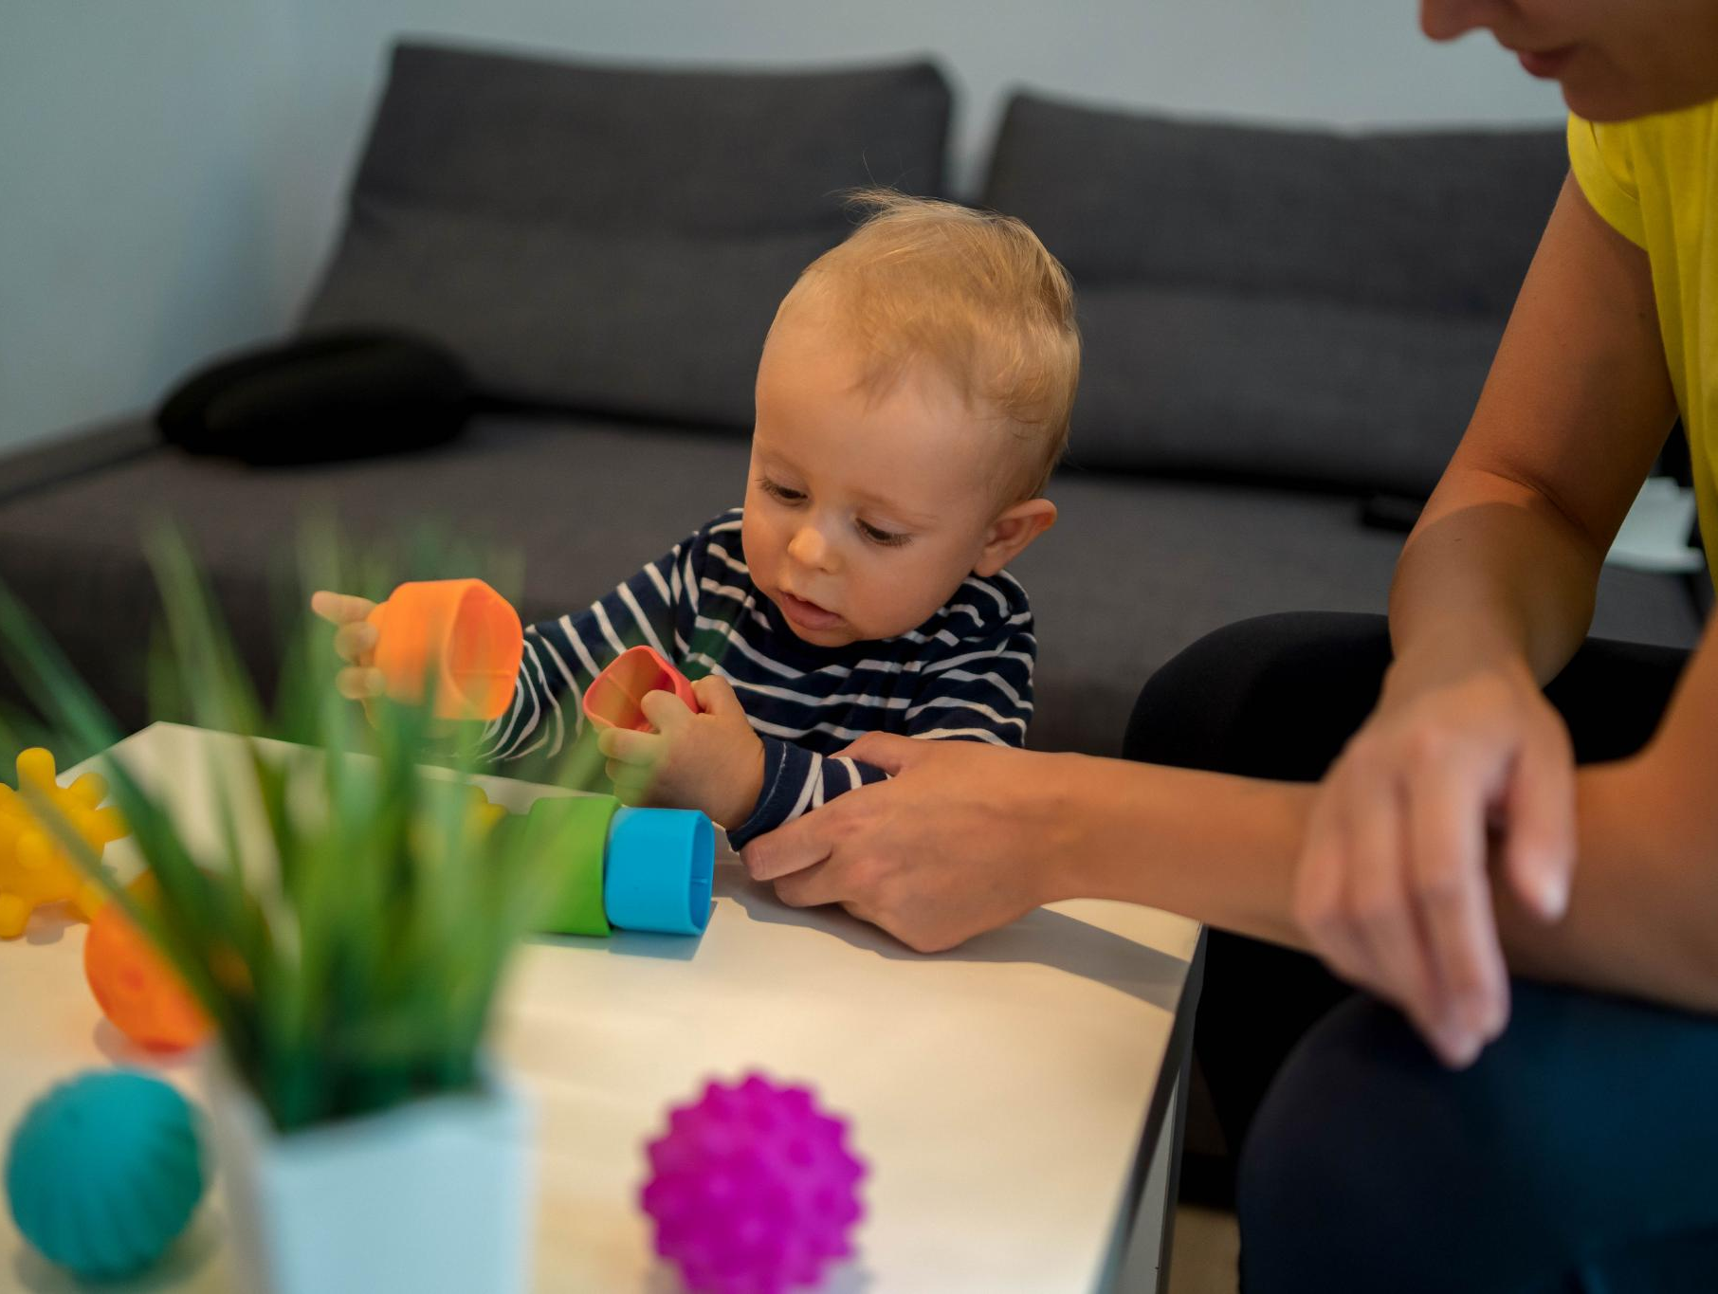
Emergence of Receptive and Expressive Skills
Receptive Language Development
  Toddlers develop the ability to understand language before they can express themselves verbally.
Expressive Language Growth
  Children gradually increase their skills in expressing needs and ideas through words and gestures.
Notes:
---
Receptive skills—understanding language—usually outpace expressive abilities. Toddlers start to comprehend simple instructions while simultaneously expanding their ability to express needs and ideas.
Image source: Microsoft 365 content library

Slide 6

Indicators of Social Language Use and Early Conversation
Turn-taking in Conversation
  Children learn to take turns speaking, which is a fundamental skill for effective conversations.
Use of Gestures
  Gestures help children express themselves and support social communication in early conversations.
Responding to Social Cues
  Recognizing and responding to social cues lays the foundation for understanding and engaging in social interactions.
Notes:
---
Children begin engaging in turn-taking, using gestures, and responding to social cues, marking the foundation of conversational skills and social communication.
Image source: Microsoft 365 content library

Slide 7
Breakthroughs in Brain Development and Language Acquisition
Notes:
The brain undergoes critical neural changes that support language learning. Play and interaction stimulate cognitive growth, while responsive caregiving shapes essential brain pathways for communication.

Slide 8

Neural Changes Supporting Language Learning
Synaptic Strengthening
  Synaptic connections in language-related brain regions strengthen, improving communication between neurons.
Enhanced Language Processing
  Stronger synapses enable toddlers to process and produce language more efficiently.
Notes:
---
Synaptic connections strengthen in language-related brain areas during this period, enhancing toddlers' ability to process and produce language efficiently.
Image source: Microsoft 365 content library

Slide 9

Role of Play and Interaction in Cognitive Growth
Play Stimulates Brain Development
  Active play enhances neural connections and supports overall cognitive growth in children.
Interactions Foster Language Skills
  Meaningful social interactions provide rich contexts that enhance language acquisition effectively.
Notes:
---
Engagement in play and meaningful interactions stimulates brain development and fosters language acquisition by providing rich contexts for learning.
Image source: Microsoft 365 content library

Slide 10

Impact of Responsive Caregiving on Brain Pathways
Role in Neural Circuit Formation
  Responsive caregiving strengthens brain pathways critical for language and social interaction development.
Support for Language Skills
  Sensitive caregiving fosters language acquisition by promoting healthy neural connections.
Promotion of Social Communication
  Attentive caregiving enhances social communication through optimized brain network growth.
Notes:
---
Responsive and sensitive caregiving supports the formation of neural circuits vital for language and social communication, promoting healthy developmental outcomes.
Image source: Microsoft 365 content library

Slide 11
Parent-Centered Approaches and Interactive Effects
Notes:
Parents play a crucial role in fostering language development by creating rich environments through reading, play, daily routines, and building secure relationships.

Slide 12

Strategies for Fostering Rich Language Environments
Narrating Daily Activities
  Describing everyday actions helps toddlers associate words with experiences and context.
Labeling Objects
  Naming objects around toddlers builds vocabulary and reinforces word-object connections.
Encouraging Vocalizations
  Prompting toddlers to vocalize fosters speech development and interactive communication skills.
Notes:
---
Techniques include narrating daily activities, labeling objects, and encouraging vocalizations to immerse toddlers in language-rich settings.
Image source: Microsoft 365 content library

Slide 13

Interactive Reading, Play, and Daily Routines
Interactive Reading Benefits
  Interactive reading encourages active engagement and enhances language development in children.
Role of Play
  Play fosters language use through social interaction and creative expression.
Embedding Language in Routines
  Incorporating language opportunities in daily routines ensures consistent practice and reinforcement.
Notes:
---
Interactive reading and play promote active language use, while embedding language opportunities in routines supports consistent practice and reinforcement.
Image source: Microsoft 365 content library

Slide 14

Building Secure Relationships for Optimal Learning
Emotional Bonds Importance
  Strong emotional connections increase toddlers' motivation to communicate and learn language effectively.
Sensitive Parenting Role
  Responsive parenting supports toddlers' exploration of language through nurturing and attentive behavior.
Notes:
---
Strong emotional bonds enhance toddlers' willingness to communicate and explore language, emphasizing the importance of sensitive and responsive parenting.
Image source: Microsoft 365 content library

Slide 15
Integrating Theory and Practice: Insights From Current Research
Notes:
We synthesize research findings and theoretical frameworks to offer practical guidance supporting language milestones and effective early language learning strategies.

Slide 16

Summary of Key Research Findings and Best Practices
Responsive Interaction
  Responsive interaction between caregivers and children fosters better language and social skills development.
Rich Language Exposure
  Exposure to diverse and rich language environments enhances early vocabulary and communication abilities.
Socio-Emotional Support
  Providing socio-emotional support promotes a secure environment critical for language growth and confidence.
Notes:
---
Research highlights the importance of responsive interaction, rich language exposure, and socio-emotional support to optimize early language development.
Image source: Microsoft 365 content library

Slide 17
Application of Vygotskian and Relationship-Based Frameworks
Social Interaction in Learning
Vygotsky highlights social interaction as essential for cognitive development and meaningful learning.
Scaffolding Support
Scaffolding provides guidance that helps learners achieve tasks beyond their current abilities.
Secure Relationships
Secure, supportive relationships foster a safe environment for guided participation.
Notes:
---
Vygotsky’s theories emphasize the role of social interaction and scaffolding in learning, underscoring the value of guided participation and secure relationships.
Image source: Microsoft 365 content library

Slide 18

Practical Guidance for Supporting Milestone Achievement
Meaningful Communication
  Engage toddlers through interactive and meaningful communication to foster language development.
Consistent Language Input
  Provide toddlers with regular and consistent exposure to language to enhance their learning.
Sensitive Responses
  Respond sensitively to toddlers’ cues to support their communication confidence and skills.
Notes:
---
Parents and caregivers are encouraged to engage in meaningful communication, provide consistent language input, and respond sensitively to encourage toddlers’ language skills.
Image source: Microsoft 365 content library

Slide 19
Conclusion
Brain Development Impact
Brain growth between 18 and 24 months critically influences early language acquisition and comprehension.
Role of Social Interaction
Engaging social interactions with caregivers foster toddlers' language skills and communication abilities.
Parent-Centered Strategies
Practical, research-based strategies enable parents to support toddlers in achieving key language milestones.
Notes:
Early language learning between 18 and 24 months is shaped by brain development, social interaction, and parent-centered approaches. Integrating research with practical strategies equips caregivers to support toddlers in reaching vital language milestones.

