Slide 1
Key Principles of Early Learning and Social-Emotional Development in Infants Aged 8-12 Months
Foundations for growth during crucial developmental months
Notes:
---
This presentation explores the critical principles guiding early learning and social-emotional development in infants between 8 to 12 months old, emphasizing foundational care, developmental milestones, and current research insights.

Slide 2
Presentation Agenda
Foundational Principles of Early Learning for 8-12 Month-Olds
Social-Emotional Development and Attachment Formation
Current Research Milestones and Breakthroughs in Brain Development
Parent-Centered Practices and Their Interactive Effects
Notes:
We will cover foundational principles of early learning for infants, delve into social-emotional development and attachment, review current brain development research, and conclude with parent-centered practices that support healthy growth during this important stage.

Slide 3
Foundational Principles of Early Learning for 8-12 Month-Olds
Notes:
Understanding the key components of early learning during this age range helps caregivers support infants’ sensory, motor, and cognitive growth effectively.

Slide 4

Sensory Exploration and Motor Development
Sensory Exploration
  Infants discover the world by using their senses, which supports cognitive and emotional growth.
Motor Skill Development
  Crawling and grasping enable infants to interact physically with their environment and improve coordination.
Notes:
---
Infants at this stage actively explore their environment through their senses and rapidly develop motor skills, such as crawling and grasping, which are essential for learning and discovery.
Image source: Microsoft 365 content library

Slide 5

Importance of Responsive Caregiving
Definition of Responsive Caregiving
  Responsive caregiving involves attentively responding to infants' needs and cues with sensitivity and promptness.
Fostering Secure Attachment
  Such caregiving creates a secure emotional bond between infant and caregiver, promoting trust and safety.
Supporting Brain Development
  Responsive interactions aid early brain development during critical stages of infant growth.
Notes:
---
Responsive caregiving—attending sensitively and promptly to infants’ cues—fosters secure attachment, emotional safety, and supports brain development during this critical period.
Image source: Microsoft 365 content library

Slide 6

Role of Play in Cognitive and Physical Growth
Cognitive Development
  Play enhances infants' problem-solving skills and boosts creativity through exploration and discovery.
Physical Coordination
  Physical play supports infants' motor skills and body coordination, essential for healthy growth.
Social Interaction
  Play encourages social skills by enabling infants to interact, communicate, and collaborate with others.
Notes:
---
Play is fundamental for infants’ cognitive processing and physical coordination, providing opportunities for problem-solving, creativity, and social interaction.
Image source: Microsoft 365 content library

Slide 7
Social-Emotional Development and Attachment Formation
Notes:
This section highlights how infants form emotional bonds and begin to show social emotions, laying the groundwork for future relationships and emotional regulation.

Slide 8
Building Secure Attachments with Caregivers
Consistent Caregiving
Consistently meeting infants’ needs fosters a sense of safety and reliability.
Establishing Trust
Trust develops when infants feel secure and cared for by their caregivers.
Emotional Development
Secure attachments provide a foundation for healthy emotional growth throughout life.
Notes:
---
Secure attachments develop when caregivers consistently meet infants’ needs, establishing trust and a foundation for healthy emotional development.
Image source: Microsoft 365 content library

Slide 9

Emergence of Social Emotions Such as Joy and Fear
Onset of Social Emotions
  Infants begin showing social emotions such as joy, fear, and shyness between 8 and 12 months, marking emotional development.
Growing Self-Awareness
  These emotions reflect infants' increasing awareness of themselves and their social environment during early development.
Notes:
---
Between 8 and 12 months, infants start expressing social emotions like joy, fear, and shyness, reflecting their growing awareness of themselves and others.
Image source: Microsoft 365 content library

Slide 10

Understanding Early Signs of Social Interaction
Early Smiling
  Smiling is one of the first social behaviors infants display, signaling positive emotional connection.
Eye Contact
  Sustained eye contact helps infants build emotional bonds and recognize social cues.
Vocalizing Sounds
  Vocalizations such as cooing and babbling indicate early communication and social development.
Notes:
---
Infants engage in early social behaviors such as smiling, eye contact, and vocalizing, which are important indicators of healthy social-emotional progress.
Image source: Microsoft 365 content library

Slide 11
Current Research Milestones and Breakthroughs in Brain Development
Notes:
Recent scientific findings reveal the dynamic brain changes occurring in infancy and the influence of early experiences on neural architecture.

Slide 12

Neural Growth Patterns in Infancy
Rapid Brain Growth
  Infant brains experience swift development, expanding neural connections within the first months of life.
Synaptic Formation
  Synapse creation is intense during infancy, establishing pathways essential for learning and emotional control.
Notes:
---
Infant brains undergo rapid growth and synaptic formation during this period, creating the neural foundation for learning and emotional regulation.
Image source: Microsoft 365 content library

Slide 13

Impact of Early Experiences on Brain Architecture
Positive Early Interactions
  Positive early experiences strengthen healthy brain pathways and support optimal developmental outcomes.
Adverse Experiences Impact
  Negative experiences can disrupt brain development and alter normal developmental trajectories.
Importance of Nurturing
  Nurturing environments are crucial to support positive brain architecture and healthy development.
Notes:
---
Positive early interactions shape brain pathways, while adverse experiences can alter developmental trajectories, highlighting the importance of nurturing environments.
Image source: Microsoft 365 content library

Slide 14

Recent Findings on Emotional Regulation and Learning
Early Emotional Regulation
  Early emotional regulation skills develop through interactions with supportive caregivers, shaping future behaviors.
Impact on Cognitive Outcomes
  Emotional regulation in early years positively influences cognitive development and learning capabilities.
Influence on Social Development
  Strong emotional regulation skills foster better social interactions and relationships later in life.
Notes:
---
Studies show that early emotional regulation skills are linked to supportive caregiving and influence cognitive and social outcomes later in life.
Image source: Microsoft 365 content library

Slide 15
Parent-Centered Practices and Their Interactive Effects
Notes:
Practical strategies for parents and caregivers can enhance infant development through responsive interactions and informed support.

Slide 16
Encouraging Responsive and Attuned Parenting
Sensitivity to Infant Cues
Responsive parents recognize and respond promptly to their infants’ signals, fostering trust and security.
Promoting Secure Attachment
Attuned parenting encourages emotional bonds that support infants’ healthy social and emotional development.
Optimizing Development
Sensitive caregiving supports infants’ cognitive and emotional growth, laying foundations for future learning.
Notes:
---
Parents who remain sensitive and attuned to their infants’ signals promote secure attachments and optimize developmental progress.
Image source: Microsoft 365 content library

Slide 17
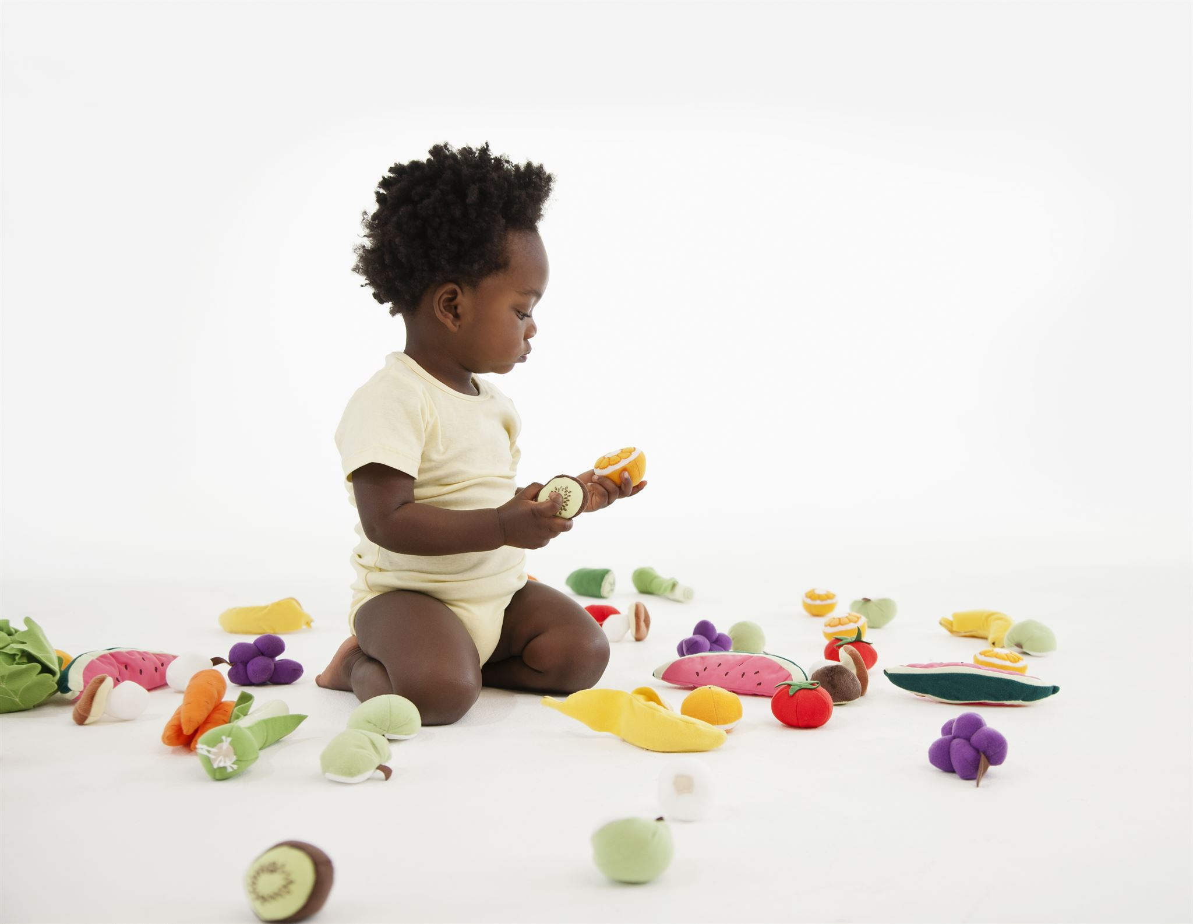
Facilitating Interactive Play and Communication
Cognitive Development
  Interactive play stimulates infants' thinking and problem-solving abilities early in life.
Language Skills Growth
  Verbal communication during play fosters infants’ vocabulary and language understanding.
Social Skill Building
  Play and communication nurture infants’ ability to engage socially and form bonds.
Notes:
---
Engaging in interactive play and verbal communication nurtures infants’ cognitive, language, and social skills during this vital stage.
Image source: Microsoft 365 content library

Slide 18

Supporting Parents in Understanding Developmental Milestones
Empowering Parents
  Educating parents about infant milestones increases their confidence in supporting child development effectively.
Providing Appropriate Stimulation
  Understanding milestones helps parents offer suitable activities that encourage infants' growth and learning.
Seeking Timely Support
  Awareness of milestones enables parents to identify delays early and seek professional help promptly.
Notes:
---
Educating parents about typical infant milestones empowers them to provide appropriate stimulation and seek timely support if needed.
Image source: Microsoft 365 content library

Slide 19
Conclusion
Interconnection of Development
Early learning and social-emotional growth are closely linked in infants aged 8 to 12 months, shaping their overall development.
Responsive Caregiving
Responsive caregiving plays a crucial role in fostering healthy social-emotional and cognitive development in infants.
Enriched Environments
Providing enriched environments supports infants' developmental milestones and lifelong learning foundations.
Informed Parenting
Informed parenting practices are essential for supporting infants' growth and social-emotional well-being.
Notes:
Early learning and social-emotional development are deeply interconnected in infants aged 8 to 12 months. Responsive caregiving, enriched environments, and informed parenting practices are essential to supporting healthy growth and building a strong foundation for lifelong development.

