Slide 1
Principles of Early Learning for 8-12 Months: Insights Into Motor Development and Brain Growth
Supporting infant growth through key developmental milestones
Notes:
---
This presentation explores the foundational aspects of early learning in infants aged 8 to 12 months, focusing on motor development milestones and brain growth. We will examine recent research and practical strategies for parents and caregivers to support this critical stage of development.

Slide 2
Agenda Overview
Key Motor Development Milestones in 8-12 Month-Olds
Breakthroughs in Infant Brain Development Research
Parent-Centered Approaches to Early Learning
Integrating Theory and Practice From Leading Research
Notes:
We will cover key motor development milestones typical for 8 to 12 month-olds, explore breakthroughs in infant brain development research, discuss parent-centered approaches to early learning, and review how leading theories and research inform practice in supporting infant growth and development.

Slide 3
Key Motor Development Milestones in 8-12 Month-Olds
Notes:
This section focuses on the typical progression of gross and fine motor skills in infants between 8 and 12 months, highlighting emerging abilities like crawling, standing, and developing the pincer grasp, as well as variability in milestone achievement according to current research.

Slide 4

Typical Progression of Gross and Fine Motor Skills
Gross Motor Skill Development
  Infants progress from sitting unsupported to crawling and pulling themselves to stand between 8 and 12 months.
Fine Motor Skill Advancement
  Improved hand-eye coordination allows infants to grasp objects more precisely, supporting independent exploration.
Notes:
---
Between 8 and 12 months, infants typically progress from sitting unsupported to crawling and pulling to stand. Fine motor skills advance with increased hand-eye coordination, including grasping objects with greater precision, laying the groundwork for independent exploration.
Image source: Microsoft 365 content library

Slide 5

Emerging Abilities Like Crawling, Standing, and Pincer Grasp
Crawling Development
  Crawling marks infants’ initial mobility phase, enabling exploration and muscle strengthening.
Supported Standing
  Standing with support helps infants build balance and leg strength for independent movement.
Pincer Grasp Refinement
  The pincer grasp allows infants to pick up small objects using thumb and forefinger, enhancing fine motor skills.
Notes:
---
During this period, infants develop key milestones such as crawling, standing with support, and refining the pincer grasp, which allows them to pick up small objects using thumb and forefinger. These abilities mark important steps toward independent mobility and manipulation.
Image source: Microsoft 365 content library

Slide 6

Variability in Milestone Achievement Based on Current Research
Individual Differences
  Milestone achievement varies greatly due to unique individual traits and developmental paces among children.
Environmental Influences
  A child's environment plays a crucial role in shaping the timing and nature of milestone achievements.
Cultural Practices
  Cultural backgrounds and practices impact when and how children reach developmental milestones.
Supporting Personalized Learning
  Understanding variability helps caregivers tailor supportive and individualized learning experiences for children.
Notes:
---
Research shows that while general milestone timelines exist, there is significant variability influenced by individual differences, environment, and cultural practices. Understanding this variability helps caregivers provide supportive, personalized learning experiences.
Image source: Microsoft 365 content library

Slide 7
Breakthroughs in Infant Brain Development Research
Notes:
This section highlights recent scientific advances that deepen our understanding of critical periods for neural growth, synaptic formation, and the impact of sensory experiences and play on cognitive development during infancy.

Slide 8

Critical Periods of Neural Growth and Synaptic Formation
Rapid Brain Growth
  During the first year, the brain experiences rapid growth crucial for later development stages.
Synaptic Formation Windows
  Critical periods allow synapses to form in response to environmental stimulation, shaping brain plasticity.
Foundation for Skills
  These critical periods establish the base for cognitive, motor, and social skill development in children.
Notes:
---
The brain undergoes rapid growth in the first year, with critical periods where synapses form in response to stimulation. These windows are essential for laying the foundation for cognitive, motor, and social skills development.
Image source: Microsoft 365 content library

Slide 9
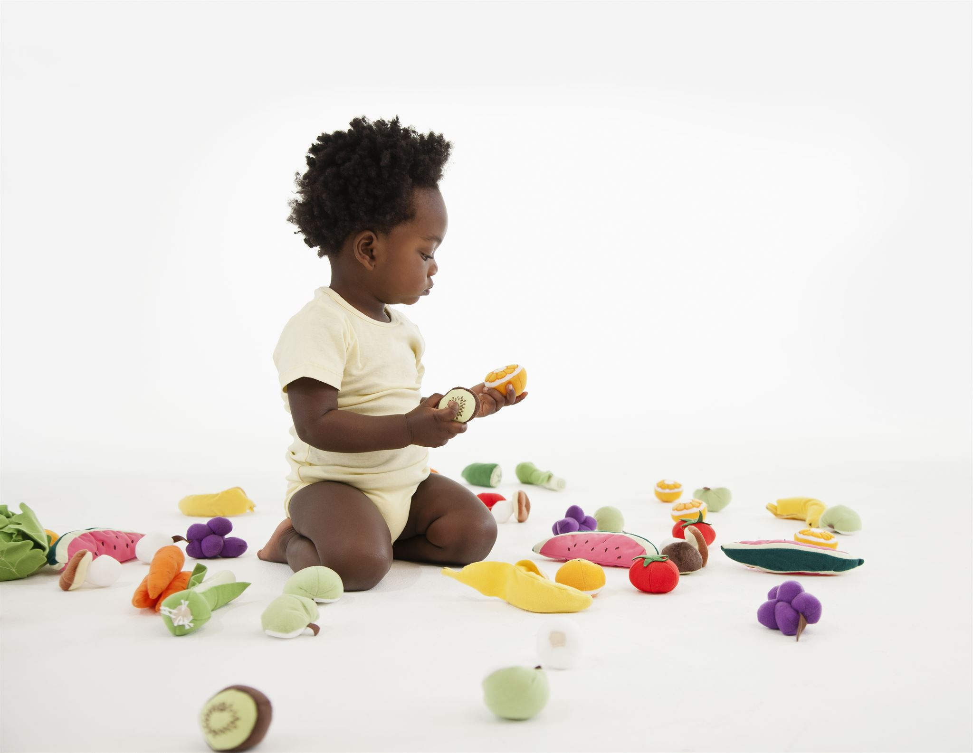
Influence of Sensory Experiences and Active Exploration
Sensory Stimulation Benefits
  Sensory input activates neural pathways, promoting brain plasticity essential for infant development.
Active Exploration Importance
  Active engagement with the environment helps infants reinforce motor and cognitive connections effectively.
Notes:
---
Sensory input and active exploration during this stage stimulate neural pathways, enhancing brain plasticity. Infants learn best through engaging with their environment using all senses, reinforcing motor and cognitive connections.
Image source: Microsoft 365 content library

Slide 10
Recent Findings on the Role of Play in Cognitive Development
Cognitive Growth Support
Play enhances cognitive abilities including problem-solving, memory, and language development in young children.
Interactive Play Benefits
Interactive play encourages infants to explore and practice new skills effectively.
Adaptation Through Exploration
Exploratory play helps children adapt to changing environments by fostering curiosity and flexibility.
Notes:
---
Play is shown to be central to cognitive growth, supporting problem-solving, memory, and language skills. Interactive and exploratory play encourages infants to practice new skills and adapt to changing environments.
Image source: Microsoft 365 content library

Slide 11
Parent-Centered Approaches to Early Learning
Notes:
This section explores strategies for caregivers to foster secure attachments and support infants’ motor and cognitive milestones through responsive and engaging interactions.

Slide 12

Responsive Caregiving and Building Secure Attachments
Attuning to Infant Cues
  Responsive caregiving involves noticing and responding promptly to an infant’s signals and needs.
Building Trust and Security
  Consistent responsiveness helps infants develop trust and a secure emotional bond with caregivers.
Supporting Brain Development
  Secure attachments formed through responsive care promote healthy brain growth and effective learning abilities.
Notes:
---
Responsive caregiving—attuning to an infant’s cues and needs—builds trust and security, which is crucial for healthy brain development and effective learning.
Image source: Microsoft 365 content library

Slide 13
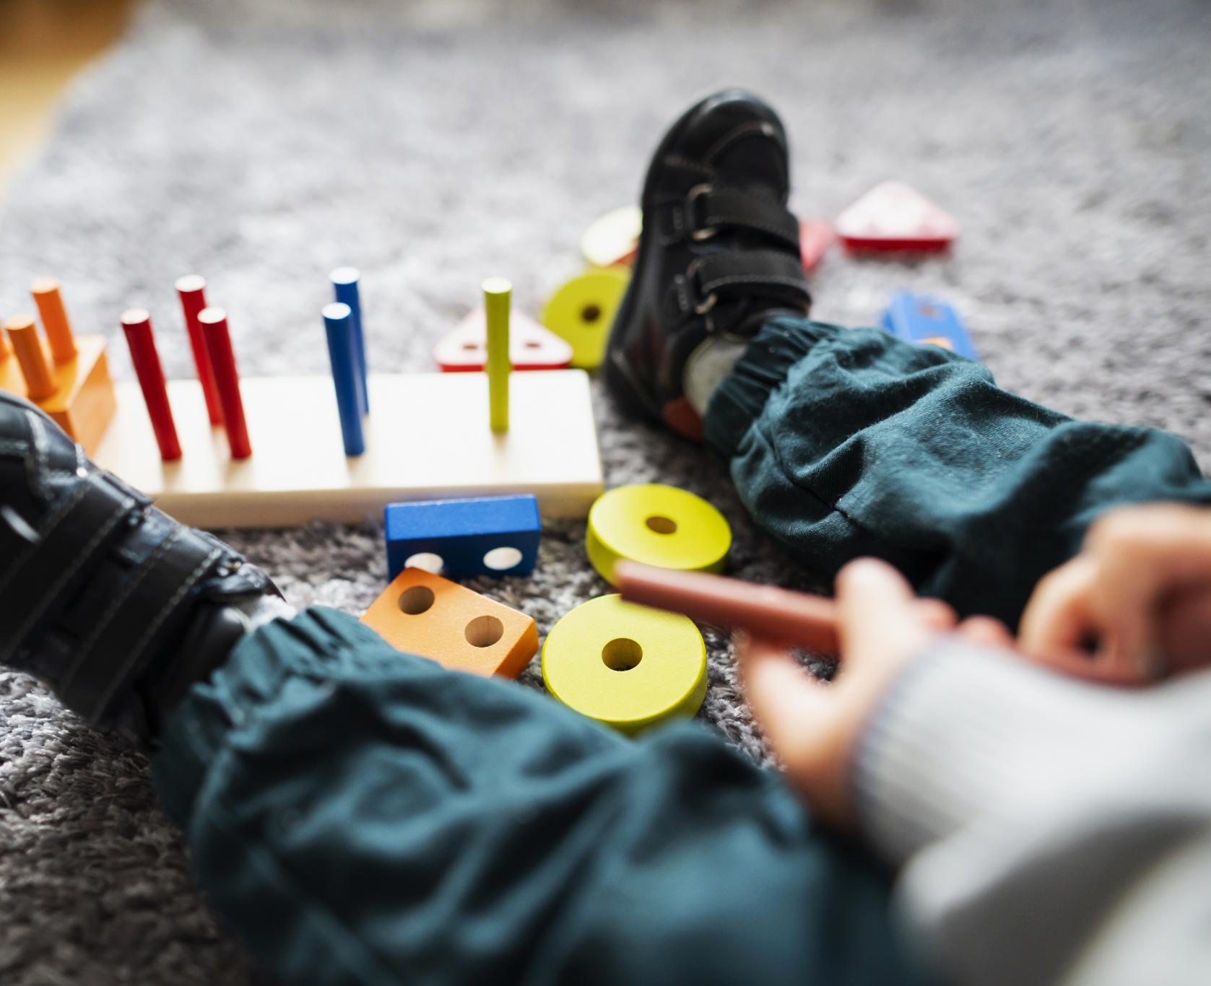
Strategies for Encouraging Motor and Cognitive Milestones
Safe Movement Spaces
  Providing safe spaces enables children to explore and develop motor skills without risk of injury.
Age-Appropriate Toys
  Toys that challenge problem-solving skills support cognitive development effectively.
Motor Skill Activities
  Engaging children in fine and gross motor activities strengthens coordination and control.
Notes:
---
Parents can encourage development by providing safe spaces for movement, offering age-appropriate toys that stimulate problem-solving, and engaging in activities that promote both fine and gross motor skills.
Image source: Microsoft 365 content library

Slide 14

Interactive Effect of Parent-Child Engagement on Development
Importance of Interaction Quality
  High-quality parent-child interactions play a crucial role in shaping positive developmental outcomes in children.
Benefits of Consistent Engagement
  Consistent and positive engagement fosters motivation, confidence, and skill acquisition in infants.
Notes:
---
The quality of parent-child interactions significantly influences developmental outcomes. Consistent, positive engagement fosters motivation, confidence, and skill acquisition in infants.
Image source: Microsoft 365 content library

Slide 15
Integrating Theory and Practice From Leading Research
Notes:
This section reviews theoretical frameworks that inform responsive and effective early learning practices, emphasizing the integration of social interaction, scaffolding, and play into daily routines.

Slide 16

Vygotskian Perspectives on Social Interaction and Scaffolding
Social Interaction in Learning
  Vygotsky emphasizes that social interaction is crucial for cognitive development and learning progression.
Scaffolding Concept
  Caregivers provide scaffolding by supporting children just beyond their current skill level to encourage growth.
Notes:
---
Vygotsky's theory highlights the importance of social interaction in learning, where caregivers provide scaffolding—supporting infants just beyond their current capabilities to promote development.
Image source: Microsoft 365 content library

Slide 17

Relationship-Based Planning and Responsive Environments
Responsive Environments
  Environments that adapt to infants’ needs encourage personalized learning and exploration.
Strengthening Relationships
  Responsive environments foster stronger caregiver-infant bonds, supporting emotional and developmental growth.
Enhanced Development
  Individualized learning facilitated by responsive settings promotes overall developmental progress in infants.
Notes:
---
Creating responsive environments that adapt to an infant’s needs and interests supports individualized learning and strengthens caregiver-infant relationships, enhancing developmental progress.
Image source: Microsoft 365 content library

Slide 18

Application of Play-Based Learning in Daily Routines
Natural Exploration Through Play
  Infants learn naturally when play is integrated into their daily routines, encouraging exploration and discovery.
Fostering Curiosity and Problem-Solving
  Play-based learning nurtures curiosity and develops problem-solving skills in early childhood.
Supporting Social Skill Development
  Playful interactions in a nurturing context help build social and communication skills among infants.
Notes:
---
Incorporating play into everyday activities allows infants to explore and learn naturally. Play-based learning fosters curiosity, problem-solving, and social skills within a nurturing context.
Image source: Microsoft 365 content library

Slide 19
Conclusion
Motor Milestones
Understanding key motor milestones helps track infants' physical development between 8 to 12 months.
Brain Development
Recent breakthroughs in brain development research reveal rapid cognitive growth in late infancy.
Parental Role
Caregivers play a crucial role by applying research-based practices to support infants’ optimal development.
Notes:
Supporting the early learning of 8 to 12 month-olds requires understanding motor milestones, brain development breakthroughs, and parental roles. Integrating research and theory into practice empowers caregivers to foster optimal growth during this pivotal stage.

